Slide 1
Variable Rate Shading with Visibility Buffer Rendering
Notes:
00) Hi. Welcome to the talk. Today we are going to discuss Visibility Buffer rendering and variable rate shading.

Slide 2

John Hable
Founder, Visible Threshold, LLC
Previous:
Electronic Arts
Naughty Dog
Epic
Unity
Contracting/Other Ventures
  Headcams, Face Scanning, AfterFX Plugins, Virtual Cameras for Movies
Notes:
I’ve been around for a while, mostly working on console gaming and engines, but also working on other projects like building photogrammetry rigs and VCams for movie previs. Up until last November I was at Unity working in Natasha’s graphics group. At that point I left Unity to begin my startup adventure: Visible Threshold.

Slide 3
VISIBLE THRESHOLD
USD
Web
for the
Maturing Ecosystem
  MaterialX
  MDL
  OpenPBR 1.0 (!)
WebGPU
  Quickly gaining adoption
  Modern rendering essentials
WebGL
  Acceptable fallback
Notes:
To give you a little context, Visible Threshold is about USD for the Web. The USD ecosystem is maturing quite rapidly, especially with OpenPBR hitting the 1.0 release. At the same time WebGPU is officially released and getting adoption in the major browsers. So the goal with Visible Threshold is to figure out the workflow issue of turning a USD scene into a standalone web experience.

Slide 4
VISIBILITY AND VRS
What is this and why do this?
Notes:
01) Why do this?

Slide 5
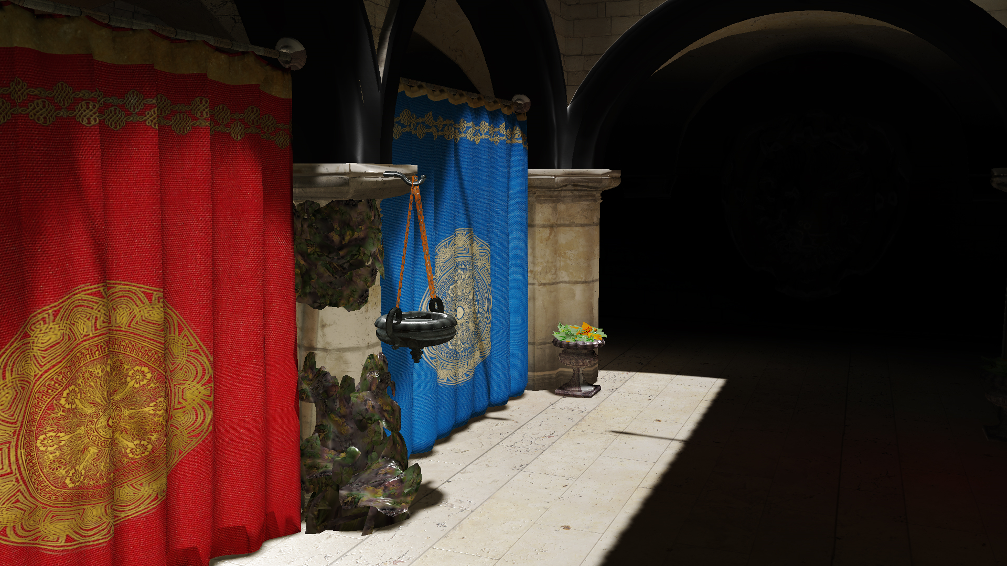
VISIBILITY AND VRS
Key Idea
We don’t “see” pixels
We “see” gradients
The eye is literally a neural network.
Notes:
The key is idea is that our eyes don’t see pixels. Rather, we see gradients. The eye is neural network that assembles these gradients into a hallucinated image.

Slide 6

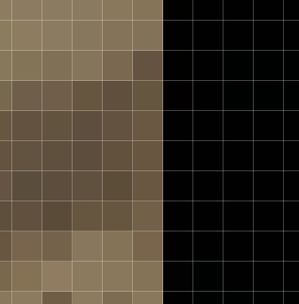
VISIBILITY AND VRS
Enhance…
Geometry Border
Notes:
Let’s enhance this image, and focus on one of the geometry borders.

Slide 7
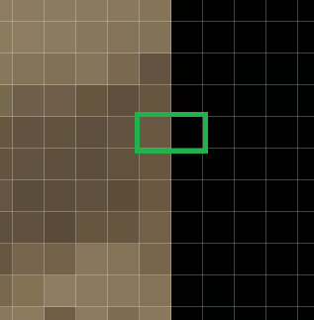
VISIBILITY AND VRS
Enhance…
Geometry Border
  Green Box
  Very important to preserve this border
Notes:
In the two pixels selected in green, one is lit directly from the sun and the pixel behind it only receives light from indirect bounces. As a result, there is a sharp luminance edge in the resulting image.

Slide 8
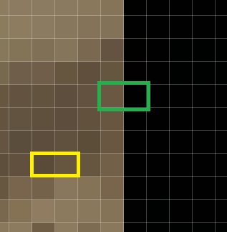
VISIBILITY AND VRS
Enhance…
Geometry Border
  Green Box
  Very important to preserve this border
Texture Detail
  Yellow Box
    Less important but still matters
Notes:
In yellow, two pixels are selected. This gradient is important, but it’s much less important than the pixels selected in green.

Slide 9
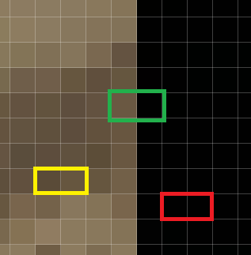
VISIBILITY AND VRS
Enhance…
Geometry Border
  Green Box
  Very important to preserve this border
Texture Detail
  Yellow Box
    Less important but still matters
  Red Box
    Imperceptible
Notes:
Finally, here are two pixels selected in red. The difference between the pixels in imperceptible, so this gradient matters even less.

Slide 10
VISIBILITY AND VRS
Key Idea
Strongest edges at borders
  Top priority
Detail matters as well
  Secondary priority
Notes:
With Variable Rate Shading we can maintain these strong edges in the scene. Then we can reduce the sample rate within geometry edges and it should give us a perceptually similar image in less rendering time.

Slide 11


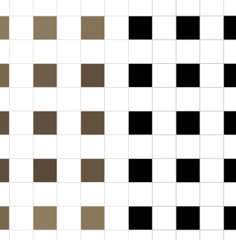
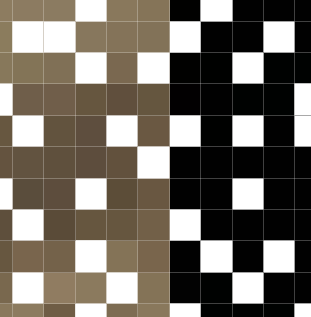
VISIBILITY AND VRS
Variable Rate
Visibility Buffer to decouple geometry rate from shading rate
  1x
  2x
  4x
  Stochastic
Reconstruction
  Always have “good” edges
    Upsampling sacrifices edges
  Tradeoff is detail vs performance
Notes:
The goal of this talk is to use a Visibility Buffer to completely separate the geometry rate and the shading rate so that we can use whatever sample pattern we like. Then with an edge-aware reconstruction, we can trade sampling rate for performance, while always preserving the dominant edges in the scene.

Slide 12
VISIBILITY AND VRS
Visibility Buffer
Burns and Hunt, The Visibility Buffer: A Cache-Friendly Approach to Deferred Shading, JCGT 2013
https://jcgt.org/published/0002/02/04/paper.pdf
Schied and Dachsbacher, Deferred Attribute Interpolation for Memory-Efficient Deferred Shading, HPG 2015
https://cg.ivd.kit.edu/publications/2015/dais/DAIS.pdf
Engel, Triangle Visibility Buffer, 2018
https://diaryofagraphicsprogrammer.blogspot.com/2018/03/triangle-visibility-buffer.html
Karis, Stubbe, Wihlidal, Nanite, A Deep Dive, SIGGRAPH 2021: Advances in Real Time Rendering in Games
https://advances.realtimerendering.com/s2021/Karis_Nanite_SIGGRAPH_Advances_2021_final.pdf
Hable, Visiblity Buffer Rendering with Material Graphs, 2021
http://filmicworlds.com/blog/visibility-buffer-rendering-with-material-graphs/
Drobot, Geometry Rendering Pipeline Architecture, REAC 2021
https://research.activision.com/publications/2021/09/geometry-rendering-pipeline-architecture
McLaren, Adventures with Deferred Texturing in Horizon Forbidden West, 2022
https://www.guerrilla-games.com/read/adventures-with-deferred-texturing-in-horizon-forbidden-west
too_much_voltage, Faster Visibility Buffer/Deferred Material Rendering via Analytical Attribute Interpolation using Ray Differentials, 2022
https://www.reddit.com/r/GraphicsProgramming/comments/uf4ykj/faster_visibility_bufferdeferred_material/
Erler and Engel, Triangle Visibility Buffer 2.0, I3D 2024
https://www.youtube.com/watch?v=kWLev9CoQdg
JMS55, Virtual Geometry in Bevy 0.14, 2024
https://jms55.github.io/posts/2024-06-09-virtual-geometry-bevy-0-14/
Li and Cao, SmartGI Evolution: Adaptive NanoMesh on Mobile, GDC 2024
https://www.youtube.com/watch?v=yD5DjNyiYIQ
Notes:
Before we get started, I should also mention that there is plenty of active work in rendering with a Visibility Buffer.

Slide 13
VISIBILITY AND VRS
Variable Rate Shading
Drobot, Hybrid Reconstruction Anti-Aliasing, SIGGRAPH 2014: Advances in Real-Time Rendering in Games
https://advances.realtimerendering.com/s2014/index.html#_HYBRID_RECONSTRUCTION_ANTI-ALIASING
Mallet and Yuksel, Deferred Adaptive Compute Shading, HPG 2018
https://geometrian.com/data/research/dacs/HPG2018_DeferredAdaptiveComputeShading.pdf
Intel, Get Started with Variable Rate Shading on Intel® Processor Graphics, 2019
https://www.intel.com/content/www/us/en/developer/articles/guide/getting-started-with-variable-rate-shading-on-intel-processor-graphics.html
Van Rhyn, Variable Rate Shading: a scalpel in a world of sledgehammers, 2019
https://devblogs.microsoft.com/directx/variable-rate-shading-a-scalpel-in-a-world-of-sledgehammers/
du Bois and Gibson, Variable Rate Shading Tier 1 with Microsoft DirectX 12 From Theory to Practice. GDC 2020
https://www.youtube.com/watch?v=d-qEvmVcg8I
Drobot, Software-based Variable Rate Shading in Call of Duty: Modern Warfare, SIGGRAPH 2020: Advances in Real Time Rendering in Games
https://research.activision.com/content/atvi/activision/research/web/en/publications/2020-09/software-based-variable-rate-shading-in-call-of-duty--modern-war
Mallet, Yuksel, and Seiler, Efficient Adaptive Deferred Shading with Hardware Scatter Tiles, ACM Computer Graphics and Interactive Techniques, 2020
https://dl.acm.org/doi/abs/10.1145/3406184
Van Rhyn, Moving Gears to Tier 2 Variable Rate Shading, 2021
https://devblogs.microsoft.com/directx/gears-vrs-tier2/
Hable, Software VRS with Visibility Buffer Rendering, 2021
http://filmicworlds.com/blog/software-vrs-with-visibility-buffer-rendering/
Fuller, Variable Rate Compute Shaders - Halving Deferred Lighting Time, 2022
https://www.youtube.com/watch?v=Sswuj7BFjGo
Whilidal, Nanite GPU-Driven Materials, GDC 2024
https://schedule.gdconf.com/session/nanite-gpu-driven-materials/899486
Notes:
As well as various approaches for Variable Rate Shading.

Slide 14
QUAD UTILIZATION
Notes:
08) Before we really get into Visibility Buffer rendering and VRS, we first need to have solid understanding of quad utilization.

Slide 15
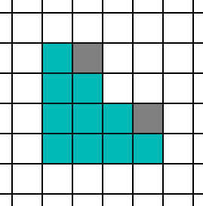
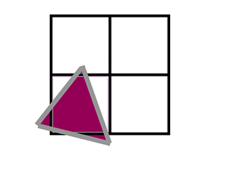
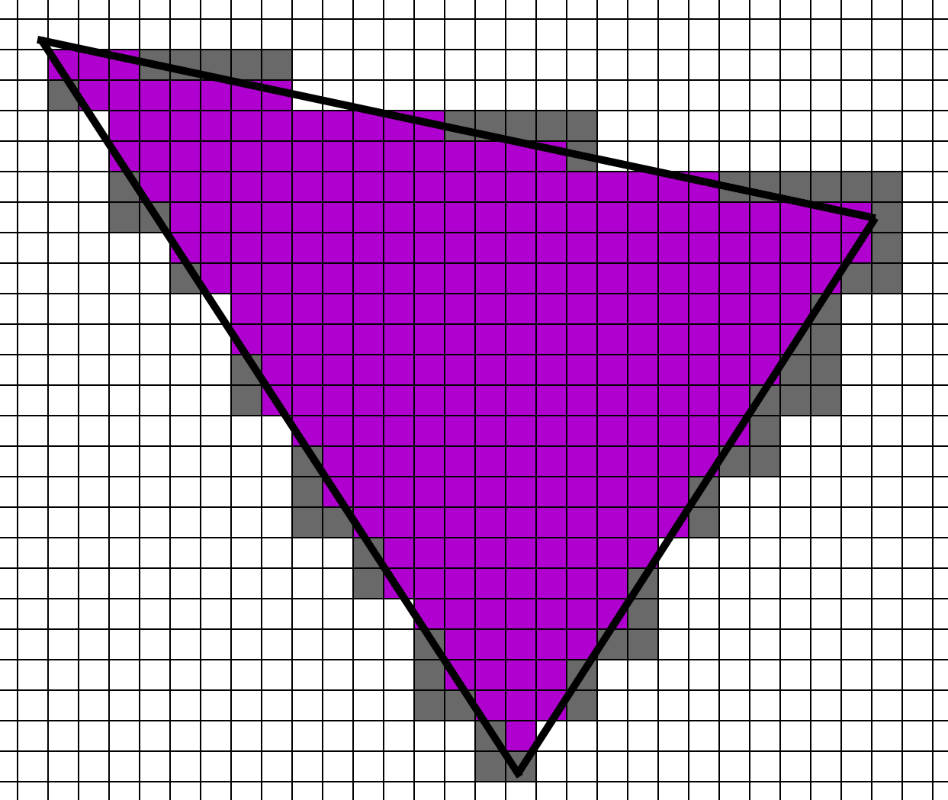
QUAD UTILIZATION
Triangle Rasterization
How does it actually work on GPU?
Quad utilization!
Notes:
GPUs are not magical. And the pixel shader interface that we use to program them hides some of the subtle details and performance implications.

Slide 16
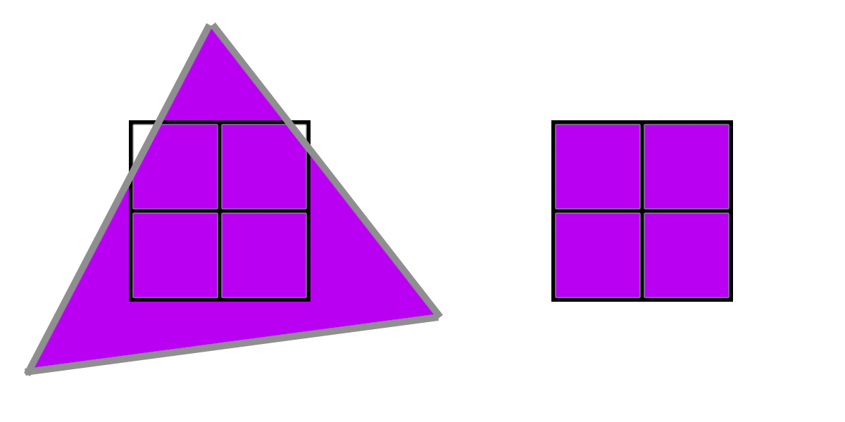
QUAD UTILIZATION
Quad Utilization
Pixel shader groups into quads
  Always groups of 4
Main PS takes one as input
  But 4 run together silently
Functionality exposed in SM 6.0
  QuadReadAcrossX, etc.
Notes:
The most important thing to remember is that pixel shaders are always invoked in groups of 4, called a quad. While your MainPS function only process one, under the hood it’s ALWAYS running 4 pixels at a time.

Slide 17
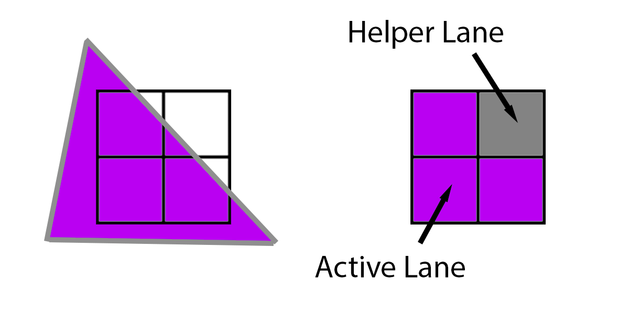
QUAD UTILIZATION
Quad Utilization
What if a quad is not full
  Filled with helper lanes
Pixel shader on helper lanes
  Result is discarded
Notes:
If you render a triangle, and it does not cover the full 2x2 quad, the empty pixel still has to run. Pixels that are being rendered to appear on the screen are called “Active Lanes”, and the soon-to-be discarded pixel shader invocations are called “Helper Lanes”.

Slide 18
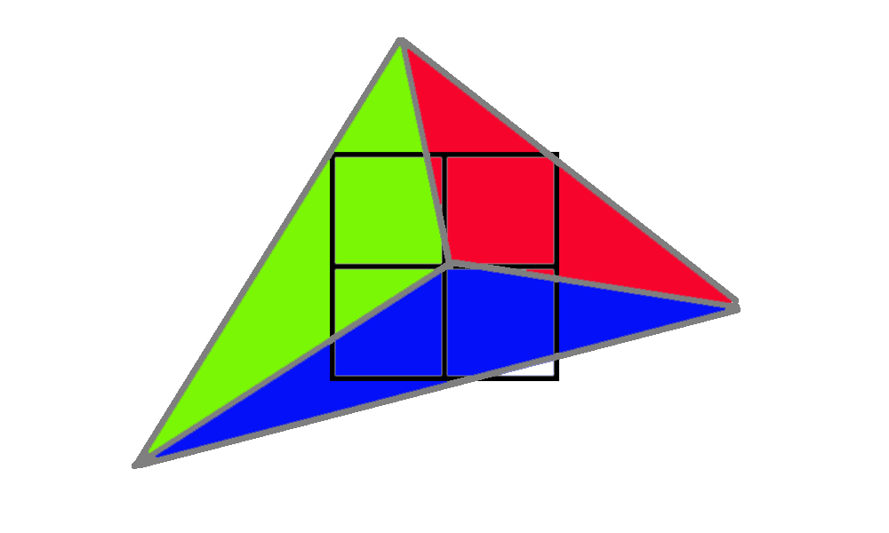
QUAD UTILIZATION
Quad utilization
What if multiple triangles cover the same quad?
Notes:
So let’s look at an example, where three different triangles cover this single 2x2 quad.

Slide 19
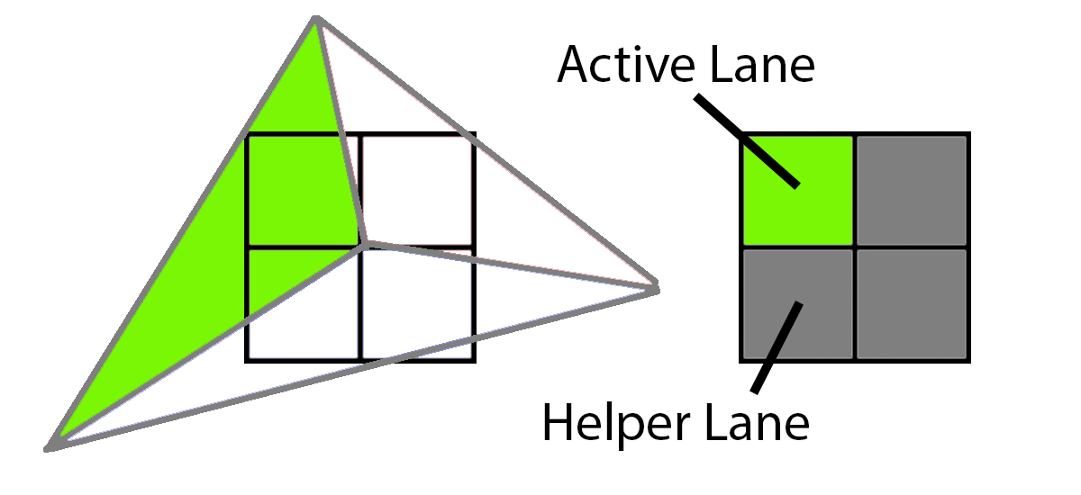
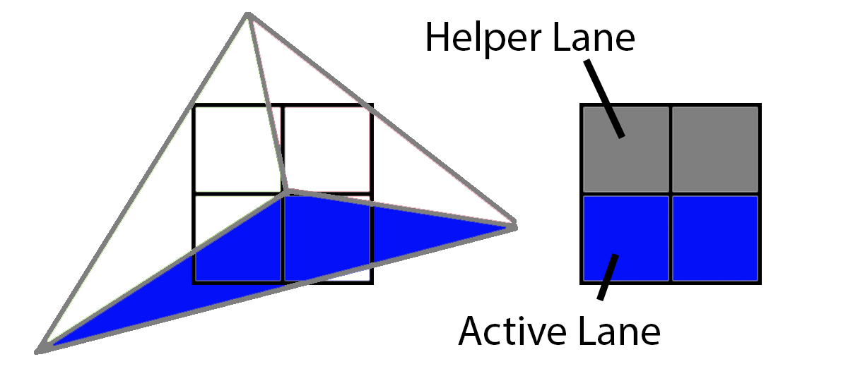
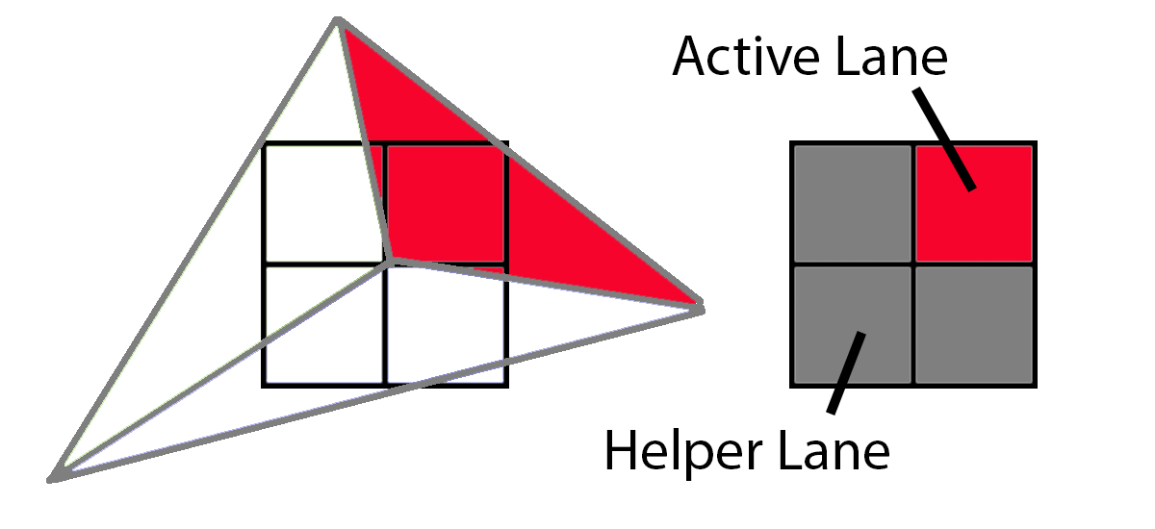
QUAD UTILIZATION
Quad Utilization
What if multiple triangles cover the same quad?
  Each triangle gets its own quad
Notes:
The green triangle gets a quad with one active lane and three helper lanes.
The blue triangle gets a quad with two active lanes and two helper lanes.
And the red triangle gets a quad with one active lane and three helper lanes.

Slide 20
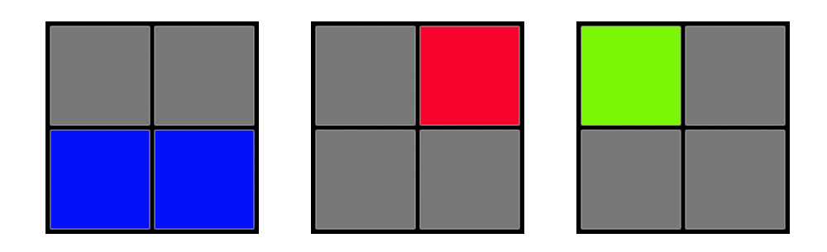
QUAD UTILIZATION
Quad utilization
If we render extra quads, isn’t this inefficient?
  Yes!
Similar to overdraw
  3x in this case
Notes:
Now you might be thinking: “Isn’t this inefficient.” Well, the answer is “yes”. In my mental model of GPUs, I think of quads as overdraw, as the GPU has to run the Pixel Shader multiple times despite only one pixel being visible.

Slide 21
QUAD UTILIZATION
Big Triangles
Low cost for extra helper lanes
Notes:
Now if we have big triangles, the extra helper lanes aren’t a major concern. With so many active lanes and so few helper lanes, the cost of the helper lanes is marginal.

Slide 22
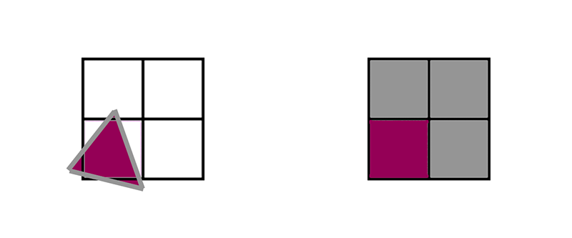
QUAD UTILIZATION
1 pixel triangles
4x cost due to helper lanes
Notes:
However, with tiny triangles, we have a major problem. A single triangle that only covers one pixel still needs a full 2x2 quad.

Slide 23
QUAD UTILIZATION
Medium Triangles (~10 pixels)
Typical game size
Ideal scenario: 1.2x cost
  10 active
  2 helper
  83% utilization
    1.2x cost
Notes:
Of course, most game triangles are in the middle. Here is an example of a 10 pixel triangle, and it has a small overhead from helper lanes.

Slide 24
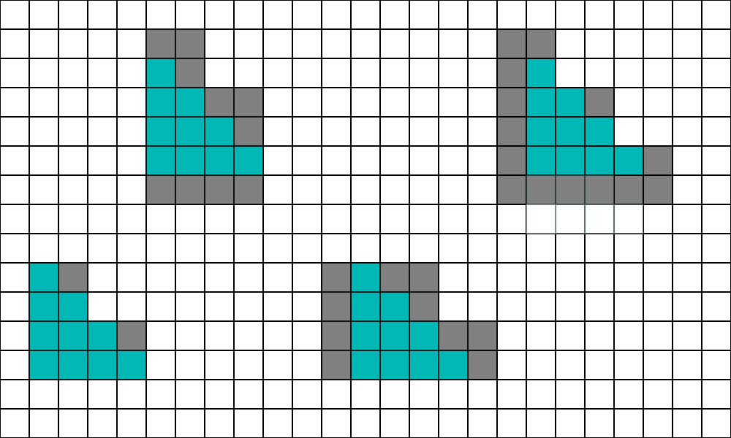
QUAD UTILIZATION
Medium Triangles (~10 pixels)
4x4 shapes
Cost depends on grid alignment
Average stats: 1.9x cost
  10 active
  9 helper
  53% utilization
Notes:
But the number of helper lanes varies depending on how the triangle aligns to the screen grid. And on average, that triangle will have a 1.9x cost.

Slide 25
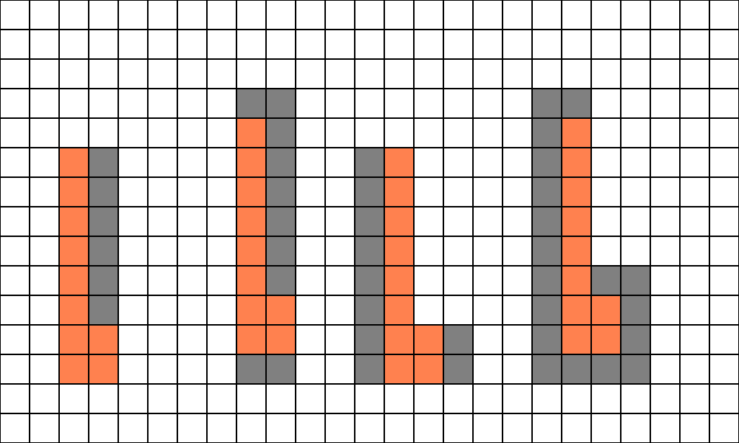
QUAD UTILIZATION
Medium Triangles (~10 pixels)
8x2 L-shape
Cost depends on grid alignment
Average stats: 2.1x cost
  10 active
  11 helper
  48% utilization
Notes:
It typically gets a little worse if the triangles are longer and thin. In this case, an L-shaped 8x2 triangle has on average 2.1x quad overdraw.

Slide 26
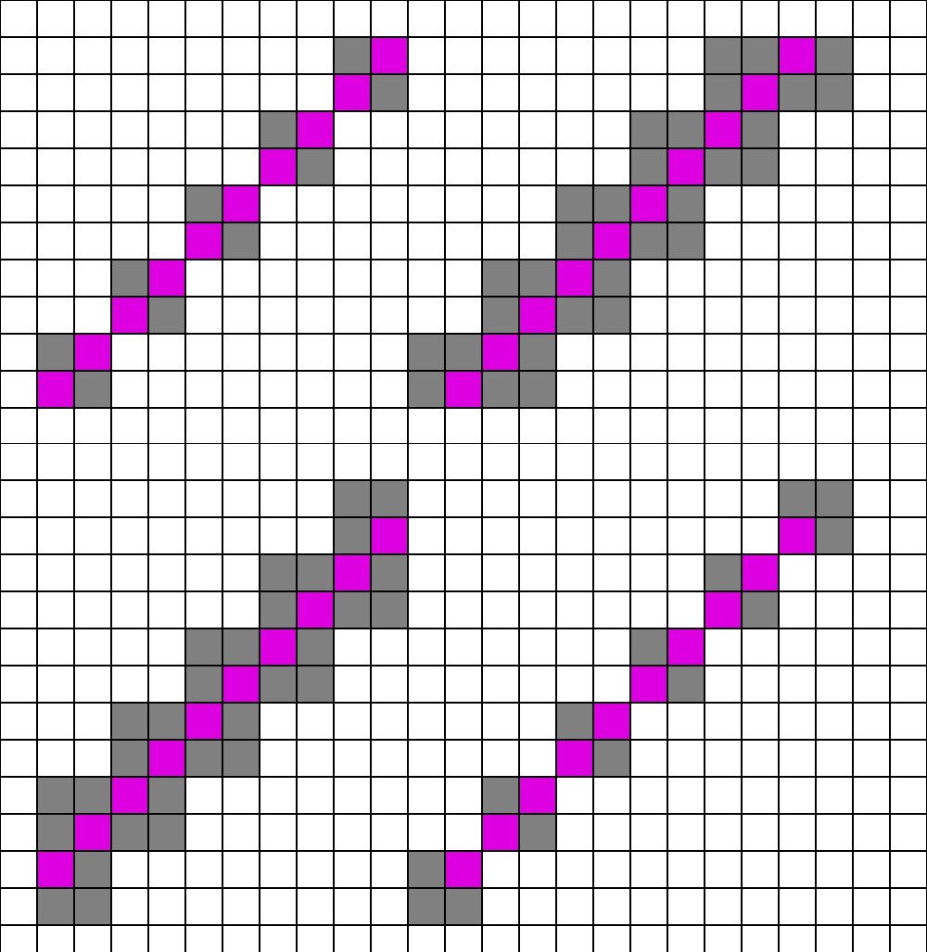
QUAD UTILIZATION
Medium Triangles (~10 pixels)
Worst case, thin and diagonal
Pretty unlikely
Average stats: 3.1x cost
  10 active
  21 helper
  32% utilization
Notes:
And just for reference here is the worst possible case, although it’s pretty unlikely. It has a 3.2x overdraw cost.

Slide 27
QUAD UTILIZATION
Triangle Size/Quad Overdraw
Large Triangles:
  1x cost
Medium Triangle: (~10 pixels)
  2x cost
Tiny Triangles: (1 pixel)
  4x cost
Notes:
If you want you can and measure every single triangle pattern, but I think about it in a simplified way. If you have large triangles, quad overdraw doesn’t matter. If you have tiny one pixel triangles, you pay a 4x cost. And for typical game triangles which are around 10 pixels, you pay a 2x cost.
And really, this is the most important thing that I want you to remember from this talk. When I talk about quad overdraw, most people think about it as something that only matters if you are targeting ultra-dense meshes. But 2x overdraw is still A LOT. If your triangles are 10 pixels in size, then you are paying a significant cost in quad overdraw, today, right now, on the game you are currently shipping.

Slide 28
QUAD UTILIZATION
Hardware Variable Rate Shading
  Is it affected by quad overdraw?
Notes:
Now, one option to mitigate pixel shader cost is Hardware VRS, so let’s look into how Hardware VRS affects quad overdraw.

Slide 29
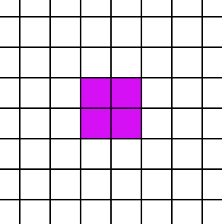
QUAD UTILIZATION
Regular Rasterization
PS invocations split into 2x2 quads
  If a triangle touches any pixel, a 2x2 quad is generated
Notes:
As mentioned before, the screen is divided into 2x2 quads. If a triangle touches any of those 4 pixels, a 2x2 quad needs to be invoked.

Slide 30
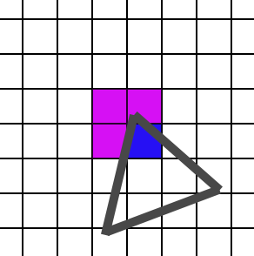
QUAD UTILIZATION
Regular Rasterization
PS invocations split into 2x2 quads
  If a triangle touches any pixel, a 2x2 quad is generated
Notes:
As mentioned before, the screen is divided into 2x2 quads. If a triangle touches any of those 4 pixels, a 2x2 quad needs to be invoked.

Slide 31
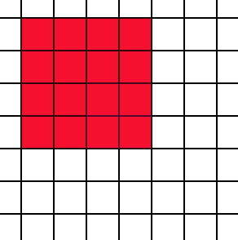
QUAD UTILIZATION
Regular Rasterization
With VRS, each 2x2 quad has 2x2 blocks of pixels
  I.e. 4x4
Notes:
With VRS, the same concept applies, except with bigger quads. In the cases of 2x2 VRS, if a triangle touches any one of these 16 pixels, a 2x2 quad needs to be invoked.

Slide 32
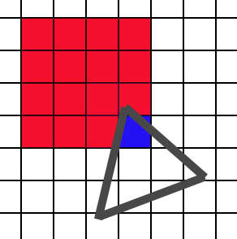
QUAD UTILIZATION
Regular Rasterization
With VRS, each 2x2 quad has 2x2 blocks of pixels
  I.e. 4x4
  If a triangle touches any pixel, a 2x2 quad is generated
Notes:
With VRS, the same concept applies, except with bigger quads. In the cases of 2x2 VRS, if a triangle touches any one of these 16 pixels, a 2x2 quad needs to be invoked.

Slide 33
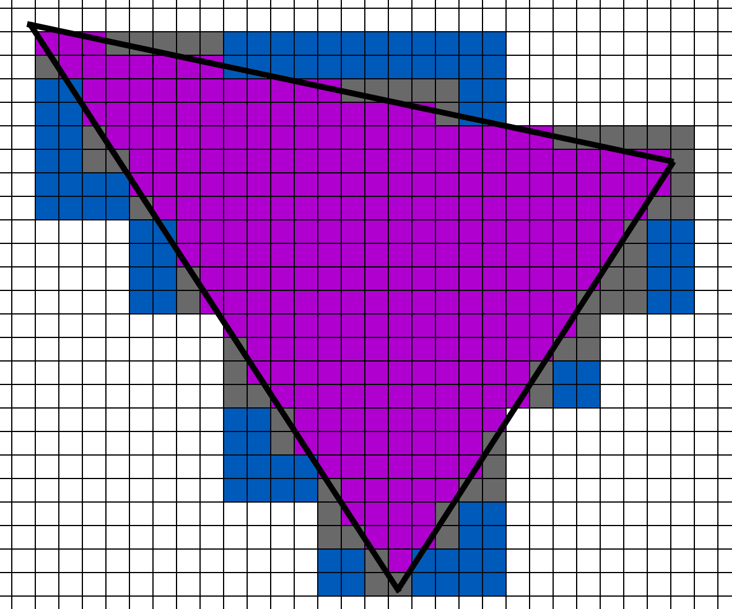
QUAD UTILIZATION
Hardware VRS
Large triangles work well with VRS
Extra lanes are still marginal
0.25x PS invocations per pixel
  We want 0.25x, we get around 0.25x
Notes:
Once again, for large triangles, the cost of the helper lanes is marginal. Although even in this case, the helper lanes are starting to add up.

Slide 34
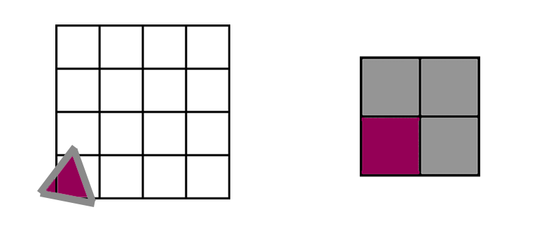
QUAD UTILIZATION
Tiny Triangles (1 pixel)
Each triangle spawns at least one quad.
4x PS invocations per pixel
  Want 0.25x, we get 4x.
  No difference from non-VRS case.
Notes:
For a one pixel triangle, each triangle spawns a quad. It doesn’t matter if VRS is enabled or not, because any touched pixel must spawn a full 2x2 quad.

Slide 35
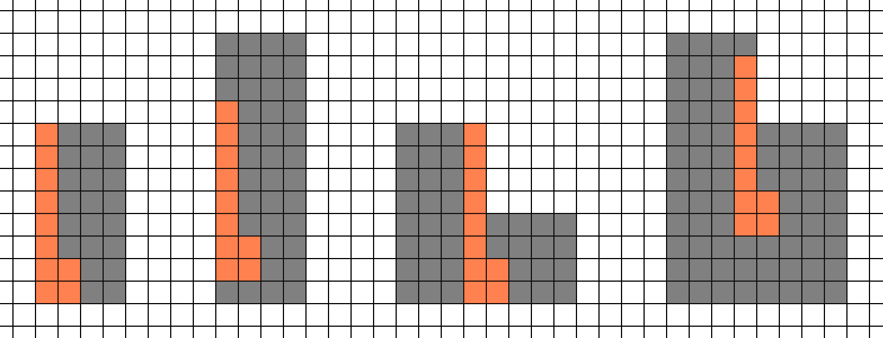
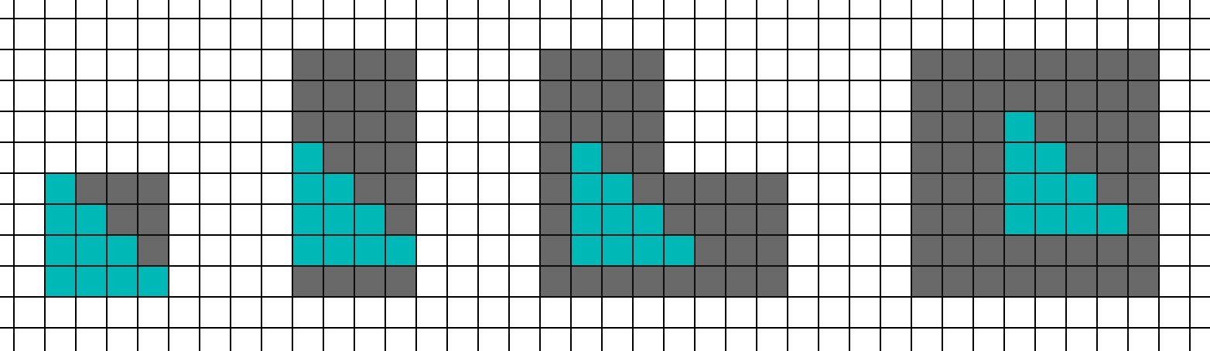
QUAD UTILIZATION
Medium Triangles
10 pixels per triangle
About 1 PS invocation per pixel.
  We want 0.25x, we get 1x
Notes:
And finally, for the 10 pixel triangle case we end up with about 1 PS invocation per pixel.

Slide 36
QUAD UTILIZATION
Hardware VRS quad utilization
4x benefit on large triangles.
2x benefit on medium triangles.
No change on tiny triangles.
 | Regular | 2x2 VRS
Large Tris | 1x | .25x
~10 Pixel Tris | 2x | 1x
1 Pixel Tris | 4x | 4x
Notes:
Getting back to rough numbers, large triangles work great for Hardware VRS. But tiny triangles still pay the 4x penalty. And 10 pixel triangles end up around 1x, which is better than without VRS, but not as good as we would like.

Slide 37
QUAD UTILIZATION
What if?
Perform VRS in Software?
Get 0.25x benefit everywhere?
Even on tiny triangles?
 | Regular | 2x2 VRS | Software VRS
Large Tris | 1x | .25x | .25x
~10 Pixel Tris | 2x | 1x | .25x
1 Pixel Tris | 4x | 4x | .25x
Notes:
What we would ideally like is something like this, and that’s the entire point of this presentation. What if we could get .25x rate everywhere, regardless of triangle size. And it turns out we can, but we will have to pay some overhead.

Slide 38
VBUFFER DETAILS

Slide 39
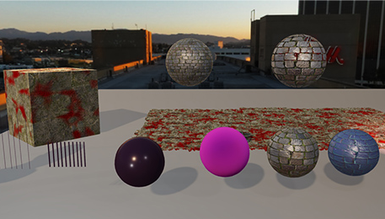
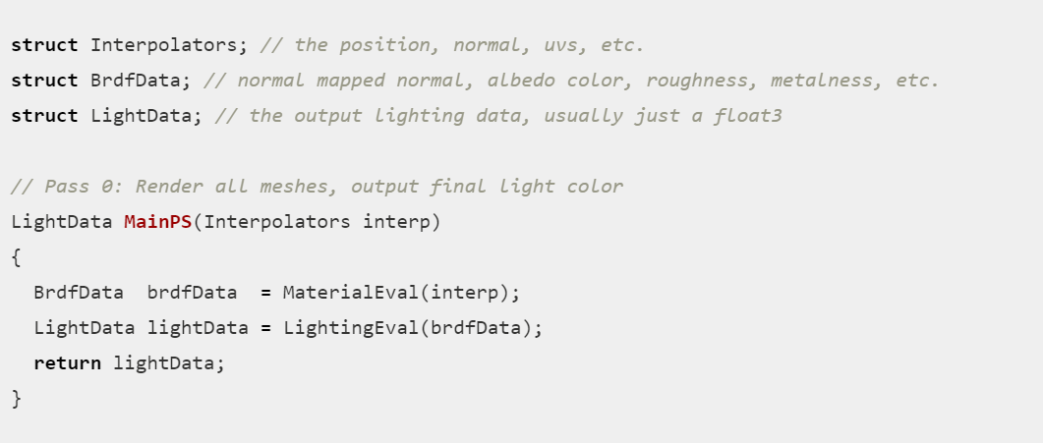
VBUFFER DETAILS
Forward Shading
Material Evaluation and Lighting in one pass
Notes:
In order to talk about Visibility Buffer rendering, first let’s take a step back and look at Forward Rendering. In Forward rendering our pixel shader takes in interpolators from the vertices. Then we have some material evaluation function that takes the interpolators and calculates the BRDF data. We also have a lighting evaluation function which takes the material data and calculates the resulting light.

Slide 40
VBUFFER DETAILS
Forward Shading
Material Evaluation and Lighting in one pass
Notes:
In order to talk about Visibility Buffer rendering, first let’s take a step back and look at Forward Rendering. In Forward rendering our pixel shader takes in interpolators from the vertices. Then we have some material evaluation function that takes the interpolators and calculates the BRDF data. We also have a lighting evaluation function which takes the material data and calculates the resulting light.

Slide 41
VBUFFER DETAILS
Forward Shading
Material Evaluation and Lighting in one pass
Notes:
In order to talk about Visibility Buffer rendering, first let’s take a step back and look at Forward Rendering. In Forward rendering our pixel shader takes in interpolators from the vertices. Then we have some material evaluation function that takes the interpolators and calculates the BRDF data. We also have a lighting evaluation function which takes the material data and calculates the resulting light.

Slide 42
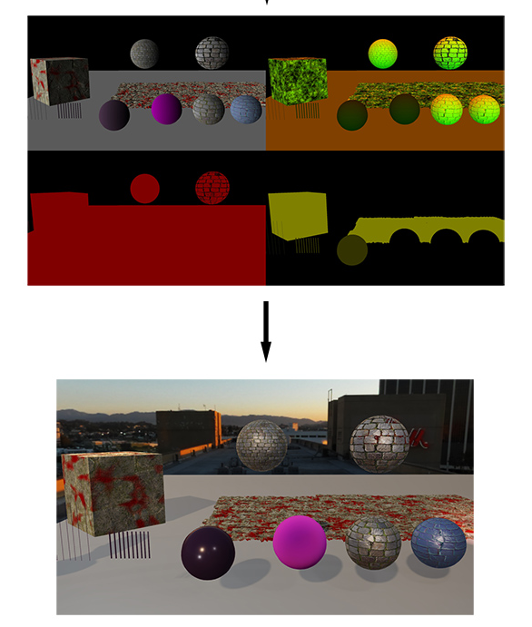
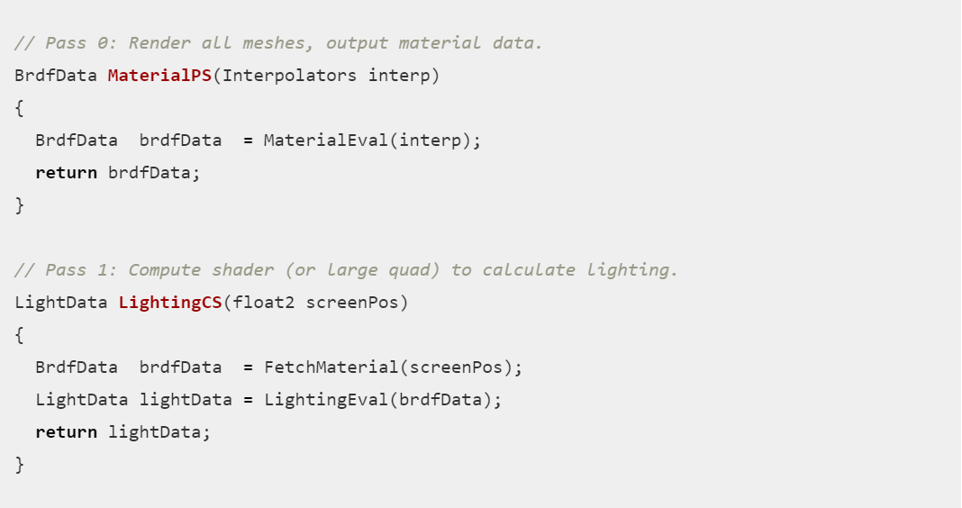
VBUFFER DETAILS
Deferred Rendering
First pass for GBuffer Write
Second pass for Lighting
Notes:
Deferred rendering splits this into two passes. We have a first pixel shader which writes the material data to a buffer. But then a second pass (either pixel shader or a compute shader) which fetches that material data, evaluates the lighting, and writes the result.

Slide 43
VBUFFER DETAILS
Deferred Rendering
First pass for GBuffer Write
Second pass for Lighting
Notes:
Deferred rendering splits this into two passes. We have a first pixel shader which writes the material data to a buffer. But then a second pass (either pixel shader or a compute shader) which fetches that material data, evaluates the lighting, and writes the result.

Slide 44
VBUFFER DETAILS
Deferred Rendering
First pass for GBuffer Write
Second pass for Lighting
Notes:
Deferred rendering splits this into two passes. We have a first pixel shader which writes the material data to a buffer. But then a second pass (either pixel shader or a compute shader) which fetches that material data, evaluates the lighting, and writes the result.

Slide 45
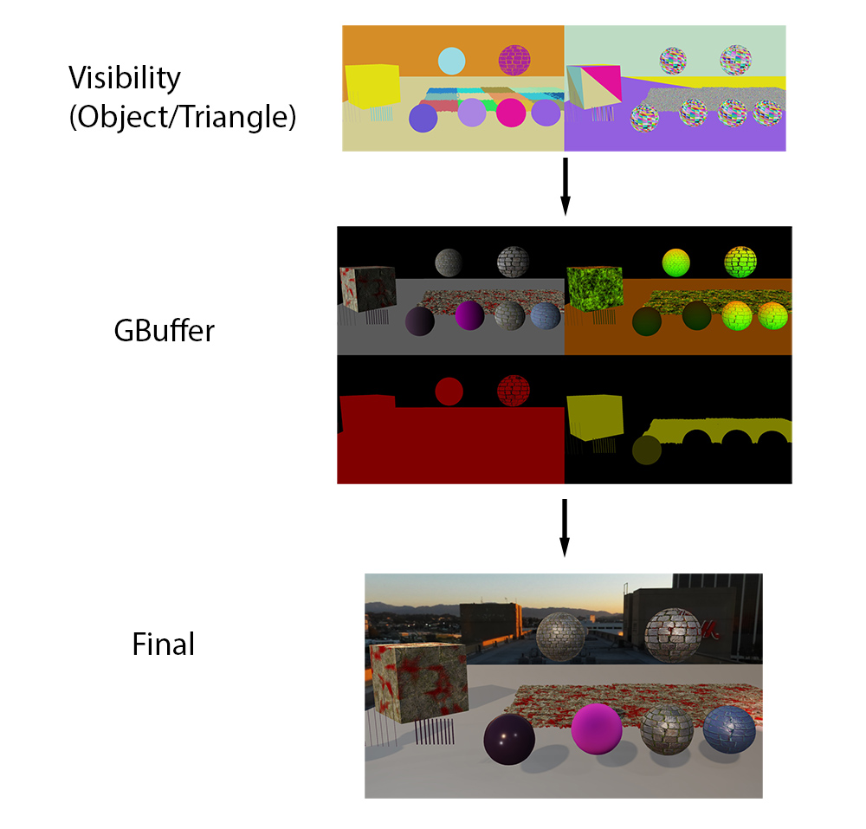
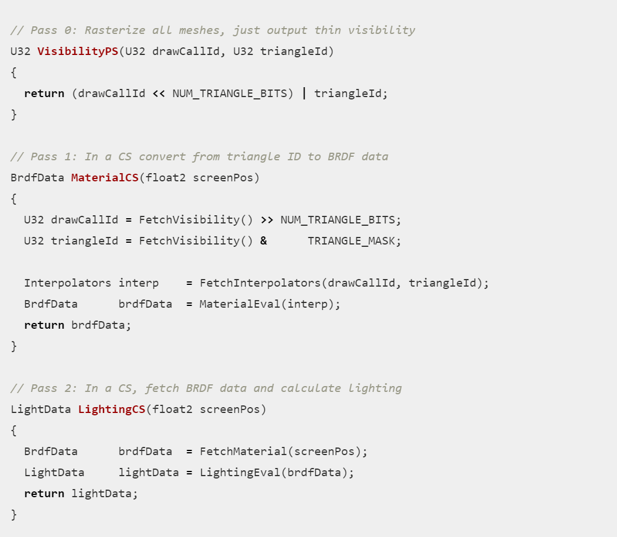
VBUFFER DETAILS
Visibility Buffer Rendering
First pass: Triangle IDs
Second Pass: GBuffer Write
Third Pass: Evaluate Lighting
Notes:
Visibility Buffer rendering splits it one more time. The first pass writes out the triangle ID. That’s it. Then the material pass needs to fetch the triangle ID, fetch the interpolators, evaluate the material and write the GBuffer. Then the lighting pass is the same as before.

Slide 46
VBUFFER DETAILS
Visibility Buffer Rendering
First pass: Triangle IDs
Second Pass: GBuffer Write
Third Pass: Evaluate Lighting
Notes:
Visibility Buffer rendering splits it one more time. The first pass writes out the triangle ID. That’s it. Then the material pass needs to fetch the triangle ID, fetch the interpolators, evaluate the material and write the GBuffer. Then the lighting pass is the same as before.

Slide 47
VBUFFER DETAILS
Visibility Buffer Rendering
First pass: Triangle IDs
Second Pass: GBuffer Write
Third Pass: Evaluate Lighting
Notes:
Visibility Buffer rendering splits it one more time. The first pass writes out the triangle ID. That’s it. Then the material pass needs to fetch the triangle ID, fetch the interpolators, evaluate the material and write the GBuffer. Then the lighting pass is the same as before.

Slide 48
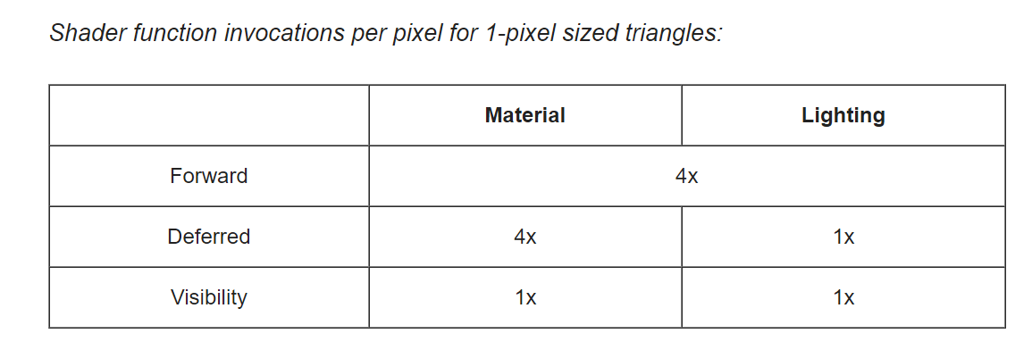
VBUFFER DETAILS
Cost for 1 Pixel Triangles
Forward:
  Entire pass is 4x cost
Deferred:
  GBuffer write is 4x cost
  Lighting is 1x cost
VBuffer:
  Everything is 1x cost
  Easy to apply Software VRS
  Downside: Extra overhead
Notes:
Now, what is the cost for all three approaches if we have tiny, one-pixel triangles? In the case of forward, we have a single pass, and our combined material and lighting pixel shader runs with 4x overdraw. In deferred, the material pass needs to run with 4x overdraw, but the lighting would run at 1x. And with VBuffer, both the material and lighting execute only once per pixel. But the downside is we have extra complexity.

Slide 49
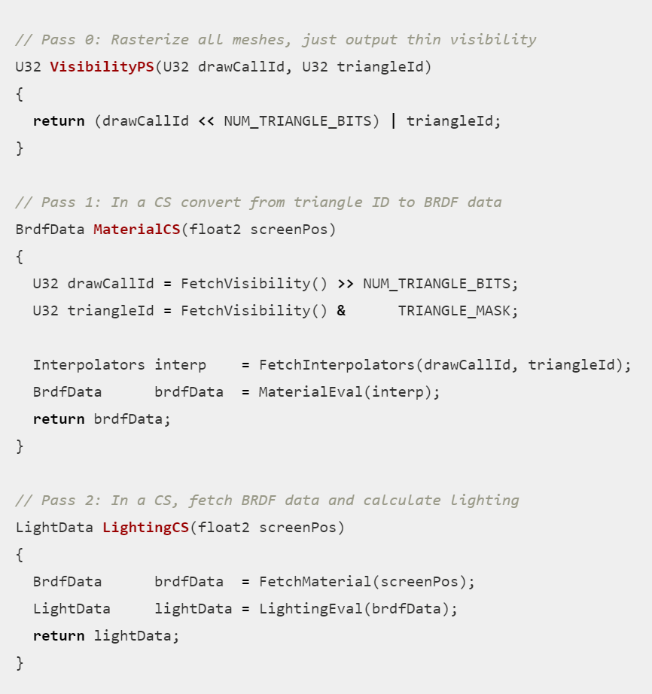
VBUFFER DETAILS
VBuffer Rendering
Theoretically simple
  Just GBuffer with an additional pass.
Vastly more complicated in practice.
Notes:
Looking at our outline for VBuffer rendering, we have a few tricky details.

Slide 50
VBUFFER DETAILS
VBuffer Rendering
Primitive ID
  Easy if we don’t care how slow it is.
  Tricky to get without performance penalty.
Notes:
First, how exactly do we get that triangle ID in the pass that writes the VBuffer?

Slide 51
VBUFFER DETAILS
VBuffer Rendering
Primitive ID
Fetch Interpolators
  Requires Mesh Pool
  And a few details for performance
Notes:
Second, how do we fetch the interpolators? The hardware can no longer just fetch it for us.

Slide 52
VBUFFER DETAILS
VBuffer Rendering
Primitive ID
Fetch Interpolators
Material Evaluation
  Key issue is derivatives
Notes:
Third, while the material evaluation is the same, we are going to need to figure out how to calculate the derivatives for mipmapping.

Slide 53
VBUFFER DETAILS
VBuffer Rendering
Primitive ID
Fetch Interpolators
Material Evaluation
VRS Reconstruction
  For software VRS, how do we choose samples and reconstruct later?
Notes:
And finally, we need to split these pixels, sort them, and put them back together into a final image.

Slide 54
PRIMITIVE ID
Notes:
11) First, we need to talk about the Primitive ID.

Slide 55
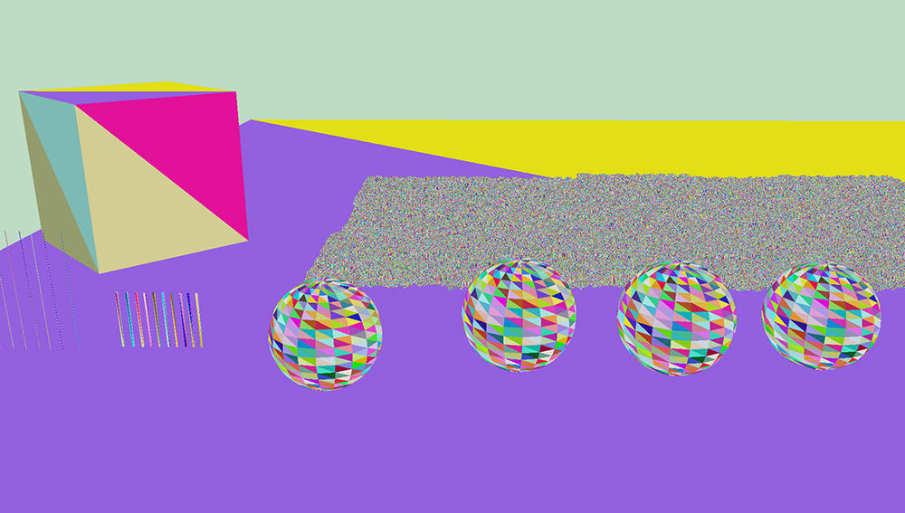
PRIMITIVE ID
Primitive ID
Need to render an image like this
  Triangle ID in a render texture
  How to do it?
One solution for all platforms
  “Good enough everywhere”
  Can add optimized solutions later
  No major performance cliffs
Notes:
The first problem is how are we going to render the texture of triangle IDs. We really want one solution that works everywhere with no major performance cliffs.

Slide 56
PRIMITIVE ID
Triangle ID Options
SV_PrimitiveID
NonIndexed
Leading Vertex
Mesh Shaders
Software Rasterizer
Geometry Shader
Notes:
There are a lot of options, so here we go.

Slide 57
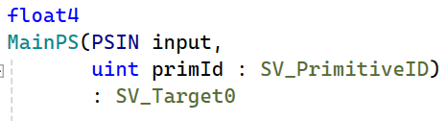
PRIMITIVE ID
Triangle ID Options
SV_PrimitiveID
SV_PrimitiveID
NonIndexed
Leading Vertex
Mesh Shaders
Software Rasterizer
Geometry Shader
Use SV_PrimitiveID/gl_PrimitiveID
  Trivial to Implement
  Not supported on some platforms
    Check your NDAs
  Performance penalty on some platforms
Notes:
The first option is to use the SV_Primitive ID semantic, or gl_PrimitiveId in glsl. It’s extremely easy, in that it’s literally one line of code. But it isn’t supported on all platforms, and does have some performance penalties.

Slide 58
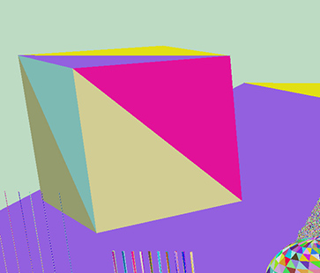
PRIMITIVE ID
Triangle ID Options
NonIndexed
SV_PrimitiveID
NonIndexed
Leading Vertex
Mesh Shaders
Software Rasterizer
Geometry Shader
Render 3 Vertices
Primitive ID as color
3x VS invocations per triangle
Notes:
The second option is NonIndexed. Suppose we want to render this cube. For this first triangle, we need to render three vertices, and we want the full triangle to have the pink ID. We can do this by rendering three vertices each with pin as the color.
The downside is that when rendering the next triangle, we have to render three vertices again, with a different color. So while this approach is simple and easy, we lose the benefits of vertex reuse, and we need 3 unique vertex invocations for each triangle.

Slide 59
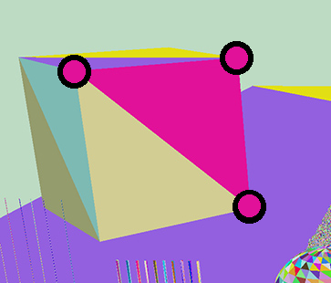
PRIMITIVE ID
Triangle ID Options
NonIndexed
SV_PrimitiveID
NonIndexed
Leading Vertex
Mesh Shaders
Software Rasterizer
Geometry Shader
Render 3 Vertices
Primitive ID as color
3x VS invocations per triangle
Notes:
The second option is NonIndexed. Suppose we want to render this cube. For this first triangle, we need to render three vertices, and we want the full triangle to have the pink ID. We can do this by rendering three vertices each with pink as the color.
The downside is that when rendering the next triangle, we have to render three vertices again, with a different color. So while this approach is simple and easy, we lose the benefits of vertex reuse, and we need 3 unique vertex invocations for each triangle.

Slide 60
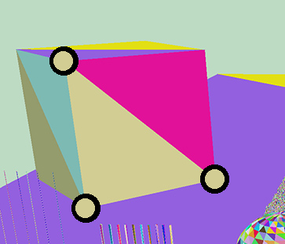
PRIMITIVE ID
Triangle ID Options
NonIndexed
SV_PrimitiveID
NonIndexed
Leading Vertex
Mesh Shaders
Software Rasterizer
Geometry Shader
Render 3 Vertices
Primitive ID as color
3x VS invocations per triangle
Notes:
The second option is NonIndexed. Suppose we want to render this cube. For this first triangle, we need to render three vertices, and we want the full triangle to have the pink ID. We can do this by rendering three vertices each with pin as the color.
The downside is that when rendering the next triangle, we have to render three vertices again, with a different color. So while this approach is simple and easy, we lose the benefits of vertex reuse, and we need 3 unique vertex invocations for each triangle.

Slide 61
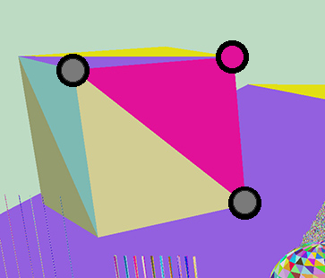
PRIMITIVE ID
Triangle ID Options
Leading Vertex
SV_PrimitiveID
NonIndexed
Leading Vertex
Mesh Shaders
Software Rasterizer
Geometry Shader
Use nointerpolate/flat interpolation
First vertex is “Provoking”
Other two are ignored
Notes:
But there is a trick. When we use nointerpolate or flat shading, the interpolator will simply use one vertex for the color, and the other two vertex colors are ignored. This vertex is called the “provoking” vertex, hence the name.
In this case, with the pink triangle, the top-right vertex is the provoking vertex. As long as that vertex is pink, we actually do not care what the color of the other two vertices is.
Then for the yellow-ish triangle, we can use the bottom right vertex as the provoking vertex, and choose the appropriate color.
Since both triangles have a different provoking vertex, they can reuse the same vertices across the edges. With this approach, we can get 1 vertex invocation per triangle. It’s not as good as the theoretical ideal of half a vertex per triangle, it’s still much better than the 3 VS invocations per triangle of NonIndexed.

Slide 62
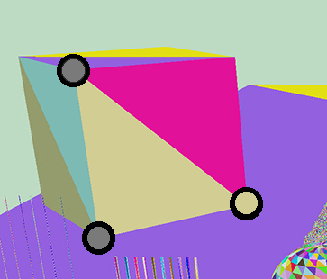
PRIMITIVE ID
Triangle ID Options
Leading Vertex
SV_PrimitiveID
NonIndexed
Leading Vertex
Mesh Shaders
Software Rasterizer
Geometry Shader
Render next triangle
Different provoking vertex
Notes:
But there is a trick. When we use nointerpolate or flat shading, the interpolator will simply use one vertex for the color, and the other two vertices are ignored. This vertex is called the “provoking” vertex, hence the name.
In this case, with the pink triangle, the top-right vertex is the provoking vertex. So as long as that vertex is pink, we actually do not care what the color of the other two vertices is.
Then for the yellow-ish triangle, we can use the bottom right vertex as the provoking vertex, and choose the appropriate color.
Since both triangles have a different provoking vertex, they can reuse the same vertices across the edges. With this approach, we can get 1 vertex invocation per triangle. It’s not as good as the theoretical ideal of half a vertex per triangle, it’s still much better than the 3 VS invocations per triangle of NonIndexed.

Slide 63
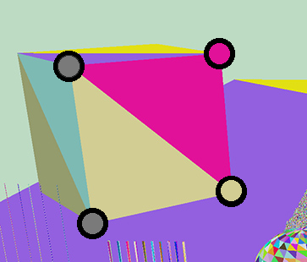
PRIMITIVE ID
Triangle ID Options
Leading Vertex
SV_PrimitiveID
NonIndexed
Leading Vertex
Mesh Shaders
Software Rasterizer
Geometry Shader
Allows vertex reuse
1x VS invocations per triangle
Works on all platforms
Notes:
But there is a trick. When we use nointerpolate or flat shading, the interpolator will simply use one vertex for the color, and the other two vertices are ignored. This vertex is called the “provoking” vertex, hence the name.
In this case, with the pink triangle, the top-right vertex is the provoking vertex. So as long as that vertex is pink, we actually do not care what the color of the other two vertices is.
Then for the yellow-ish triangle, we can use the bottom right vertex as the provoking vertex, and choose the appropriate color.
Since both triangles have a different provoking vertex, they can reuse the same vertices across the edges. With this approach, we can get 1 vertex invocation per triangle. It’s not as good as the theoretical ideal of half a vertex per triangle, it’s still much better than the 3 VS invocations per triangle of NonIndexed.

Slide 64
PRIMITIVE ID
Triangle ID Options
Mesh Shaders
SV_PrimitiveID
NonIndexed
Leading Vertex
Mesh Shaders
Software Rasterizer
Geometry Shader
Pros
  Peak vertex performance
  Best memory
Cons
  Not supported on all platforms.
Notes:
The next option is mesh shaders. If your min spec supports it, then it’s the best option. But quite far from full support.

Slide 65
PRIMITIVE ID
Triangle ID Options
Software Rasterizer
SV_PrimitiveID
NonIndexed
Leading Vertex
Mesh Shaders
Software Rasterizer
Geometry Shader
Pros
  Fastest option on some hardware
Cons
  64bit atomics not supported by all platforms
  Requires a platform-independent fallback
Notes:
A software rasterizer is the fastest option on some platforms. But requires 64 bit atomics, generally requires a fallback for large triangles, and would have battery issues on mobile.

Slide 66
PRIMITIVE ID
Triangle ID Options
Geometry Shader
SV_PrimitiveID
NonIndexed
Leading Vertex
Mesh Shaders
Software Rasterizer
Geometry Shader
Very inconsistent performance on different hardware.
Notes:
A geometry shader could work, but the performance across vendors is extremely inconsistent.

Slide 67
PRIMITIVE ID
Viable Options
Non-Viable Options
SV_PrimitiveID
NonIndexed
Leading Vertex
Mesh Shaders
Software Rasterizer
Geometry Shader
Note: These are viable as an optimization, but are not viable as a unified path for all platforms.
Notes:
So we have three viable options as a complete solution. SV_PrimitiveID, NonIndexed, and Provoking Vertex could work. Mesh shaders and a software rasterizer are good candidates for optimization later, but for the first implementation we only have the three options on the left.

Slide 68

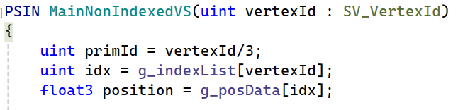
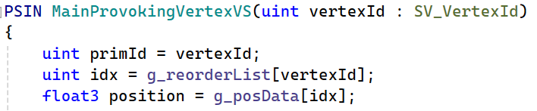
PRIMITIVE ID
Primitive ID performance
Not practical to test all platforms.
GPUs 10 years ago are very different from GPUs today
  But GPUs from 10 years ago are still relevant!
Sebastian Aaltonen to the rescue.
  Numbers for NVIDIA, AMD, and Intel
Notes:
In order to decide which option, we need to test the performance, which is quite an undertaking. Fortunately, Sebastian Aaltonen did a thorough investigation several years ago and posted the results on twitter. He tested one NVIDIA, one AMD, and one Intel machine.

Slide 69
PRIMITIVE ID
Performance Comparison
NVIDIA
  Leading Vertex: 0.883
  SV_PrimitiveID: 1.367
  Non-Indexed: 1.750
Baseline missing from tweet.
  But matches leading vertex in the NSIGHT captures in a later post.
  Not easy to fit nuanced graphics experiments into 140 characters.
 | NVIDIA | AMD | Intel
Leading Vertex | 1x
SV_PrimitiveID | 1.5x
Non-Indexed | 2.0x
https://x.com/SebAaltonen/status/1483760745821184004
Notes:
On NVIDIA, Leading Vertex was the fastest option. SV_PrimitiveID was roughly 50% slower and non-indexed was roughly 100% slower.

Slide 70
PRIMITIVE ID
Performance Comparison
AMD RDNA1
  Baseline: 2.06
  Leading Vertex: 2.16
  SV_PrimitiveID: 3.78
  Non-Indexed: 5.45
Slight cost for leading vertex
 | NVIDIA | AMD | Intel
Leading Vertex | 1x | 1x
SV_PrimitiveID | 1.5x | 1.8x
Non-Indexed | 2.0x | 2.6x
https://x.com/SebAaltonen/status/1483802377970929671
Notes:
AMD was similar to NVIDIA. Leading vertex had a slight cost but SV_PrimitiveId and non-indexed where significantly more expensive.

Slide 71
PRIMITIVE ID
Performance Comparison
Intel iGPU (Gen12)
  Baseline: 12.63
  Leading Vertex: 12.83
  SV_PrimitiveID: 12.87
  Non-Indexed: 20.17
 | NVIDIA | AMD | Intel
Leading Vertex | 1x | 1x | 1x
SV_PrimitiveID | 1.5x | 1.8x | 1x
Non-Indexed | 2.0x | 2.6x | 1.6x
https://x.com/SebAaltonen/status/1483772372754870274
Notes:
Intel was interesting. Intel has a very fast SV_PrimitiveID implementation, and it was nearly free, as was leading vertex. Non-indexed had a significant penalty.

Slide 72
PRIMITIVE ID
Rough Comparison with Baseline (and some rounding)
Leading Vertex is the clear winner.
 | NVIDIA | AMD | Intel
Leading Vertex | 1x | 1x | 1x
SV_PrimitiveID | 1.5x | 1.8x | 1x
Non-Indexed | 2.0x | 2.6x | 1.6x
Notes:
Putting them all together as a scale factor relative to the baseline, Leading Vertex was the obvious winner. SV_PrimitiveID and Non-Indexed had various performance penalties, but Leading Vertex had at most a tiny additional cost over the baseline.

Slide 73
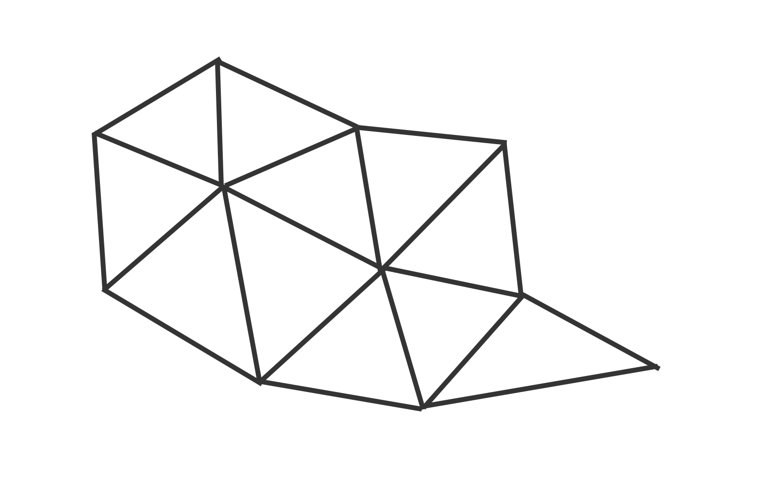
PRIMITIVE ID
Leading Vertex Example
Here are some triangles.
Notes:
So, how do we actually reorder our cluster for leading vertex rendering. Let’s take an example with a few triangles.

Slide 74
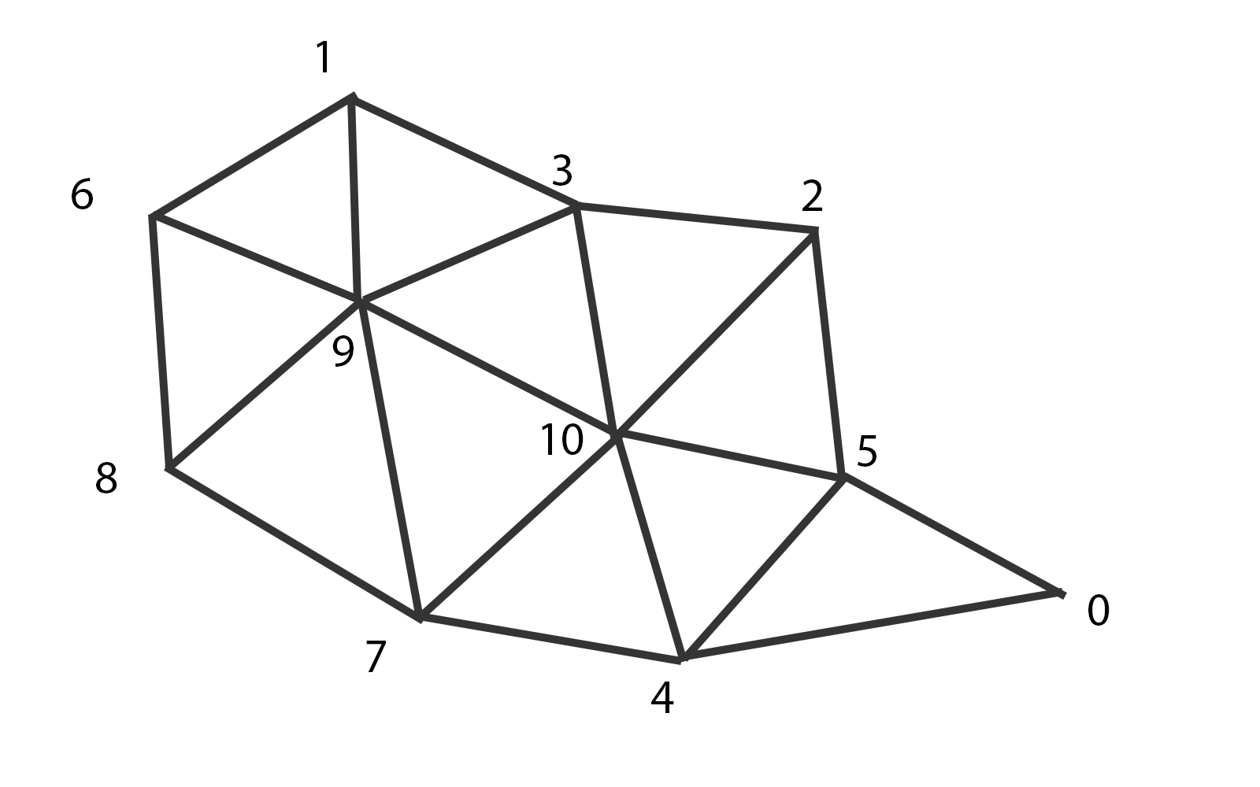
PRIMITIVE ID
Leading Vertex Example
Here are some triangles.
Let’s number the vertices.
Notes:
And to show the concept, let’s just just order the vertices in this way.

Slide 75
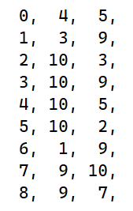
PRIMITIVE ID
Leading Vertex Example
Here are some triangles.
Let’s number the vertices.
Here is a proposed index list.
Notes:
If we do that, we end up with an index list that looks like this.

Slide 76

PRIMITIVE ID
Leading Vertex Example
Here are some triangles.
Let’s number the vertices.
Here is a proposed index list.
Notice a pattern in the first column?
Notes:
With the ordering listed here, we now have them set up where the primitive ID exactly matches the leading vertex id.

Slide 77
PRIMITIVE ID
Leading Vertex
Use flat/nointerpolate mode.
One color is used for entire triangle.
  Called the “Provoking Vertex”
  First vertex on most platforms.
  Last vertex on OpenGL.
Notes:
If we have the indices laid out in this way, the vertex shader is quite simple. The primitive id is simply the incoming vertex id. And we need a single indirection to convert the incoming index into the actual vertex buffer index.

Slide 78
PRIMITIVE ID
Leading Vertex
Step 1) Initial Tris
Step 2) Rotate Vertices
Notes:
We can optimize a cluster in this way in two steps. The first step will be a quick, greedy attempt to initialize as many triangles as possible to a provoking vertex. And a second pass will rotate the vertices to fill in any triangles leftover from step 1.

Slide 79

PRIMITIVE ID
Step 1) Initial Tris
First, count the number of tris touching each vertex (valence).
Notes:
As a first step, it helps to count the number of triangles touching each vertex.

Slide 80

PRIMITIVE ID
Step 1) Initial Tris
First, count the number of tris touching each vertex (valence).
How to handle this triangle?
  Intuition: We should use the vertex with lowest valence.
  That one on the right can’t be used for any other triangle.
Notes:
The first pass is a greedy for loop where each triangle simply chooses the best forward vertex. Intuitively, the “best” choice is the one with the lowest valence, as the higher valence vertices are more likely to be usable by other triangles. Also, this approach will tend to pick the borders first.

Slide 81
PRIMITIVE ID
Step 1) Initial Tris
For each triangle:
  If vertex is available?
    Take it
  If no vertex is available?
    Try again in next pass
Notes:
So this algorithm is pretty simple. Iterate over each triangle, and choose the best provoking vertex available. If nothing is available, then wait for the next pass.

Slide 82

PRIMITIVE ID
Step 2) Rotate Vertices
Back to our example.
Suppose these vertices were taken.
  Purple dot goes into their allocated triangle.
Notes:
After the first greedy pass, some of the triangles will have chosen their provoking vertex. Here, the purple dots show the chosen provoking vertices for those triangles.

Slide 83

PRIMITIVE ID
Step 2) Rotate Vertices
Back to our example.
Suppose these vertices were taken.
  Purple dot goes into their allocated triangle.
Choose provoking vertex for tri.
Notes:
And now we want to choose the provoking vertex for this triangle in blue.

Slide 84

PRIMITIVE ID
Step 2) Rotate Vertices
Back to our example.
Suppose these vertices were taken.
  Purple dot goes into their allocated triangle.
Choose provoking vertex for tri.
  But all three are taken.
Notes:
However, all the vertices have been chosen by other triangles.

Slide 85

PRIMITIVE ID
Step 2) Rotate Vertices
Back to our example.
Suppose these vertices were taken.
  Purple dot goes into their allocated triangle.
Choose provoking vertex for tri.
  But all three are taken.
Free vertex over here
  Rotate vertices
Notes:
Thankfully, we have this free vertex over here. We could find it by doing a depth-first search around the triangle.

Slide 86

PRIMITIVE ID
Step 2) Rotate Vertices
Back to our example.
Suppose these vertices were taken.
  Purple dot goes into their allocated triangle.
Choose provoking vertex for tri.
  But all three are taken.
Free vertex over here
  Rotate vertices
Notes:
Once we have a path found, we can free up a vertex from our new triangle by rotating the provoking vertex.

Slide 87

PRIMITIVE ID
Step 2) Rotate Vertices
Back to our example.
Suppose these vertices were taken.
  Purple dot goes into their allocated triangle.
Choose provoking vertex for tri.
  But all three are taken.
Rotate vertex
Notes:
First, we’ll rotate the provoking vertex from the neighbor triangle.

Slide 88

PRIMITIVE ID
Step 2) Rotate Vertices
Back to our example.
Suppose these vertices were taken.
  Purple dot goes into their allocated triangle.
Choose provoking vertex for tri.
  But all three are taken.
Rotate vertex
Notes:
And the next triangle…

Slide 89

PRIMITIVE ID
Step 2) Rotate Vertices
Back to our example.
Suppose these vertices were taken.
  Purple dot goes into their allocated triangle.
Choose provoking vertex for tri.
  But all three are taken.
Rotate vertex
Notes:
And the next triangle…

Slide 90

PRIMITIVE ID
Step 2) Rotate Vertices
Back to our example.
Suppose these vertices were taken.
  Purple dot goes into their allocated triangle.
Choose provoking vertex for tri.
  But all three are taken.
Rotate vertex
This tri has a free vertex!
Notes:
This triangle has a free vertex which we can select as the new provoking vertex for the this triangle.

Slide 91

PRIMITIVE ID
Step 2) Rotate Vertices
Back to our example.
Suppose these vertices were taken.
  Purple dot goes into their allocated triangle.
Choose provoking vertex for tri.
  But all three are taken.
Rotate vertex
This tri has a free vertex!
Notes:
And afterwards, we now have a provoking vertex for all of the triangles processed so far.

Slide 92
PRIMITIVE ID
Leading Vertex Algorithm:
Find valence of each vertex.
For each tri:
  Choose available vertex with lowest valence.
For each tri:
  Depth first search for free vertex.
  Rotate forward vertex.
Notes:
The algorithm runs in two stages. The first pass simply chooses the best vertex based on lowest valence. And the second stage performs a depth first search and rotates the provoking vertices. It actually turns out that in most cases, the second stage doesn’t even need to run because the first step finds a valid provoking vertex for each triangle.

Slide 93
PRIMITIVE ID
Extra Detail
Clusters are 64 tris, 64 verts.
Q) What if more tris than verts?
  Say, 64 tris, 50 verts
A) Solution
  Find provoking vertex for 50 verts
  Pick any 14 to duplicate to fill up
Failure case:
  For each vertex that is NOT a provoking vertex, we will have to drop a triangle from a cluster
Notes:
However, there are some failure cases. In my case, clusters are always 64 triangles and 64 vertices.

Slide 94

PRIMITIVE ID
Leading Vertex
Most common failure:
Triangle with multiple 1 valence verts.
With 64 tris, all verts must map to one unique triangle.
Free vertex can not rotate to a triangle that needs it.
Notes:
The most common failure case is when one triangle is loosely connected to the rest of the cluster by a single index. It chooses the purple vertex as its provoking vertex. But the green vertex can’t be rotated into the cluster, and thus there is a triangle somewhere in the cluster that does not fit.

Slide 95
PRIMITIVE ID
MeshOptimizer for clustering
  https://github.com/zeux/meshoptimizer
  Also LODs
Base algorithm:
  Adds triangles to a buffer, one at a time
  Emits cluster once it exceeds limits (64 tris/64 verts)
  Repeat
Forked version:
  Before emitting, reorder for provoking vertex
  Any leftover triangles remain in the buffer for the next cluster
  Usually, all triangles fit
Notes:
This algorithm is incorporated into my fork of MeshOptimizer, which I also use for LODs because it is ridiculously fast. MeshOptimzer employs a greedy algorithm where it adds triangles to a buffer, one at a time. Once the buffer exceeds the limit you specify, which in my case is 64 tris and 64 verts, it then emits a cluster and begins a new one.
The change I made looks at the cluster which is being emitted, and reorders the triangles for provoking vertex. If a triangle fails to find a provoking vertex, then it gets put back into the buffer for the next cluster generated. In practice, usually all the triangles fit, but there are occasional clusters that end up missing a triangle or two.

Slide 96

PRIMITIVE ID
Packed Cluster Data
64 reorder indices
Only 2 indices per triangle
  6 bits each
32 bit indices
  5.5 bytes per triangle
  Reference: 12 bytes (3x U32s)
16 bit indices
  3.5 bytes per triangle
  Reference: 6 bytes (3x U16s)
Notes:
The actual data structure on disk is pretty tight. For each cluster, we need 64 indices into the source vertex buffer, and there will likely be duplicates.
Also, we don’t need to store two of the three indices, as the first vertex is implied. If we pack them into 6 bits per index, 32bit index meshes end up as 5.5 bytes per triangle, which is a nice win for disk space over storing uncompressed indices.

Slide 97
PRIMITIVE ID
Practical Issue: Some platforms might need multiple rendering paths.
I.e. shipping a PC game, might need multiple options:
  Mesh Shaders
  Leading Vertex
  Fallback to Regular
How to serialize?
  Definitely don’t want to store 3 versions on disk.
Solution:
  Store compressed mesh representation on disk
  Use compressed representation for mesh shaders
  Convert to Leading Vertex or Regular index list at load time
Notes:
There is one more practical issue. Suppose we want to support different mesh implementations on the same platform? For example, on a new GPU you might want to use mesh shaders but on an older GPU you would fall back to leading vertex or even regular GBuffer rendering.
In this case, we really do not want to store three versions of the mesh on disk.
Fortunately, converting from the packed leading vertex clusters to other interpretations is trivial. The tightly packed representation is the only one you need on disk. Then you can expand the index list at run time if necessary. Games are very tight on disk space these days so the compression is, in my opinion, a win even for games that will only ever use the fat index list for regular GBuffer rendering.

Slide 98
MESH POOL
Notes:
22) Next up, we have to discuss meshes a bit.

Slide 99
MESH POOL
Mesh Pool
Given a triangle ID, we need to fetch the three vertices.
Store all geometry in a large buffer.
Notes:
The next problem is fetching vertices and indices from the triangle ID. And in order to do this, you will need to store all of your meshes in one giant buffer, instead of a bunch of little ones.

Slide 100
MESH POOL
Mesh Pool
Provides benefits, even on mobile.
  Reduces a few API calls.
  Hard to think of a good reason not to do it.
HypeHype renderer
Aaltonen, HypeHype Mobile Rendering Architecture, SIGGRAPH 2023: Advances in Real Time Rendering in Games
https://advances.realtimerendering.com/s2023/index.html#HypeHype
Notes:
Storing a giant, managed pool of vertices is probably a good idea, anyways. In fact, in last year’s presentation, HypeHype was able to squeeze a few cycles out of their CPU cost since there were fewer calls to switch vertex or index buffer.

Slide 101
MESH POOL
Vertex Animation
Common to have vertex animation
  Wind is most common.
Fetching three vertices
  Matrix mul cost is quite small.
  Vertex animation quickly adds up.
  Expensive vertex animation is a non-starter
Notes:
The one tricky issue is going to be vertex animation. Each pixel needs to read all three vertices, and the cost of the model matrix ends up being trivial. However, if you have complex vertex animation, the cost is going to explode.

Slide 102
MESH POOL
Vertex Animation
Solution
  Precalculate vertex animation
Has a memory cost
Has performance cost
Notes:
So you are going to need to run a pre-pass and store the positions with compute. Depending on your renderer, this memory cost might be very painful. But either you’re going to have to pay for memory, or you are going to have to pay for performance. Pick one.

Slide 103
DERIVATIVES
Notes:
23) The next problem that we need to discuss is derivatives.

Slide 104
DERIVATIVES
GPUs render quads.
Why do this?
  Derivatives
All four lanes run in parallel
  Dx/Dy from offsets
Tex.Sample()
  Implicitly calculates Dx/Dy from all four samples.
  That’s why it is illegal in a Compute or Vertex shader
Notes:
In the earlier discussion, you might have wondered why GPUs are restricted to 2x2 quads, and the reason is derivatives. Any time that you perform a texture sample, the GPU is approximating the partial derivative of the UV by using the 4 samples. That’s why they are called “helper” lanes…they help the active lanes compute partial derivatives.

Slide 105
DERIVATIVES
GPUs render quads.
Solution:
  Calculate derivatives on our own.
Tex.Sample() -> Tex.SampleGrad()
  Pass the derivatives in.
Notes:
We are going to need to calculate these derivatives ourselves, and use SampleGrad() instead of Sample().

Slide 106

DERIVATIVES
Derivatives of Interpolators
First, we need the derivative of the barycentric coordinate.
This code donated by James McLaren and Stephen Hill
Schied and Dachsbacher, Deferred Attribute Interpolation for Memory-Efficient Deferred Shading, HPG 2015
https://cg.ivd.kit.edu/publications/2015/dais/DAIS.pdf
Notes:
To calculate the UV derivatives, the first thing we actually need is partial derivative of the barycentric relative to X and Y in screen space. I wrote a version in my blog posts a few years ago, and it turns out there was a mistake in there. Fortunately, James McLaren and Stephen Hill contacted me and the correct version is shown here. Feel free to use it. Technically the license on the blog post is CC0 but if that’s an issue just ping me and you can have it under any license you want.

Slide 107

DERIVATIVES
Derivatives of Interpolators
Given:
  Barycentric derivative
  Value from 3 attributes
Calculate derivative of attribute
Notes:
Once we have the partial derivative of the barycentric, we can calculate the partial derivative of the attribute using the code shown here.

Slide 108


DERIVATIVES
Derivatives of Interpolators
Then how to calculate derivatives for textures samples?
Use structure for Derived_float2.
Write derivative versions of all functions, like divide and cosine.
Notes:
Logistically, the best way organize derivatives is with a structure similar to the Derived_Float2 shown here. Any expressions on the critical path from the interpolator to a texture sample need to use these structs and carry the derivatives all the way through. Each time you do a multiply, divide, or any other operation you need to use the chain rule.

Slide 109


DERIVATIVES
Derivatives of Interpolators
Make sure the derivative functions are used on the path from interpolators to the texture samples.
Notes:
We have to modify code like this. Where our original code would be “uv = baseUv * scale”, we instead need to use the derived versions of those functions. Then instead of using Sample(), we need to use SampleGrad() and pass in our analytic derivatives.

Slide 110

DERIVATIVES
Material Graphs
Lots of maintenance.
Learn to love type conversions.
Notes:
But if you are using material graphs, be prepared for a bit of an adventure, as you’ll have to change your code generator to maintain derivatives and perform a bunch of conversion between derivative and non-derivative nodes.

Slide 111
DERIVATIVES
MDL/OSL
Both Languages:
  Surface description
  Calculate derivatives.
  Generated from MaterialX
Material Definition Language (MDL)
  NVIDIA
  Generates HLSL
Open Shading Language (OSL)
  Sony Imageworks
  Does not generate HLSL
Notes:
Alternatively we can use a surface description API such as MDL or OSL. Both are surface description languages that can be generated from MaterialX and can calculate derivatives for you. MDL is NVIDIA’s language, and OSL is from Sony Imageworks. Both are viable option, but the tie-breaker for me is that MDL includes an HLSL backend but OSL does not.

Slide 112
DERIVATIVES
USD/MDL Pipeline
USD -> MaterialX -> MDL -> HLSL
  Sounds more complicated than it is.
  Easier than building a material editor, parser, generator, etc.
MDL has other useful features
  Baking uniforms.
  Baking textures.
Notes:
So that’s the pipeline I’ve been going with. USD to MaterialX to MDL to HLSL, which sounds like a lot of work, but it’s a lot less work than writing an entire material editor. MDL also has some other useful features as well.

Slide 113
RECONSTRUCTION
Notes:
26) The final issue we need to go over is a reconstruction algorithm.

Slide 114

RECONSTRUCTION
VRS Patterns
2x Diagonal
4x Grid
25% Noise-Based
1x Everything
Notes:
There are several different ways we can generate our initial sample points. The first approach is to use a checkerboard approach.

Slide 115

RECONSTRUCTION
VRS Patterns
2x Diagonal
4x Grid
25% Noise-Based
1x Everything
Notes:
A second approach is go 1/4th rate, and use a grid at half res.

Slide 116

RECONSTRUCTION
VRS Patterns
2x Diagonal
4x Grid
25% Noise-Based
1x Everything
Notes:
A third option is to us a stochastic approach, biasing the samples to get more samples where there is more detail.

Slide 117

RECONSTRUCTION
VRS Patterns
2x Diagonal
4x Grid
25% Noise-Based
1x Reference
Notes:
And a final approach is to just render every sample.

Slide 118


RECONSTRUCTION
Reconstruction
Edge detection
  Horizontal and Vertical
  Stored as bitmask
Edge criteria
  Instance ID
  Depth
  Geometry Normal
Notes:
One of the key tricks is to perform an accurate edge detection. If you use the instance ID, depth, and geometry normal, you actually get a very good edge detector.

Slide 119

RECONSTRUCTION
Reconstruction
Choose “best” 4 pixels.
For each pixel, look in 4 regions
Diagonals go clockwise
Prioritize based on distance
Notes:
For reconstruction of arbitrary positions, we can split the nearby area into 4 regions, and choose one pixel for each region.

Slide 120

RECONSTRUCTION
Reconstruction
Given a pixel position
  Grey pixel is start
  Blue pixels are valid neighbors
  Red edges are invalid borders
Find best neighbor
  We need to find the best neighbor.
  Don’t cross border edes.
Notes:
As an example, suppose we want to find a neighbor for the pixel in grey. The blue pixels are valid neighbors, and the red lines are edges.

Slide 121

RECONSTRUCTION
Reconstruction
Given a pixel position
  Grey pixel is start
  Blue pixels are valid neighbors
  Red edges are invalid borders
Find best neighbor
  We need to find the best neighbor.
  Don’t cross border edes.
Notes:
The best neighbor can be found using this path.

Slide 122



RECONSTRUCTION
Search Algorithm
Many ways to search
  Flood fill is too expensive
  Faster algorithm
Notes:
But how do we perform this search quickly. Given the start and target pixels, there are many ways to find the same pixel, and flood fill is going to be too slow.

Slide 123

RECONSTRUCTION
Search Algorithm
Hardcoded search path
  Same result in most cases
  Much simpler
How to search?
  For loop?
  Binary expression.
Notes:
As an optimization, we can have a pre-specified search path. In theory this approach can miss valid paths to some pixels, but if we need multiple 90 degree rotation to find a pixel, it probably isn’t a great candidate anyways.
While the obvious way to search this pattern would be with a for loop, we can actually optimize it as a binary expression.

Slide 124

RECONSTRUCTION
Search Algorithm
Only search this one path
  Ignore other paths
Notes:
So given the center pixel in grey, we have only one path that we need to go through to see if that blue pixel is the one we want.

Slide 125
RECONSTRUCTION
Valid path requirements:
Notes:
There are three rules here.

Slide 126

RECONSTRUCTION
Valid path requirements:
No other hits along the path.
Notes:
First, we should not have any valid pixels on the way to the search path. Otherwise, that pixel in pink would be the hit, not this one in blue.

Slide 127

RECONSTRUCTION
Valid path requirements:
No other hits along the path.
Horizontal edges must be legal.
Notes:
Second, we shouldn’t have any horizontal borders.

Slide 128

RECONSTRUCTION
Valid path requirements:
No other hits along the path.
Horizontal edges must be legal.
Vertical edges must be legal.
Notes:
And third, we should have any vertical borders along the path.

Slide 129

RECONSTRUCTION
Valid path requirements:
No other hits along the path.
Horizontal edges must be legal.
Vertical edges must be legal.
Boolean expression
Similar in spirit to EQAA
Notes:
The best way to evaluate this is as a boolean expression. We don’t need a for loop.

Slide 130

RECONSTRUCTION
Faster Boolean Expression
Use bitmask instead of bools
Radius is 4 pixels
Search 24 pixels at a time
  4 pad on left and right
Notes:
And the great thing about booleans is that we can pack them into uints. Since our search radius is only 4 pixels, we can search for 24 pixels at a time with 4 bits of pad on each side.

Slide 131

RECONSTRUCTION
For each search direction, find a value between [-4,4]
  Axis fits in 4 bits
  Pack 4 directions into a single u32
Very generic
  About a hundred microseconds for edge detection and searching
    Geforce 3070, @1080p
  TODO: Optimize
Notes:
After evaluating this giant boolean expression for all of the search positions, we have a result between -4 and +4 in each dimension, as well as a special value for no hit at all. And four directions can be packed into a single 32 bit int.
It’s slower than I would like, and optimizing that pass is on my todo list.

Slide 132

RECONSTRUCTION
Reconstruction
Chosen pixels
Notes:
To show the algorithm, first, we have some sparse samples chosen to render.

Slide 133

RECONSTRUCTION
Reconstruction
Chosen pixels
Vertical edges
Notes:
We then need to find the vertical edges…

Slide 134

RECONSTRUCTION
Reconstruction
Chosen pixels
Vertical edges
Horizontal edges
Notes:
…and the horizontal edges.

Slide 135

RECONSTRUCTION
Reconstruction
Chosen pixels
Vertical edges
Horizontal edges
Reconstructed frame
  Red pixels are invalid
Notes:
From there, we can interpolate using the best 4 hits, without crossing borders. A few pixels will not find a valid hit, and are marked in red if you look closely.

Slide 136

RECONSTRUCTION
Reconstruction
Chosen pixels
Vertical edges
Horizontal edges
Reconstructed frame
  Red pixels are invalid
TAA
  Must handle invalid pixels
Notes:
Then we can apply TAA, and we have to modify our TAA algorithm such that we can disregard pixels from the current frame that failed to find at least one neighbor.

Slide 137
PERFORMANCE
Fully variable rate:
Ghosting issues on light changes.
  TAA color clamp becomes unreliable.
  Clamping pixels change every frame.
  Will require constant tweaking.
  1x, 2x, and 4x patterns work fine.
Alternative: History sample selection
  As in:
Drobot, Software-based Variable Rate Shading in Call of Duty: Modern Warfare, SIGGRAPH 2020: Advances in Real Time Rendering in Games
https://research.activision.com/content/atvi/activision/research/web/en/publications/2020-09/software-based-variable-rate-shading-in-call-of-duty--modern-war
Notes:
Also, fully variable rate does have some issues with TAA when light changes. The problem is that the neighbors of the current frame used for the color clamp are changing every frame, making the color clamp inconsistent. This causes artifacts with sudden light shifts. It’s one of those TAA issues that you have to tweak forever. However the 1x, 2x, and 4x patterns work reliably.

Slide 138
PERFORMANCE
Notes:
32) Performance numbers.

Slide 139

PERFORMANCE
Early Tests
2021 Synthetic Tests
Large and small tris
  Right around 1 pixel per triangle
http://filmicworlds.com/blog/visibility-buffer-rendering-with-material-graphs/
Notes:
Now, let’s talk about performance, and we’ll start with some synthetic tests I did a few years ago. In these tests, I had a complex material and a quad that was tessellated to micromanage the size of the triangles.

Slide 140
PERFORMANCE
Big Tris
Early Tests
Test with large triangles
Quad utilization not an issue
VBuffer is slightly slower due to overhead.
Time in ms
 | Material | Lighting | Other | Total
Forward | 1.60 | — | 0.59 | 2.19
Deferred | 1.07 | 0.75 | 0.59 | 2.41
VBuffer | 1.12 | 0.79 | 1.04 | 2.95
Notes:
In the test with large triangles, forward and deferred perform quite well. The VBuffer pass costs slightly more in the material and lighting passes, and VBuffer has some extra passes for managing the data. In these scene VBuffer is a small performance loss.

Slide 141
PERFORMANCE
Tiny Tris (1 pixel)
Early Tests
With one pixel triangles, significant quad overdraw issues for Forward and Deferred-Material
VBuffer pays smaller cost for high density.
  Dense geometry causes more bandwidth usage and cache misses when fetching vertices.
 | Material | Lighting | Other | Total
Forward | 8.96 | — | 1.59 | 10.55
Deferred | 4.65 | 0.77 | 1.59 | 7.01
VBuffer | 1.70 | 0.84 | 2.18 | 4.72
Notes:
However, if we use tiny 1-pixel triangles, everything changes. The combined material and lighting pass of forward explodes in cost. The deferred material cost increase significantly as well. But the VBuffer cost stays relatively stable, and VBuffer is the clear winner.

Slide 142
PERFORMANCE
Ratio: Tiny/Big
Early Tests
Tiny triangle time / big triangle time
  Would expect 4x cost to Forward and Deferred Material
    Vertex cost matters as well
  VBuffer pays small cost for higher density
 | Material | Lighting
Forward | 5.60x | —
Deferred | 4.35x | 1.03x
VBuffer | 1.52x | 1.06x
Notes:
Looking at the ratio of tiny triangle to large triangle time, the forward cost ends up being 5.6x slower and the deferred pass becomes more than 4.3x slower. The Vbuffer cost goes up slightly, since more vertices means more bandwidth and more cache misses, but stays much more stable.

Slide 143
PERFORMANCE
Tiny Tris with VRS (2x2)
Early Tests
Numbers for tiny triangles with VRS
  Hardware VRS for Forward and Deferred Material
  Software VRS for VBuffer
VRS pays extra cost (other)
  About 1.14ms
  But major saving elsewhere
 | Material | Lighting | Other | Total
Forward | 8.98 | — | 1.57 | 10.55
Deferred | 5.08 | 0.76 | 1.59 | 7.43
VBuffer | 0.72 | 0.27 | 2.73 | 3.72
Notes:
Then if we have tiny triangle with VRS, we get the numbers shown here.

Slide 144
PERFORMANCE
Tiny Tris 2x2 VRS Ratio
Early Tests
VRS/NonVRS
Definitely a small performance penalty for deferred
  Ran multiple times to be sure
VBuffer would ideally be .25x
 | Material | Lighting
Forward | 1.00x | —
Deferred | 1.09x | 0.99x
VBuffer | 0.42x | 0.32x
Notes:
And here is a comparison of the cost between VRS and non-VRS for tiny triangles. In the forward case, we get no benefit from VRS. Interestingly, the deferred path is actually slower with VRS than without it. However, the VBuffer approach gains significantly. It doesn’t quite get the ideal 25% cost that we would like, but it is still pretty good.

Slide 145

PERFORMANCE
Performance Test
March of the Monkeys
  Dense, but with LODs
  Flat areas
  Trivial material shader
  Depth Prepass always enabled
    Necessary for DBuffer Decals
  Lighting
    Sun with 4 cascades and a Spot light
  Depth Prepass/Vis and Shadow cost same for all variations
NVIDIA 3070, at 1080p, Dx12
Notes:
For some performance numbers, we can use a test scene, with a bunch of monkeys. This mesh is subdivided to about 1m triangles, with automatic LODs from meshoptimizer. None of the meshes are actually at LOD 0 though, although 6 are at LOD 1 which is 500k tris.
For numbers, I’m going to skip the prepass, shadow passes even though they are significant. But they are about the same on all platforms. In particular, I make the assumption that you always need normals in the prepass, because they are necessary for DBuffer decals.

Slide 146
PERFORMANCE
Forward
Pass | Combined
Forward | 2.47
Deferred
Vis 1x
Vis 2x
Vis 4x
Vis 4x (Variable)
Forward Lighting
  2.47ms
Notes:
With forward rendering, the combined material and lighting pass takes about 2.47ms.

Slide 147
PERFORMANCE
Deferred
Pass | Combined
Forward | 2.47
Deferred | 1.94
Vis 1x
Vis 2x
Vis 4x
Vis 4x (Variable)
GBuffer Write
  1.34ms
GBuffer Lighting
  0.60ms
Total:
  1.94ms
Notes:
The GBuffer approach looks the same, requiring only 1.94 ms.

Slide 148
PERFORMANCE
VBuffer (1x)
Pass | Combined
Forward | 2.47
Deferred | 1.94
Vis 1x | 1.67
Vis 2x
Vis 4x
Vis 4x (Variable)
VBuffer Materials and Lighting
  GBuffer Write: 0.45ms
  Lighting: 0.84ms
  Reconstruction: 0.38ms
Combined:
  Combined Total: 1.67ms
Notes:
VBuffer looks takes a combined total of 1.67ms.

Slide 149
PERFORMANCE
VBuffer (2x)
Pass | Combined
Forward | 2.47
Deferred | 1.94
Vis 1x | 1.67
Vis 2x | 1.44
Vis 4x
Vis 4x (Variable)
Edge Detect:
  0.11ms
VBuffer Materials and Lighting
  GBuffer Write: 0.29ms
  Lighting: 0.36ms
  Reconstruction: 0.68ms
Combined:
  Combined Total: 1.44ms
Notes:
In order to perform 2x checkerboard, we need to perform the edge detection pass, as well as apply reconstruction passses. The total time is 1.44ms.

Slide 150
PERFORMANCE
VBuffer (4x)
Pass | Combined
Forward | 2.47
Deferred | 1.94
Vis 1x | 1.67
Vis 2x | 1.44
Vis 4x | 1.35
Vis 4x (Variable)
Edge Detect:
  0.11ms
VBuffer Materials and Lighting
  GBuffer Write: 0.20ms
  Lighting: 0.20ms
  Reconstruction: 0.84ms
Combined:
  Combined Total: 1.35ms
Notes:
The half resolution pass requires the edge detection pass, similar to the checkerboard pass. It performs the full 4 region search because I haven’t had time to optimize it.

Slide 151
PERFORMANCE
VBuffer (4x, variable)
Pass | Combined
Forward | 2.47
Deferred | 1.94
Vis 1x | 1.67
Vis 2x | 1.44
Vis 4x | 1.35
Vis 4x (Variable) | 1.47
Edge Detect:
  0.11ms
VBuffer Materials and Lighting
  GBuffer Write: 0.21ms
  Lighting: 0.21ms
  Reconstruction: 0.94ms
Combined:
  Combined Total: 1.47ms
Notes:
And finally, the fully generic sparse sampling pass, which also has to perform extra work to sort and choose which pixels to use.

Slide 152
PERFORMANCE
Performance Comparison
Pass | Combined
Forward | 2.47
Deferred | 1.94
Vis 1x | 1.67
Vis 2x | 1.44
Vis 4x | 1.35
Vis 4x (Variable) | 1.47
Timings for Material + Lighting
Shadow and Prepass similar for all.
Visibility at 1x is already a win
  And looks the same
Notes:
In general, the VBuffer approach at 1x is faster and looks the same as deferred. The benefits from quad occupancy outweigh the costs of the extra passes, even though material evaluation shader is extremely light. The variable rate images have a gain, but it is pretty minimal.

Slide 153
PERFORMANCE
Performance Comparison
Timings for Material + Lighting
Significant room for optimization.
  Was a bit pressed for time.
Lower rate scales well for more complex materials.
 | Material | Lighting | Other
1x | .45 | .70* | .38
2x | .29 | .36 | .79
4x | .20 | .20 | .95
Variable | .21 | .21 | 1.05
* Actual marker to marker was 0.84, but adjusting to 0.70 because NSIGHT showed a gap
Notes:
In this table, for each of the VBuffer VRS variations, the Material, Lighting, have been separated. Other is “everything else”. Even though it’s a pretty short material shader, we get pretty good scaling of the material and lighting cost as the resolution decreases. At 4x VRS we just don’t have enough work to keep the GPU busy.

Slide 154
CONCLUSION
VBuffer is better…
GBuffer/Forward is better…
High Triangle Density
High Material Graph Complexity
Powerful GPUs
  VBuffer overhead is minimal
Low Triangle Density
Low Material Graph Complexity
Weak GPUs
  VBuffer overhead is significant
GPUs get more powerful every year.
Notes:
Looking at the overall numbers, scenes with dense triangles and complex materials on high-end GPUs will run much better with VBuffer rendering. However, on less complex scenes on less powerful GPUs VBuffer does not make sense because the overhead of VBuffer rendering outweighs the benefits.
But here’s the thing. GPUs become more powerful every year. So in all these cases where VBuffer is a net loss because of the overhead, eventually the GPUs will improve and VBuffer will be a win.

Slide 155
CONCLUSION
Personal Opinion
  Agree/disagree, decide for yourself.
Is VBuffer the better approach?
Notes:
This is my personal opinion, and you can agree or disagree for yourself. But it’s tempting to ask the question, is VBuffer the better approach.
But in my very subjective and very biased opinion which you should be skeptical of, it isn’t a question. VBuffer is the better approach…eventually. But eventually can be a pretty long time. So the right question is when is the transition point where VBuffer makes sense, and how do we logistically manage that transition. Because eventually we’ll all get there, but it’s going to be a pretty bumpy road.
That being said, this is 100% my personal opinion, which you are free to disagree with. And since I’m giving a presentation on how great VBuffer rendering is, I’m too biased and you should not believe or trust anything that I say about it. Run the numbers yourself and make your own conclusion.

Slide 156
CONCLUSION
Personal Opinion
  Agree/disagree, decide for yourself.
Is VBuffer the better approach?
VBuffer is the better approach…
Notes:
This is my personal opinion, and you can agree or disagree for yourself. But it’s tempting to ask the question, is VBuffer the better approach.
But in my very subjective and very biased opinion which you should be skeptical of, it isn’t a question. VBuffer is the better approach…eventually. But eventually can be a pretty long time. So the right question is when is the transition point where VBuffer makes sense, and how do we logistically manage that transition. Because eventually we’ll all get there, but it’s going to be a pretty bumpy road.
That being said, this is 100% my personal opinion, which you are free to disagree with. And since I’m giving a presentation on how great VBuffer rendering is, I’m too biased and you should not believe or trust anything that I say about it. Run the numbers yourself and make your own conclusion.

Slide 157
CONCLUSION
Personal Opinion
  Agree/disagree, decide for yourself.
Is VBuffer the better approach?
VBuffer is the better approach…eventually.
Notes:
This is my personal opinion, and you can agree or disagree for yourself. But it’s tempting to ask the question, is VBuffer the better approach.
But in my very subjective and very biased opinion which you should be skeptical of, it isn’t a question. VBuffer is the better approach…eventually. But eventually can be a pretty long time. So the right question is when is the transition point where VBuffer makes sense, and how do we logistically manage that transition. Because eventually we’ll all get there, but it’s going to be a pretty bumpy road.
That being said, this is 100% my personal opinion, which you are free to disagree with. And since I’m giving a presentation on how great VBuffer rendering is, I’m too biased and you should not believe or trust anything that I say about it. Run the numbers yourself and make your own conclusion.

Slide 158
CONCLUSION
Personal Opinion
  Agree/disagree, decide for yourself.
Is VBuffer the better approach?
VBuffer is the better approach…eventually.
  But eventually can be a long time.
  Games still shipping on PS4/XBox1
When is the transition point for VBuffer? Not if.
How should this transition be managed technically?
  If you switch to VBuffer, be prepared to maintain legacy GBuffer/Forward for a long time.
    “Long Time” = “Forever”.
  Run the numbers yourself on your min spec.
Notes:
This is my personal opinion, and you can agree or disagree for yourself. But it’s tempting to ask the question, is VBuffer the better approach.
But in my very subjective and very biased opinion which you should be skeptical of, it isn’t a question. VBuffer is the better approach…eventually. But eventually can be a pretty long time. So the right question is when is the transition point where VBuffer makes sense, and how do we logistically manage that transition. Because eventually we’ll all get there, but it’s going to be a pretty bumpy road.
That being said, this is 100% my personal opinion, which you are free to disagree with. Run the numbers yourself and make your own conclusion.

Slide 159
OIT
Order Independent Transparency
Notes:
39) Finally, let’s take a moment to discuss OIT. Before we finish up, there are some interesting opportunities for OIT, and here are the results of a prototype. I wouldn’t call this a finished product, but it’s an interesting experiment that shows promise.

Slide 160


OIT
Let’s do OIT
OIT is easy.
  The hard part is everything else.
  We have all the tools.
Notes:
Here is the classic OIT issue, with just a torus. In the top, you can see an artifact from the invalid blend order, and how it is fixed below. It turns out that if we do everything for a VBuffer with VRS, then adding OIT support is actually easy. The hard part is everything else.

Slide 161

OIT
Render with OIT
Notes:
Here is a diagram for a simple transparent mesh. How would we render this with OIT?

Slide 162

OIT
Render with OIT
Store all samples in a line.
  Original approach was Depth Peeling.
  Pixel linked list is more common.
  Not considering approximations like moment based OIT.
Cass, Interactive Order-Independent Transparency, NVIDIA, 2001
https://developer.download.nvidia.com/assets/gamedev/docs/OrderIndependentTransparency.pdf
Thibieroz, Per-Pixel Linked Lists with Direct3D 11, GDC 2010
https://ubm-twvideo01.s3.amazonaws.com/o1/vault/gdc10/slides/Thibieroz_Nicolas_AdvancedVisualEffectsWithDirect3D_OIT_and_Indirect_Illumination_using_DX11_Linked_Lists_part1.pdf
Münstermann, Krumpen, Klein, and Peters, Moment-Based Order-Independent Transparency, I3D 2018
https://cg.ivd.kit.edu/english/mboit.php
Notes:
If you want accurate ordering of the layers, the typical method would be to render the mesh while storing all the samples in a per-pixel linked list, which seems to have replaced depth peeling. Note that I’m focused on accurate representations, so moment-based OIT isn’t an option here.

Slide 163

OIT
Render with OIT
Store all samples in a line.
  Original approach was Depth Peeling.
  Pixel linked list is more common.
  Not considering approximations like moment based OIT.
Unbounded number of samples
  Unbounded memory
  Unbounded performance
Cass, Interactive Order-Independent Transparency, NVIDIA, 2001
https://developer.download.nvidia.com/assets/gamedev/docs/OrderIndependentTransparency.pdf
Thibieroz, Per-Pixel Linked Lists with Direct3D 11, GDC 2010
https://ubm-twvideo01.s3.amazonaws.com/o1/vault/gdc10/slides/Thibieroz_Nicolas_AdvancedVisualEffectsWithDirect3D_OIT_and_Indirect_Illumination_using_DX11_Linked_Lists_part1.pdf
Münstermann, Krumpen, Klein, and Peters, Moment-Based Order-Independent Transparency, I3D 2018
https://cg.ivd.kit.edu/english/mboit.php
Notes:
Unfortunately, the number of samples is unbounded. So you can end up with bad camera angles that have unbounded numbers of samples. This means unbounded memory and unbounded performance costs.

Slide 164

OIT
Render with OIT
Set a hard limit on samples
  Choose as many pixels as possible within limit
  Interpolate other samples
Bounded number of samples
  Bounded memory
  Bounded performance
Notes:
Rather, we’ll just set a hard limit on the number of samples. Instead of storing the layer information for every pixel, we will store the full layers for as many pixels as we can. For the other pixels, we will interpolate based on neighbors. This approach has bounded memory and bounded performance, at the expense of quality.

Slide 165

OIT
Render with OIT
Add another valid pixel
  2 samples instead of 6
Notes:
However, suppose we have another valid pixel to the left. But since this pixel has only 2 samples, it will look quite different from the pixel with 6 samples next to it.

Slide 166

OIT
Render with OIT
Add another valid pixel
  2 samples instead of 6
Interpolate blue point
  Want to interpolate from similar points
  Calculate hash for each line
  Only blend if hash is the same
Notes:
This is a problem if we want to interpolate this new blue pixel. Since it has 6 samples, we want to interpolate from the similar pixel on the right with 6 samples, but we want to ignore the pixel on the left with two samples. The trick is we can calculate a hash for each pixel, and only interpolate from nearby pixels with the same hash.

Slide 167

OIT
Render with OIT
Desired result
Notes:
As an example, here is a different march of the monkeys, with transparency.

Slide 168

OIT
Order Independent Transparency
Rasterize hash
  Give each mesh a unique id
  Increment for each sample
    1 + (meshId << 8)
  Only interpolate with similar hash
Notes:
We can give each mesh a unique id, then increment the hash for every sample that touches that pixel.

Slide 169

OIT
1st Geometry Pass
Give each pixel a hash.
  8 bits for count
  16 bits for hash
  8 bits for overflow
Max valid layers: 255
  TODO: Proper checking
Notes:
Here is the actual shader code. You can look at it later. Every mesh has a 16 bit id. For every sample we add the value of 1 plus the hash shifted 8 bits to the left. The bottom 8 bits store the count, the middle 16 bits will store a unique hash, and the top 8 bits are to prevent overflow.

Slide 170

OIT
Order Independent Transparency
Choose sparse pixels
  Selected in GREEN
  Allocate space in a giant buffer
Notes:
From the rendered hash, we choose as many samples as we can while staying below a hard cutoff. As the number of layers increases, the pixels become increasingly sparse.

Slide 171

OIT
2nd Geometry Pass
Bump allocate sample data
  Visibility ID
  Depth
  Source XY
All samples in a giant buffer
Notes:
One the pixels are chosen, we can bump allocate all the visibility samples for the valid pixels.

Slide 172
OIT
Sort Samples by Material
ExecuteIndirect for each Material
  Write GBuffer data to a buffer
  Also store modulation/coverage
Lighting Pass
  Just like opaque pass
Detect edges
  Similar to opaque pass, but use hash instead of depth/normal/instance.
Reconstruction
  Just like opaque pass
Notes:
The actual passes for OIT are very similar to the passed for opaque geometry. We sort the samples by material, and perform an execute indirect for each material which stores the GBuffer data. Then we have a lighting pass, just like the opaque pass. For edges detection, we can use the hash instead of the depth, normal, and instance id. And the reconstruction chooses the a neighbor from each of the 4 regions.

Slide 173
OIT
Order Independent Transparency
Rasterized hash
Choose pixels
Count number of samples
Write sample ids for pixels
Sort sparse pixels
Blend colors for sparse pixels
Interpolate using hash for edges
TAA
Notes:
That’s the final algorithm. Rasterize the hash, choose the pixels that fit within the hard cutoff, write the sample IDs, sort the pixels, calculate and blend the colors, interpolate them, and then apply TAA.

Slide 174
OIT
OIT Performance
Fixed number of OIT samples
  0.25x camera screen resolution.
  Transparent materials usually lack high-frequency detail
 | Time
Forward | 1.91ms
OIT | 2.00ms
Notes:
From a timing comparison, the OIT pass is only slightly lower than forward. That being said, the OIT pass has significantly less resolution.

Slide 175
OIT
Cost in MS
OIT Performance
Count: .22
Choose Pixels: .23
Prefix Sum: .08
Write Vis: .25
Evaluate Material: .24
Evaluate Lighting: .30
Sort: .12
Merge: .15
Find Neighbors: .13
Blend Neighbors: .15
Other: .14
Frame breakdown.
  2.00ms total
Rasterization Passes:
  “Count” and “Write Vis”
  0.49ms
Lighting/Material Passes:
  0.54ms
Notes:
The main issue is that there are a lot of passes. None of them are particularly slow, but they all add up. The actual lighting/material calculation is significantly faster than the forward version because of sparsity. With more complicated lighting or materials, it could catch up, but an extra 1ms of fixed cost is A LOT.

Slide 176
OIT
Order Independent Transparency
Pros:
  Guaranteed memory size
  Scales well with complexity
Cons:
  Extra passes add up
  Trouble with detailed geometry
    Fortunately, transparency materials tend to be low frequency
Notes:
There are some interesting benefits. The memory size is guaranteed. It scales well with the complexity of the materials and the lighting. The major downside is the hefty fixed cost.

Slide 177
OIT
Order Independent Transparency
Stepping stone to future algorithms.
  Sparse approximation of depth layers opens interesting possibilities.
  Multiple refraction?
  DOF with transparent?
Notes:
The real win is that this approach has the potential a stepping stone to several unsolved problems. Since the algorithm stores depth information, it’s potentially viable to have arbitrary refraction by using raymarching. We could possibly tackle some hard problems like DOF with transparency.

Slide 178
OIT
Use case: Enterprise Assets
USD Viewer for High End
  Assets designed for VFX/Offline
  Realtime viewer needs to “just work”
Notes:
And this all goes back to my initial use case. If an asset is designed with for an offline path tracer, it’s not practical to match the exact quality with a realtime renderer. OpenPBR specifies refraction, and it would be nice to have a better option than just turning refraction off in realtime mode. If we can solve these problems like refraction and depth of field in a generic way it should be possible to create a reasonable approximation that “just works”. And my hope is that sparse OIT can be a step in that direction.

Slide 179
ACKNOWLEDGEMENTS
Sebastien Aaltonen
Scott Anderson
Simon Brown
Antoine Cohade
Kathia Contreras
Kleber Garcia
Soufiane Khiat
Kristin Lague
Sebastien Legarde
Timothy Lottes
Alix Michel
Greg Mitrano
Masayoshi Miyamoto
Daniel Suttor
Natasha Tatarchuk
Rinaldo Tjan
Habib Zargarpour
And everyone from the Weta Realtime team at Unity
Notes:
Finally, I need to add a thank you to a bunch of people at Unity.

Slide 180
ACKNOWLEDGEMENTS
Michal Drobot
Stephen Hill
James McLaren
Notes:
Finally, I need to add a thank you to a bunch of people at Unity.

Slide 181
REFERENCES - VBUFFER
Burns and Hunt, The Visibility Buffer: A Cache-Friendly Approach to Deferred Shading, JCGT 2013
https://jcgt.org/published/0002/02/04/paper.pdf
Schied and Dachsbacher, Deferred Attribute Interpolation for Memory-Efficient Deferred Shading, HPG 2015
  https://cg.ivd.kit.edu/publications/2015/dais/DAIS.pdf
Engel, Triangle Visibility Buffer, 2018
https://diaryofagraphicsprogrammer.blogspot.com/2018/03/triangle-visibility-buffer.html
Karis, Stubbe, Wihlidal, Nanite, A Deep Dive, SIGGRAPH 2021: Advances in Real Time Rendering in Games
https://advances.realtimerendering.com/s2021/Karis_Nanite_SIGGRAPH_Advances_2021_final.pdf
Hable, Visiblity Buffer Rendering with Material Graphs, 2021
http://filmicworlds.com/blog/visibility-buffer-rendering-with-material-graphs/
Drobot, Geometry Rendering Pipeline Architecture, REAC 2021
  https://research.activision.com/publications/2021/09/geometry-rendering-pipeline-architecture
McLaren, Adventures with Deferred Texturing in Horizon Forbidden West, 2022
  https://www.guerrilla-games.com/read/adventures-with-deferred-texturing-in-horizon-forbidden-west
too_much_voltage, Faster Visibility Buffer/Deferred Material Rendering via Analytical Attribute Interpolation using Ray Differentials, 2022
https://www.reddit.com/r/GraphicsProgramming/comments/uf4ykj/faster_visibility_bufferdeferred_material/
Erler and Engel, Triangle Visibility Buffer 2.0, I3D 2024
https://www.youtube.com/watch?v=kWLev9CoQdg
JMS55, Virtual Geometry in Bevy 0.14, 2024
https://jms55.github.io/posts/2024-06-09-virtual-geometry-bevy-0-14/
Li and Cao, SmartGI Evolution: Adaptive NanoMesh on Mobile, GDC 2024
https://www.youtube.com/watch?v=yD5DjNyiYIQ
Notes:
And for when you look at the slides later, here are the VBuffer references.

Slide 182
REFERENCES - VRS
Drobot, Hybrid Reconstruction Anti-Aliasing, SIGGRAPH 2014: Advances in Real-Time Rendering in Games
  https://advances.realtimerendering.com/s2014/index.html#_HYBRID_RECONSTRUCTION_ANTI-ALIASING
Mallet and Yuksel, Deferred Adaptive Compute Shading, HPG 2018
https://geometrian.com/data/research/dacs/HPG2018_DeferredAdaptiveComputeShading.pdf
Intel, Get Started with Variable Rate Shading on Intel® Processor Graphics, 2019
https://www.intel.com/content/www/us/en/developer/articles/guide/getting-started-with-variable-rate-shading-on-intel-processor-graphics.html
Van Rhyn, Variable Rate Shading: a scalpel in a world of sledgehammers, 2019
https://devblogs.microsoft.com/directx/variable-rate-shading-a-scalpel-in-a-world-of-sledgehammers/
du Bois and Gibson, Variable Rate Shading Tier 1 with Microsoft DirectX 12 From Theory to Practice, GDC 2020
https://www.youtube.com/watch?v=d-qEvmVcg8I
Drobot, Software-based Variable Rate Shading in Call of Duty: Modern Warfare, SIGGRAPH 2020: Advances in Real Time Rendering in Games
https://research.activision.com/content/atvi/activision/research/web/en/publications/2020-09/software-based-variable-rate-shading-in-call-of-duty--modern-war
Mallet, Yuksel, and Seiler, Efficient Adaptive Deferred Shading with Hardware Scatter Tiles, ACM Computer Graphics and Interactive Techniques, 2020
https://dl.acm.org/doi/abs/10.1145/3406184
Van Rhyn, Moving Gears to Tier 2 Variable Rate Shading, 2021
https://devblogs.microsoft.com/directx/gears-vrs-tier2/
Hable, Software VRS with Visibility Buffer Rendering, 2021
http://filmicworlds.com/blog/software-vrs-with-visibility-buffer-rendering/
Fuller, Variable Rate Compute Shaders - Halving Deferred Lighting Time, 2022
https://www.youtube.com/watch?v=Sswuj7BFjGo
Whilidal, Nanite GPU-Driven Materials, GDC 2024
https://schedule.gdconf.com/session/nanite-gpu-driven-materials/899486
Notes:
VRS references.

Slide 183
REFERENCES
Kapoulkine, 2024, meshoptimizer
https://github.com/zeux/meshoptimizer
Aaltonen, 2022, Tweets
https://x.com/SebAaltonen/status/1483760745821184004
https://x.com/SebAaltonen/status/1483802377970929671
https://x.com/SebAaltonen/status/1483772372754870274
Aaltonen, HypeHype Mobile Rendering Architecture, SIGGRAPH 2023: Advances in Real Time Rendering in Games
  https://advances.realtimerendering.com/s2023/index.html#HypeHype
Cass, Interactive Order-Independent Transparency, NVIDIA, 2001
  https://developer.download.nvidia.com/assets/gamedev/docs/OrderIndependentTransparency.pdf
Thibieroz, Per-Pixel Linked Lists with Direct3D 11, GDC 2010
  https://ubm-twvideo01.s3.amazonaws.com/o1/vault/gdc10/slides/Thibieroz_Nicolas_AdvancedVisualEffectsWithDirect3D_OIT_and_Indirect_Illumination_using_DX11_Linked_Lists_part1.pdf
Münstermann, Krumpen, Klein, and Peters, Moment-Based Order-Independent Transparency, I3D 2018
  https://cg.ivd.kit.edu/english/mboit.php
Pharr, Wronski, Salvi, and Fajardo, Filtering After Shading With Stochastic Texture Filtering, I3D 2024
https://research.nvidia.com/labs/rtr/publication/pharr2024stochtex/stochtex.pdf
Notes:
And other references in the talk,

Slide 184

Contact
www.visiblethreshold.com
jhable@visiblethreshold.com
Notes:
Any questions?

Slide 185
QUESTIONS
Questions?
Notes:
45) Any questions?

