Slide 1

Flexible and Extensible Shader Authoring in Frostbite with Serac
Simon Taylor
Senior Software Engineer
EA Frostbite

Slide 2
Outline
Why did we create a new shader language?
What is Serac?
Serac Extensibility Features
Conclusions

Slide 3


Background
Notes:
I work on Frostbite, which is EA’s internal engine used for our AAA games. What this means in practice, is that it gets used in a large variety of different scenarios and use cases. For example…

Slide 4


Notes:
Battlefield 2042, which is a large world, fast-paced, first-person shooter.

Slide 5


Notes:
At the other end of the spectrum is Dead Space, which is a slow-paced, corridor shooter.

Slide 6

Notes:
We have a number of Sports games, like Madden, which have their own unique set of challenges, such as a large crowd of thousands of animated characters.

Slide 7

Notes:
UFC is different again, with a very close-in camera and a tight focus on just 2 characters.

Slide 8
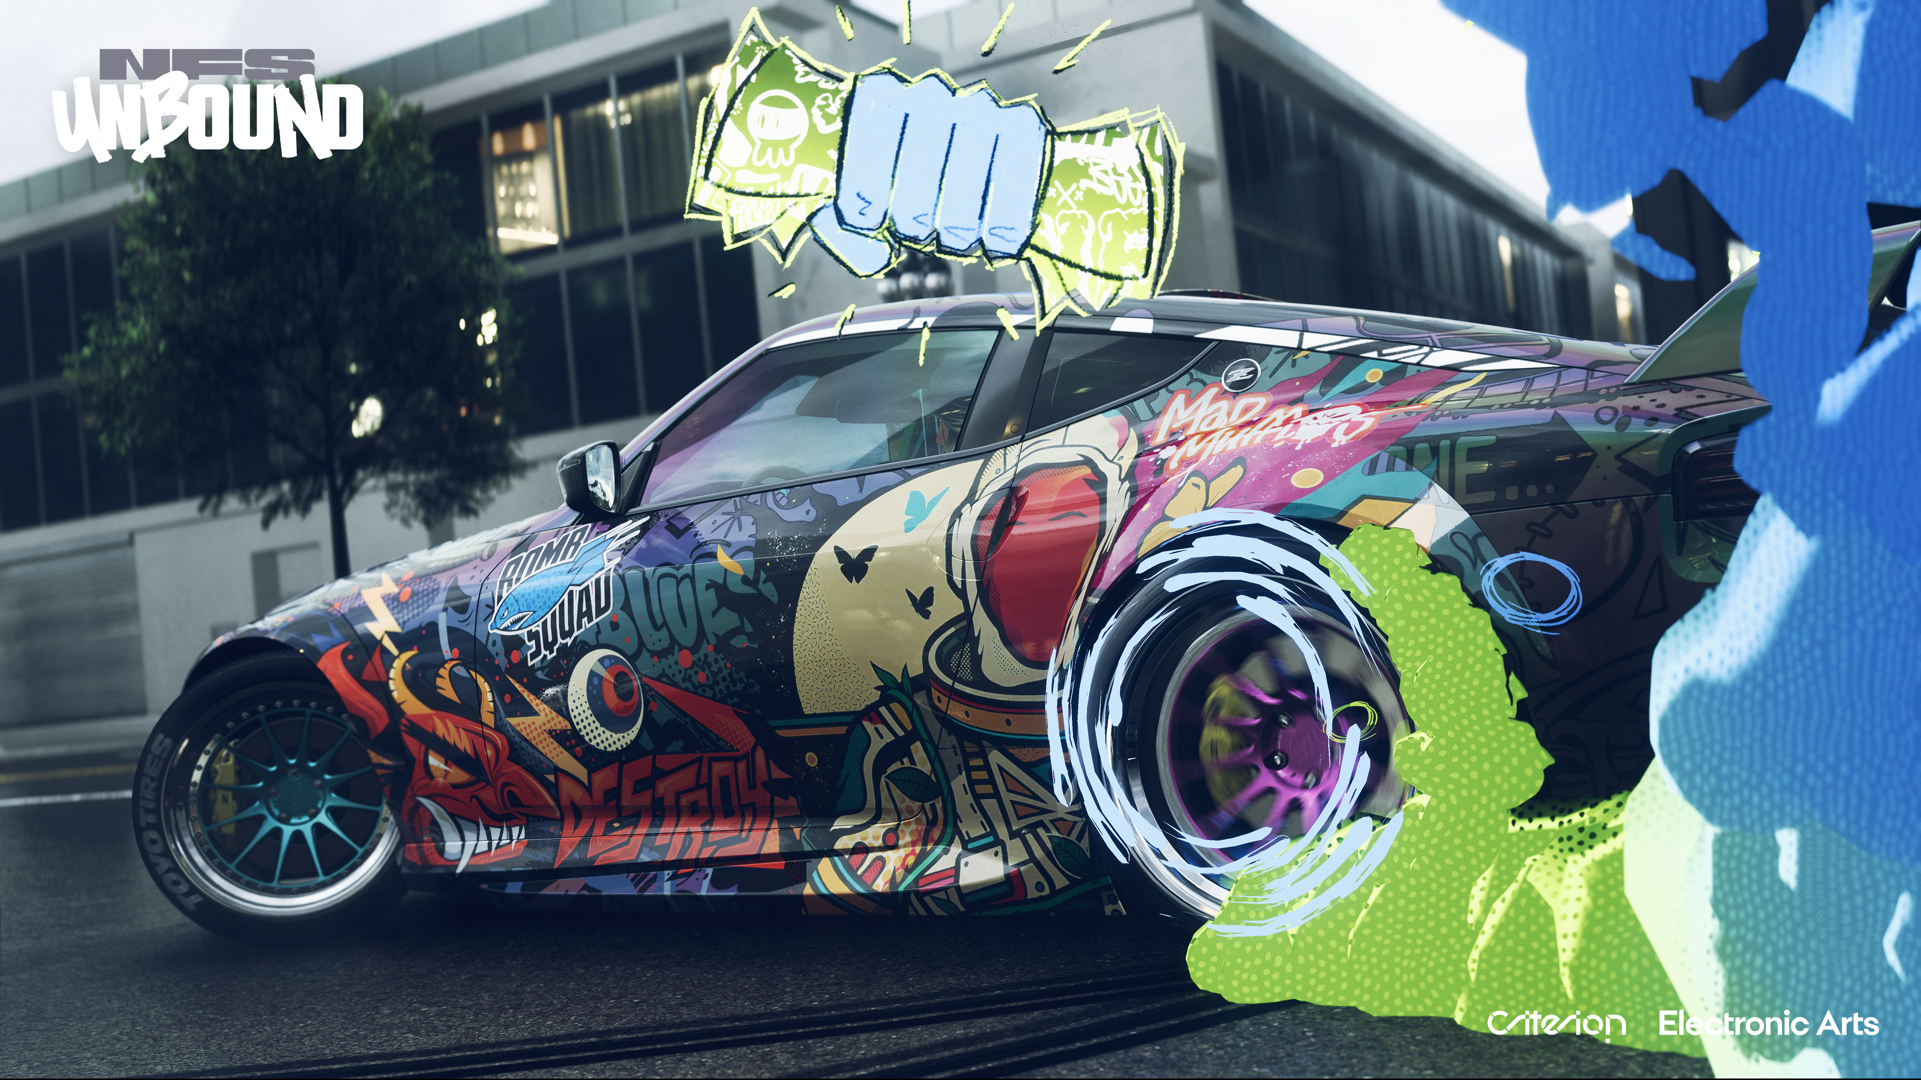
Notes:
In stark contrast to that is Need For Speed Unbound, which has a huge open world with very fast traversal, so puts a lot of emphasis on streaming performance.

Slide 9

Notes:
Dragon Age The Veilguard is different again, with a fantasy setting and features like detailed strand-based hair.

Slide 10
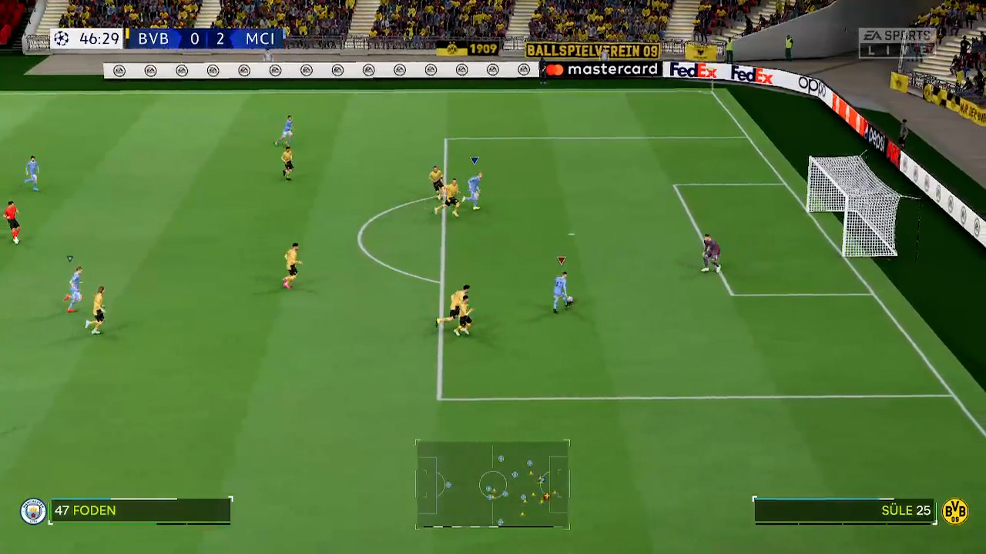



Notes:
Furthermore, we can have a large amount of variety even within a single game. This slide shows 2 screenshots from FC 24: one of gameplay on Switch, one from a replay mode on PC. They look very different, and are rendered very differently – they use different shading modes (forward vs deferred), completely different shadowing solutions, etc.
The upshot of all this variety is that there is no “one-size-fits-all” solution in Frostbite – the engine needs to be flexible and extensible to allow our game teams to achieve the look they are going for and hit their performance targets.

Slide 11
HLSL at Scale
Global everything
  No private/protected
Centralised definitions
No link between shader and dispatch code
  String/register bindings
No extensibility mechanisms
(Node Graphs)
Notes:
When it comes to shader authoring, we in general can’t just use HLSL directly, as it has a number of issues at the scale that Frostbite operates at.
Everything in HLSL – functions, resources, etc. – is global, and no encapsulation mechanisms like private or protected are available. When used in a large codebase like Frostbite’s, this makes it difficult to make changes without the worry of breaking some other code, possibly outside of your control, that may be reusing your code.
HLSL has a number of what I’m calling “centralised definitions” – parts of the shader that must be defined in a single central location. For example, an efficiently-packed cbuffer, or vertex to pixel shader interpolators, which must be defined in the shader entry points’ function signatures. This means that any additions to these must be done in the central location, which is incompatible with extensibility.
There is no link between the shader itself and the code on the CPU which launches it, meaning that resources must be bound by string or register index.
There are no real extensibility mechanisms available.
The last reason we can’t use HLSL directly isn’t HLSL’s fault, and that’s the use of shader node graphs. Like them or loath them, they are an important part of a lot of game engines, including Frostbite. And HLSL obviously does not have any native mechanisms for interacting with such graphs.
What this all means is that most general-purpose engines usually end up having to layer some kind of HLSL generation system on top of HLSL itself to make up for these limitations.

Slide 12
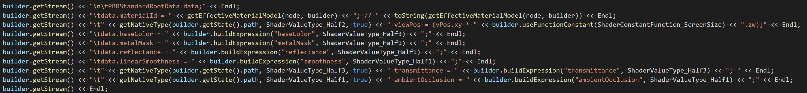
Background: Shaders at Frostbite
Notes:
This includes Frostbite. Prior to writing Serac, we had a system of bespoke C++ code generation that had a number of issues.
It had…
Lots of handwritten C++ code-printing-code

Slide 13
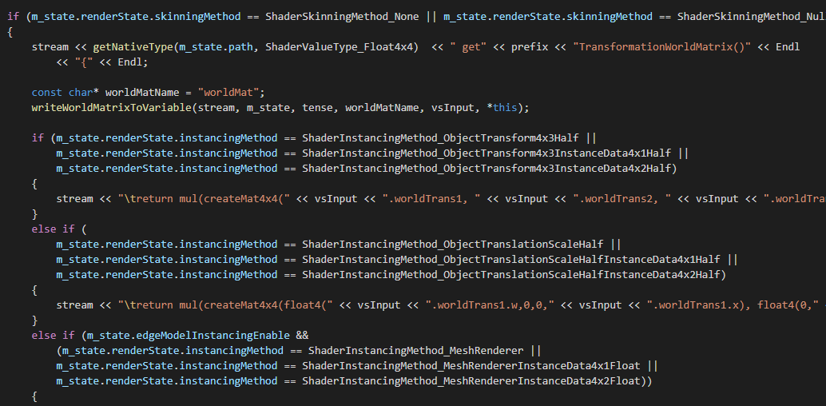
Background: Shaders at Frostbite
Notes:
Endless ifs and switches, hardcoded enums controlling everything, etc. This is not glue code either, this is part of skinning calculations.
This system possessed a number of obvious problems:
Very hard to see what’s going on and what the shader generated by the C++ code would look like, thus making it very hard to understand and maintain.
The iteration times were very poor, owing to one having to close everything down, rebuild the C++ code, recompile all the shaders and then re-launch the game to see the result of any change that you made.
The system had very limited extensibility, owing to the use of for example hardcoded enums.
So we were largely unhappy with this system, which had grown organically over time with ever increasing complexity, and was reaching a point where it was no longer sustainable.

Slide 14
Inspiration: Spire
“A System for Rapid Exploration of Shader Optimization Choices” by Yong He et al [1]
shader SpireExample
{
@MeshVertex vec3 position;
@MeshVertex vec3 colour;
@ModelInstance mat4 modelViewProj;
out @CoarseVertex vec4 projCoord = modelViewProj * vec4(position, 1);
out @Fragment vec4 colourTarget = vec4(colour, 1);
}
Notes:
Fortunately, we came across a couple of other projects that inspired us, and pointed towards a better way of doing things.
The first of these was “Spire”, presented in the SIGGRAPH 2016 paper “A System for Rapid Exploration of Shader Optimization Choices” by Yong He et al [1].
Spire is a new shader language, but rather than having explicit entry points for individual shader stages, instead defines the full pipeline together, declaratively saying what the shader produces, rather than how it produces it.

Slide 15
Inspiration: Spire
interface IMaterial
{
vec3 albedo = vec3(1);
vec3 normal = vec3(0, 0, 1);
float shadow(vec3 l)
{
return 1;
}
}
Notes:
Spire also has a system of “interfaces”, which allows parts of the shader to be swapped in and out as desired. This is presented in the paper as a way to do performance tuning, but it could also be used as a general extensibility mechanism.
The problem with Spire is that Frostbite has 180,000 lines of HLSL code, and porting to Spire would require them all to be rewritten. However, this issue is addressed by our second source of inspiration…

Slide 16
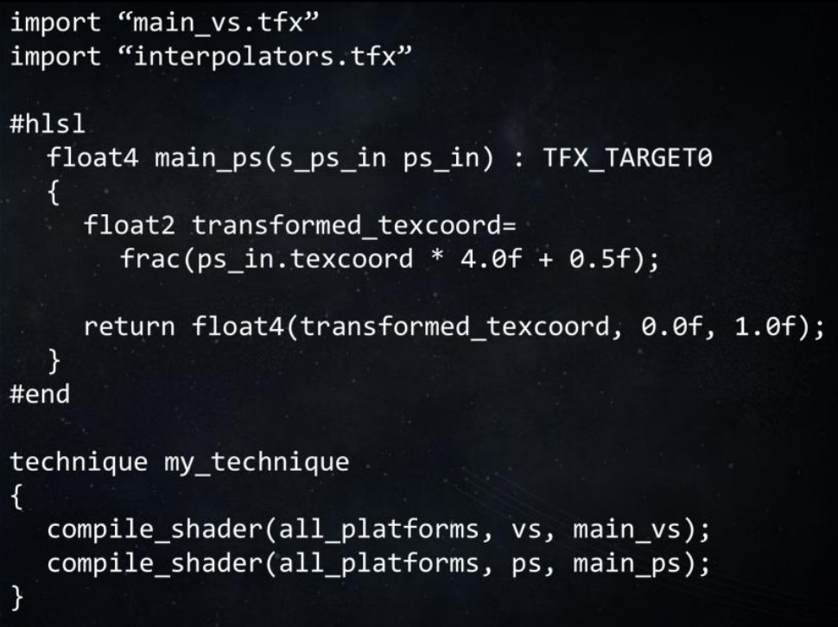
Inspiration: TFX
import “main_vs.tfx”
import “interpolators.tfx”
#hlsl
float4 main_ps(s_ps_in ps_in) : TFX_TARGET0
{
float2 transformed_texcoord =
frac(ps_in.texcoord * 4.0f + 0.5f);
return float4(transformed_texcoord, 0.0f, 1.0f);
}
#end
technique my_technique
{
compile_shader(all_platforms, vs, main_vs);
compile_shader(all_platforms, ps, main_ps);
}
[2]
Notes:
Our second inspiration was Bungie’s “TFX” system, as presented at GDC 2017 [2]. This is also a new shader language, but it keeps the executable code as pure HLSL, with the TFX language “wrapping” that code. This was a very attractive idea to us, as it would allow us to keep the majority of our existing HLSL code.
TFX also has an interface system similar to Spire’s.

Slide 17

Serac
Notes:
So, at the start of 2018 we started work on what became Serac, with the goal of taking the best bits of Spire and TFX.
(Aside: Frostbite tradition to name things after ice things, and a Serac is a giant, dangerous ice monolith, which seemed like an appropriate name for a software system ☺).

Slide 18
Serac
component PixelShader
{
[Domain("PerDispatch")]
extern Texture2D<float4> MyTex;
UvSource source;
#hlsl
float4 load()
{
return MyTex.Load(source.texelPos());
}
#endhlsl
}
Notes:
Here is a simple example of what Serac looks like.

Slide 19
Serac
component PixelShader
{
[Domain("PerDispatch")]
extern Texture2D<float4> MyTex;
UvSource source;
#hlsl
float4 load()
{
return MyTex.Load(source.texelPos());
}
#endhlsl
}
Notes:
At the top level we have ”components,” which are where all the code lives.

Slide 20
Serac
component PixelShader
{
[Domain("PerDispatch")]
extern Texture2D<float4> MyTex;
UvSource source;
#hlsl
float4 load()
{
return MyTex.Load(source.texelPos());
}
#endhlsl
}
Notes:
Components contain blocks of pure HLSL code, which is used to define the component’s member functions.

Slide 21
Serac
component PixelShader
{
[Domain("PerDispatch")]
extern Texture2D<float4> MyTex;
UvSource source;
#hlsl
float4 load()
{
return MyTex.Load(source.texelPos());
}
#endhlsl
}
Notes:
Components can reference other components, like the “UVSource” component in this example.

Slide 22
Serac
component PixelShader
{
[Domain("PerDispatch")]
extern Texture2D<float4> MyTex;
UvSource source;
#hlsl
float4 load()
{
return MyTex.Load(source.texelPos());
}
#endhlsl
}
Notes:
Components can also contain ”externs,” which allow data to be imported from an external source. In this example that is a texture.

Slide 23
Serac
component PixelShader
{
[Domain("PerDispatch")]
extern Texture2D<float4> MyTex;
UvSource source;
#hlsl
float4 load()
{
return MyTex.Load(source.texelPos());
}
#endhlsl
}
Notes:
The HLSL code can then reference the components and externs like they were member variables. So it can load from the texture, and call functions on the referenced component.

Slide 24
Serac
technique MyTechnique
{
VertexTransform vt;
PixelShader ps;
[Domain("Vs")]
[Semantic("SV_Position")]
export float4 Position = vt.pos();
[Domain("Ps")]
[Semantic("SV_Target0")]
export float4 Colour = ps.colour();
}
Notes:
Serac also has ”techniques,” which define a complete shader.

Slide 25
Serac
technique MyTechnique
{
VertexTransform vt;
PixelShader ps;
[Domain("Vs")]
[Semantic("SV_Position")]
export float4 Position = vt.pos();
[Domain("Ps")]
[Semantic("SV_Target0")]
export float4 Colour = ps.colour();
}
Notes:
Like Spire, rather than defining explicit entry points, we instead have ”exports,” which allow us to declare the outputs of the shader.

Slide 26
DAGs and Domains
Vertex
Pos
Vertex
Transform
Position
LocalTo
World
UV0
UvSource
PixelShader
Colour
Notes:
So, if we don’t have explicit shader entry points, how do we generate a shader? Serac is not a direct source-source translation, instead we first put everything a DAG (directed acyclic graph).
Conceptually the construction of the graph is fairly straightforward. We start on the far left with the exports as defined by the technique. Each component they reference become nodes, then component those components reference, etc. Then finally the externs act as inputs, on the far left in this image.

Slide 27
DAGs and Domains
Vertex
Pos
Vertex
Transform
Position
LocalTo
World
UV0
UvSource
PixelShader
Colour
Notes:
Then, to determine what goes into which shader stage, we partition the graph into what we call “domains” (these are identical in concept to what Spire calls “Worlds”). There are domains for pixel shader, vertex shader, etc., seeded by the domain specified by the export.
Once everything has a domain, we can walk the graph and generate code for each stage as we go.

Slide 28
HLSL Parsing
component PixelShader
{
[Domain("PerDispatch")]
extern Texture2D<float4> MyTex;
UvSource source;
#hlsl
float4 load()
{
return MyTex.Load(
source.texelPos());
}
#endhlsl
}
CXXRecordDecl struct PixelShader definition
|-FieldDecl referenced MyTex 'Texture2D<float4>'
|-FieldDecl referenced source 'UvSource'
|-CXXMethodDecl load 'float4 ()'
| `-CompoundStmt
| `-ReturnStmt
| `-CXXMemberCallExpr 'float4'
| |-MemberExpr '<member function>' .Load8
| | `-MemberExpr 'Texture2D<float4>' lvalue ->MyTex8
| | `-CXXThisExpr 'PixelShader *' this
| `-ImplicitCastExpr 'int3' <HLSLVectorSplat>
| `-CXXMemberCallExpr 'int'
| `-MemberExpr '<member function>' .texelPos0
| `-MemberExpr 'UvSource' lvalue ->source8
| `-CXXThisExpr 'PixelShader *' this
Notes:
One additional important detail is that we need to know what functions a component declares, for various reasons. However, those functions are only declared in the HLSL code, so we need to parse that HLSL. To do this we did not want to write and maintain our own HLSL parser, as it would quickly become out-of-date when Microsoft added features to the language.
So instead we use the open-source DirectX Shader Compiler (DXC) libraries. But rather than calling the standard compiler API, we link against the low-level clang API, which allows us to parse the source into an AST, and then extract all the information we need from there.

Slide 29
Component Replacement
interface IPosition
{
float3 position();
}
component MeshPosition : IPosition
{
[Domain("PerVertex")]
extern float3 Pos;
#hlsl
float3 position()
{ return Pos; }
#endhlsl
}
Notes:
Next up is probably Serac’s most important feature, that of “component replacement.”
We start with an interface, which as you’d expect, is just a component without an implementation. In this example we have “IPosition” which represent a simple way to access the position of a vertex in whatever it is we’re drawing.
We can then implement that interface using a component. In this case we have “MeshPosition”, which simply gets the position from a vertex stream. But we could also have a TerrainPosition, which maybe uses a heightmap, or a ParticlePosition, etc.

Slide 30
Component Replacement
interface IPosition
{
float3 position();
}
component PositionUser
{
IPosition p;
#hlsl
float getPosZ()
{ return p.position().z; }
#endhlsl
}
Notes:
When we need to access the vertex position, we simply reference the base interface, IPosition, and call functions on it. The user doesn’t need to worry about if the shader is for a mesh, a terrain, a particle, etc., it just knows that the position is available.

Slide 31
Component Replacement – Implementation
struct PositionUser
{
IPosition p;
float getPosZ()
{ return p.position().z; }
}
Notes:
This is of course fairly standard object-oriented programming, but HLSL does not have virtual functions, so how is this implemented?
When generating HLSL for PositionUser, normally we’d generate something like this, with an HLSL struct and a reference to IPosition.

Slide 32
Component Replacement – Implementation
struct PositionUser
{
MeshPosition p;
float getPosZ()
{ return p.position().z; }
}
Notes:
If IPosition is however overridden with MeshPosition, then we simply generate a reference to MeshPosition instead. Not exactly complicated! But now when calling p.position(), the call is made to MeshPosition’s version of the function as a standard inline HLSL function call just like any other. So we’ve achieved the virtual call semantics that we’re after, without the overhead.
There is an obvious limitation, and that is that there can be only one IPosition implementation per shader permutation. However, that is usually not an issue, because we usually write shaders for meshes or terrain, but not both at the same time.

Slide 33
Component Replacement – Usage
Vertex Data
GI Sample
Mesh
Probes
Terrain
Surfels
Particles
Lightmaps
Directional Lightmaps
Mesh Transform
SH Lightmaps
Rigid
Texture Sample
Skinned
Manual Gradients
Crowd
Notes:
This feature is used extensively throughout Frostbite. A few examples:
Similar to what was shown in the example, we have an interface for accessing vertex data, and different implementations for meshes, terrain, particles, etc. This keeps those systems modular, putting the mesh code with the mesh system, the terrain code with the terrain system, etc. In our previous system much of the code had things like “if (terrain)” checks throughout, meaning that every system needed to know about the subtle differences between meshes and terrain. Using component replacement allows us to isolate those differences to their respective parts of the codebase, making everything easier to understand and maintain.
Within the mesh system, there is a Mesh Transform interface for transforming vertices from local to world space, with built-in implementations for rigid meshes, skinned meshes, etc. But the Crowd extension used by our sports titles adds its own implementation with its custom skinning implementation optimised for a very large number of characters. It can do this without anything in the engine needing to know about it or any engine code being modified, thus achieving the extensibility we were striving for.
Another example is our global illumination system, which has a top-level interface for sampling the GI, and implementations for probes, surfels and lightmaps. But then within those implementations there are further interfaces, for example the lightmap system has another interface with implementations for directional lightmaps and spherical harmonic lightmaps. (Note that this is a simplified view, there are actually over 30 GI-related interfaces!) Combining different interfaces and implementations like this allows us to create different permutations of shaders for different usecases, without sprinkling preprocessor macros everywhere, making things easier to read and understand.
The final example is the Texture Sample component. Unlike the others, this was not originally designed as an interface, it is simply the component used when an artist places a texture into our editor-side shader node graph. Since it simply calls “Sample” on the texture in question, it only works in a pixel shader, where automatic gradients are available. When we came to use this in the new terrain virtual texture system we created for Battlefield 2042, it didn’t work, because it uses a compute shader. At first we weren’t sure how to solve this problem, but then we realised that whilst it’s not an interface, components are basically the same as interfaces, and could be overridden with a custom implementation in the same way. So we wrote a new version of Texture Sample that used manually-computed gradients, and replaced the base implementation with this new one for the terrain VT shaders. That way texture sampling works just as it would in a pixel shader, and the user nor any of the rest of the engine needs to change anything.
In this way our system moves from one of interface overrides to full component replacement – any component can be swapped out for an alternative version where it is needed. This turns out to be very useful and powerful. We currently have over 130 components and interfaces throughout the engine that are overridden at some point.

Slide 34
Externs
component MeshPosition : IPosition
{
[Domain("PerVertex")]
extern float3 Pos;
#hlsl
float3 position()
{ return Pos; }
#endhlsl
}
Notes:
So, we have our nice extensibility mechanism, but what are the implications of this in practice?
If we look again at the example from before, we can see that the actual signature of the “position” function doesn’t pass in any parameters, so the vertex data we need cannot come from there – and if it did, then it wouldn’t work for terrain, or particles, etc., since they would need different data.
Therefore the implication of this free-replacement of components is that we must be able to access the data that we need wherever it is that we need it – we cannot rely on pushing data in from outside. Since we don’t want to use global variables, since that is the model we are trying to move away from, we need an alternative, which is externs.

Slide 35
Externs
component ExternExample
{
[Domain("PerVertex")]
[VertexElement("Position")]
extern float3 Pos;
[Domain("PerDispatch")]
extern float4 Colour;
[Domain("PerView")]
extern StructuredBuffer<Light> Lights;
[Domain("PerInstance")]
extern float3 InstanceTranslation;
}
Notes:
We have a number of different types of extern, which are generally identified by their Domain.
We have vertex elements, as we have already seen, coming from a vertex buffer.
We have uniforms (cbuffer entries) and resources coming from the CPU. The domain additionally encodes the rate-of-change of the data to allow more efficient binding at draw-time.
And we have per-instance data, which comes from an instance buffer.
Handling externs in this way has a number of advantages in addition to enabling component replacement.
The data is encapsulated – private to the component – so can be freely modified without fear of breaking other code.
The data is local to the code using it – we don’t need to declare things in a central cbuffer definition, for example, avoiding the “central definition” problem described earlier. The backend is responsible for gathering all the uniforms together and producing an efficiently packed cbuffer.
We generate C++ code alongside the generated HLSL code that allows data to be bound in a type-safe way, instead of relying on string-matching.
Because the backend handles all the code to actually set and fetch the data when needed, we gain a lot of flexibility to change this where needed.
The simplest way this manifests is that it allows you to change your mind. Say that you declare a “Colour” member that is set pre-draw in a cbuffer, but you discover that it would be more efficient if that data was per-instance to give better batching. All that is required is a single-line change to set the Domain to per-instance instead, and everything is hooked up automatically, without having to refactor a lot of code.
Furthermore, decisions like this can be made at a more global level. For example, we can change a single setting to change all resources to bindless, or change all vertex data to use software vertex fetch instead of the input assembler. This allows us to select the appropriate implementation where it would be most efficient, for example using a different setting on different platforms. No modifications to the user code is required.

Slide 36
Interpolation
component PixelShader
{
[Domain("PerVertex")]
[VertexElement("Texcoord0")]
extern float2 UV0;
}
Notes:
Additionally, accessing data wherever we need it includes accessing vertex data in the pixel shader, which is obviously a very common requirement. This of course means that the data needs to be passed through the vertex shader and interpolated to the pixel shader.

Slide 37
Interpolation
void vsMain(
float2 in_uv0 : TEXCOORD0,
float2 in_uv1 : TEXCOORD1,
out float2 out_uv0 : TEXCOORD0,
out float2 out_uv1 : TEXCOORD1)
{
out_uv0 = in_uv0;
out_uv1 = in_uv1;
}
Notes:
Normally this would require the user to write something like this – adding the vertex data and the interpolators to the vertex shaders entry point signature and writing code to copy the data through. This requirement to modify the entry point of the shader is incompatible with an extensible system, because the entry point may be defined in the core engine, and extensions need to be able to access data without modifying the engine. (This is another example of the “central definition” problem).

Slide 38
Interpolation in Serac
Vertex
Pos
Vertex
Transform
Position
LocalTo
World
UV0
UvSource
PixelShader
Colour
Notes:
For this reason, all interpolation in Serac is automatic. We already have our DAG representing the complete shader, so it is trivial to identify the places where data is being passed from vertex to pixel shader. We simply walk the graph, identify such locations and insert the appropriate interpolators. Automatically packing things into float4s can be done at the same time.

Slide 39
Interpolation in Serac
[AllowedDomains("Vs")]
component CalculateInVs
{
#hlsl
float performCalculationInVs();
#endhlsl
}
Notes:
Another implication of this is that it is trivial to move expensive calculations from the pixel shader to the vertex shader – only a single line of code is required.

Slide 40
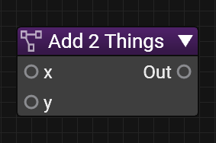
Node Graph Interaction
component Add2Things
{
[Contexts("ShaderEditor")]
[Name("Add 2 Things")]
[Description("Adds two things.")]
float add(float x, float y)
@{
return x + y;
@}
}
Notes:
The last thing I’d like to touch on is how Serac interacts with our shader node graph.
Serac allows very seamless interaction with our node graph, and the first way it allows that is by making it very easy to create new nodes that can be used by artists from the graph. To do this, you just add a component and declare a function in it…

Slide 41
Node Graph Interaction
component Add2Things
{
[Contexts("ShaderEditor")]
[Name("Add 2 Things")]
[Description("Adds two things.")]
float add(float x, float y)
@{
return x + y;
@}
}
Notes:
Add some attributes to tell the system you would like this function to be available as a node in the graph, plus optionally various pieces of metadata, like a friendly name or description (note that this example only shows a small subset of the metadata attributes available).

Slide 42
Node Graph Interaction
component Add2Things
{
[Contexts("ShaderEditor")]
[Name("Add 2 Things")]
[Description("Adds two things.")]
float add(float x, float y)
@{
return x + y;
@}
}
Notes:
And that’s it. The functions signature defines the pins on the node, with in parameters becoming input ports on the node, and out parameters and return values becoming outputs (and inout parameters becoming both inputs and outputs).
This is a very simple toy example, but of course in reality you have full access to all of Serac’s features like externs, component references, etc., meaning that it is very easy to add powerful features to the graph.

Slide 43
Node Graph Interaction
component Add2Things
{
[Contexts("ShaderEditor")]
[Name("Add 2 Things")]
[Description("Adds two things.")]
float add(float x, float y)
@{
return x + y;
@}
}
Notes:
A quick note about this @{ @} syntax – this is an alternative way to embed HLSL in Serac. The difference to the #hlsl blocks seen earlier being that the function declaration is on the Serac side of things, with only the function’s body being in HLSL. This makes it easier to attach attributes to the function and its parameters, so is generally preferred for functions used as graph nodes.

Slide 44
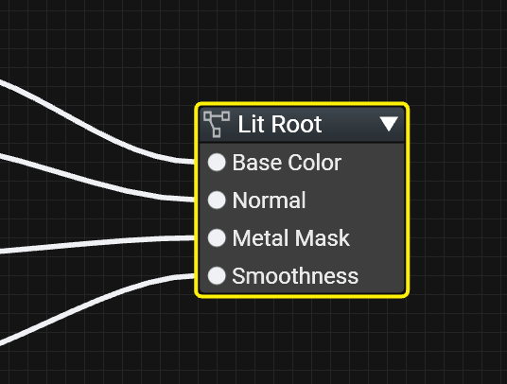
Graph-Implemented Interfaces
interface IMaterial
{
float3 baseColor();
float3 normal();
float metalMask();
float smoothness();
}
Notes:
Adding new nodes handles the node graph calling into Serac code, but how does Serac code invoke a node graph in the first place?
The answer is that we use component replacement again.
If we define a standard Serac interface, then instead of implementing it with a Serac component, as we saw earlier in the talk, we can implement it using a node graph.
The user adds what we call a “root node” to the graph, with ports automatically populated from the Serac interface. The connections to that node then define what will be returned by the functions in the interface. And Serac code that needs to call the interface’s functions does so just as if it was any other Serac interface, it does not even need to know that it might be implemented with a node graph.
On the backend the system generates a dummy component to implement the interface, with code generated for each function that evaluates the appropriate nodes in the graph.
These two features combined give us seamless interface between Serac and the node graph in both directions, and at no point does one need to write a single line of manual code generation – everything is defined in pure Serac.

Slide 45

Conclusions

Slide 46
Current Status
Limited use cases shipped in Battlefield 2042
Entire engine now ported
In use in production, will ship in upcoming titles
Notes:
Battlefield 2042 used Serac in limited use cases, most notably terrain virtual texture composition, making it the first game to utilise Serac
The rest of the engine has since been ported. The system is being using in production and will ship in those upcoming titles. Note that this only refers to shaders using the old C++-based HLSL generation system – Frostbite also contains handwritten pure-HLSL shaders, which have not all been ported (although we would like to port at least some of them eventually, to gain access to the benefits described earlier).

Slide 47
What Went Well
It actually works!
Well-liked by engineers
  Write code directly
  Live edit
Component replacement used extensively
  Adds extensibility and modularity
Accessible to TAs, powerful enough for engineers
Notes:
Looking back, a number of things went well.
The system works and has shipped. Definitely important!
Engineers who’ve used the system seem to like it, especially compared to the old system. Being able to write code directly instance of writing code-that-generates-code is a much nicer way of working, and being able to edit shader live and see the results immediately instead of having to restart everything is of course a significant productivity benefit.
As mentioned earlier, component replacement has been very successful – more so than originally expected – and is used extensively across the engine.
Despite being original designed for engineers, Serac has also been embraced by our technical artists. The seamless node graph interaction offered by Serac allows the TAs to extend the graph with new features without always requiring an engineer to get involved.

Slide 48
What Went Less Well
Non-obvious component semantics
  Components are not classes
Fake virtual calls are not real virtual calls
Auto-interpolation is a blessing and a curse
Verbose generated code
Notes:
Of course not everything went well.
The semantics of Serac components can be a bit non-obvious, particularly at first. It is common for engineers to see Serac components and think they’re just like classes in something like C++, and try to do things like create them on the stack and pass them around between functions. But components don’t really work like classes, so trying to do those things will fail. Components are basically singletons, designed to encapsulate code, but not state. This adds a learning curve for engineers trying to get up to speed with Serac.
The “fake” virtual calls used by component replacement are not real virtual calls, and that illusion breaks down in some scenarios. Specifically, when a component calls an overridden function on itself (a “this call”), then it will call the base version of the function instead of the override (see bonus slide for an example of this). We have a workaround for this situation, but it’s pretty ugly.
Auto-interpolation is a very useful feature, but it does make it very easy to accidentally add a large number of interpolators without realising it. In hindsight, perhaps a “semi-automatic” system requiring explicit opt-in may have been preferable.
Finally, the HLSL code generated by Serac tends to be rather verbose, making it difficult to follow, for example when debugging it.

Slide 49
Future Work
More flexible component replacement
Mesh Shaders
General usability improvements
Notes:
In the future, we’d like to address the limitation of only having a single implementation of an interface per shader – usually this isn’t an issue, but there are cases where it is. For example, we’d like to allow implementations to nest within each other, or perhaps have an array of implementations that you could loop over.
Mesh shaders are an interesting case for Serac, because you’d want a hybrid of a compute shader, with explicit control to allow things like LDS and wave-wide operations, and a vertex shader, with the automatically-generated plumbing for things like interpolators. I have some ideas as to what this could look like, but it’s not something we’d had time to look at in detail yet.
Finally, there are of course many small usability improvements we’d like to make.

Slide 50
Shader Languages in 2024
Serac’s focus is software engineering
Not traditional focus of shader languages
Its importance is likely only to increase
Serac is a solution to Frostbite’s problems, not a general solution
More research required!
Notes:
To finish, I’d like to take a step back and look at the wider ecosystem of shader languages in 2024.
As hopefully has been clear, Serac’s focus is on what I call software engineering problems – issues that occur only when developing a large codebase and maintaining it over an extended period of time. Such issues have not traditionally been the focus of shader languages – and with good reason. HLSL was introduced in 2002, when we were still on Shader Model 2.0, with its very limited instruction counts. Obviously with such simple shaders there weren’t many software engineering concerns!
But in the 22 years between then and now what we think of as a “shader” has changed dramatically. And yet the languages we use to author them are largely unchanged. And these problems are only going to get more important going forward – complexity is only going to increase, and things like live service games means that our codebases are no longer “one and done,” they need to be maintained over multiple years.
I’m certainly not claiming that Serac is a solution to these problems – far from it, it is a solution for a specific set of problems faced by Frostbite. But I hope that this talk has brought some attention to this area, which is one I truly believe is one worthy of more focus and attention. It would be remiss of me not to mention the great work Slang is doing in this area, and the improvements to HLSL in HLSL 2021, but I think we are a long way from being able to declare this a solved problem. It may not be a sexy topic, but it is an important one!

Slide 51
Thanks
References
Natasha Tatarchuk & Stephen Hill
Spire & TFX authors
Microsoft for open-sourcing DXC
Everyone at Frostbite Rendering
  Dan Elksnitis
  Andreas Asplund
  Andreas Tarandi
  Darren Sweeney
  Johan Sichtling
  Emma Dalkvist Fagerholm
  Jens Olsson
  Victor Lopez
  Adam Carlson
  Matthias Moulin
[1] Yong He, Theresa Foley, Kayvon Fatahalian.
A system for rapid exploration of shader optimization choices
http://graphics.cs.cmu.edu/projects/spire/
[2] Natalya Tatarchuk, Chris Tchou. TFX: Destiny Shader Pipeline
https://advances.realtimerendering.com/destiny/gdc_2017/index.html
[3] Andrew Lauritzen. Future Directions for Compute-for-Graphics
https://www.ea.com/seed/news/seed-siggraph2017-compute-for-graphics
Notes:
Thanks to Natasha Tatarchuk for her tireless work organising this course year after year, and to Stephen Hill for the great feedback on this talk.
Thanks to the Spire and TFX authors for sharing their work.
Thanks to Microsoft for their decision to open source the HLSL compiler, thus allowing us to use it to parse our HLSL code.
And thanks to everyone at Frostbite Rendering who worked on Serac or provided invaluable feedback on its design, particularly those listed here.

Slide 52

Questions?
Contact:
simon.taylor@frostbite.com
simontaylor8157@gmail.com

Slide 53
Bonus Slides

Slide 54
Fake virtual calls are not real virtual calls
component SelfCaller
{
#hlsl
float3 getVector();
float3 getNormalisedVector()
{
return normalize(getVector());
}
#endhlsl
}
struct SelfCaller
{
float3 getVector();
float3 getNormalisedVector()
{
return normalize(getVector());
}
}
Notes:
This is an example of a case where the “fake virtual call” illusion breaks down. Note that the call to getVector will not call any overridden version of getVector in a child component, as it is going through the implicit “this” rather than an explicit reference that we have swapped out for the child component.

Slide 55
Culling
interface ISurface
{
float4 colour();
float alpha();
}
component ZOnly
{
ISurface surface;
#hlsl
float ps()
{
clip(surface.alpha() - 0.5f);
return 0;
}
#endhlsl
}
Notes:
Generally the HLSL compile is very good at deadstripping away unused parts of a shader. However, there are certain things that cannot be stripped by the compiler – for example, it cannot remove interpolators, because that would change the input/output signature of the shader, which must match between VS and PS (and the compiler only sees one at a time). Therefore, we run our own culling pass prior to code generation to remove unused parts of the shader.
In the example shown here, the interface defines colour and alpha, but only alpha is actually called. The implementation of “colour” might be a very complex graph with multiple interpolators, textures, etc. The culling pass identifies that nothing connected to colour is used, so can be stripped away, so none of those interpolators will be generated, for example.
This turns out to be very important in practice, particularly for things like z-only shaders.

Slide 56
Usage Analysis
component Comp
{
extern float B;
OtherComp oc;
#hlsl
float a() { return 7.0f; }
float b() { return B; }
float c() { return oc.c(); }
#endhlsl
}
|-CXXMethodDecl a 'float ()'
| `-CompoundStmt
| `-ReturnStmt
| `-FloatingLiteral 'float' 7.000000e+00
|-CXXMethodDecl b 'float ()'
| `-CompoundStmt
| `-ReturnStmt
| `-ImplicitCastExpr 'float' <LValueToRValue>
| `-MemberExpr 'float' lvalue ->B
| `-CXXThisExpr 'Comp1 *' this
`-CXXMethodDecl c 'float ()'
`-CompoundStmt
`-ReturnStmt
`-CXXMemberCallExpr 'float'
`-MemberExpr '<bound member function type>' .c
`-MemberExpr 'OtherComp' lvalue ->oc
`-CXXThisExpr 'Comp1 *' this
Notes:
For culling to work, we need to analyse the HLSL code to know what is used and what is now.
We do this by extracting the information at the same time as we parse the HLSL to find the functions. For each Serac function, we determine what externs it references, and what functions it calls on other components.
The advantage of doing it like this is that it’s fast (since we’re parsing the HLSL anyway) and it’s pretty simple to implement. The downside is that it does not take flow control or dead code elimination into account. Originally we had a more complicated system that used the full HLSL compiler in order to rectify that deficiency, but it proved to be too slow to use in practice, so it was removed. The simple system we have now works well and is enough in 99% of cases.

