Slide 2
Deferred Lighting in Uncharted 4
Ramy El Garawany

Slide 4
Deferred lighting
Introduction

Slide 6
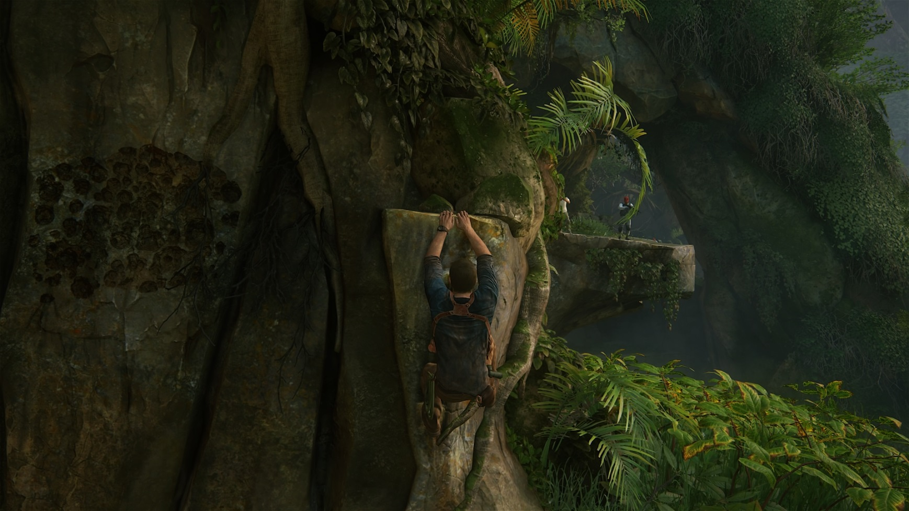

Slide 7
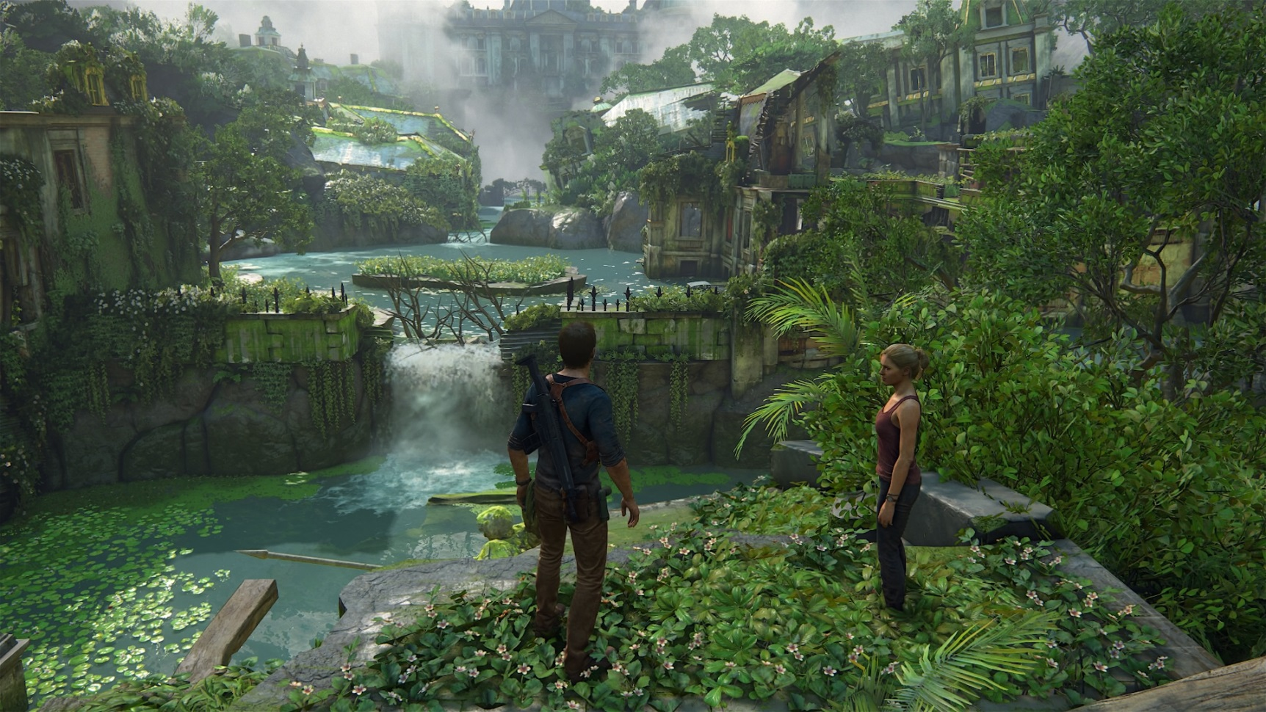

Slide 9
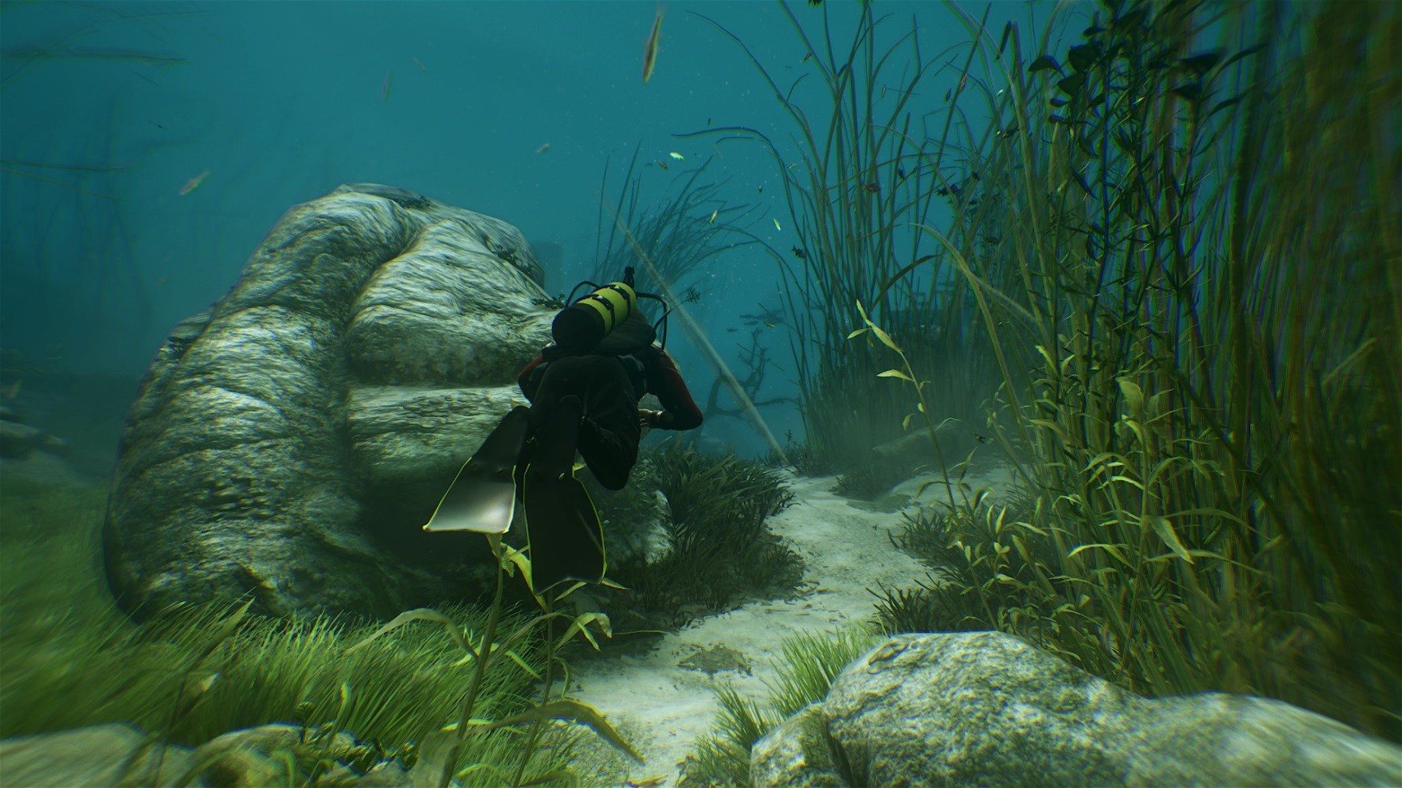

Slide 10
Goals and Motivations
Many screen-space effects that need to read/modify material data:
Particles
Decals
More importantly: SSR, cubemaps, indirect shadows, etc…
Can’t get away from saving material data.

Slide 11
Options
Experimented with a “cheap” GBuffer pass that had few outputs (color, normal, dominant indirect direction, etc…) accompanied by a Forward geometry pass
Geometry passes aren’t cheap in current hardware
We have… dense objects

Slide 13
Options
The complexity of the lighting in a Forward shader adds incredible register pressure, which slows down the geometry pass even further.
Is there a way to have the best of both worlds?
Notes:
No. But we can come close ☺

Slide 14
Solution
Go fully deferred!

Slide 15
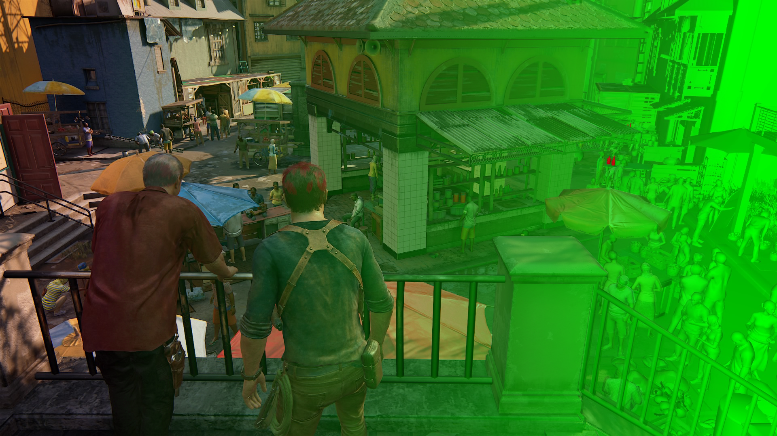

Slide 16
Solution
GBuffer must unfortunately support all of the materials in the game..
Thankfully we have lots of memory and lots of bandwidth.

Slide 17
GBuffer
16 bits-per-pixel unsigned buffers.
Constantly moving bits around between features during production. Lots of visual tests to determine exactly how many bits were needed for the various features.
Heavy use of GCN parameter packing intrinsics.
Check out “The Technical Art of Uncharted 4” on Wednesday for more details.
GBuffer 0
GBuffer 1
R | r |  | g
G | b |  | spec
B | normalx |  | normaly
A | iblUseParent | normalExtra | roughness
R | ambientTranslucency |  | sunShadowHigh |  | specOcclusion
G | heightmapShadowing |  |  | sunShadowLow | metallic
B | dominantDirectionX |  |  | dominantDirectionY
A | ao | extraMaterialMask |  | sheen | thinWallTranslucency

Slide 18
Optional GBuffer
A third optional GBuffer is used by more complicated materials. It is interpreted differently based on the type of the material.
Examples of materials that use the optional GBuffer are fabric, hair, skin, and silk.
The interpretation of the GBuffer is mutually exclusive (i.e. cannot have fabric and skin in the same pixel). This constraint is enforced in the material authoring pipeline.
The optional GBuffer is neither written to nor read from if the material doesn’t need it.

Slide 19
Problems
Deferred shader gets very bloated very quickly.
Has to support skin, fabric, plants, metal, hair, etc… Not to mention all the light types

Slide 20
Deferred Pipeline
Save off a material “ID” texture.
Not really material ID. Just a bitmask of used shader features
12-bits compressed into 8-bits (by taking into account feature mutual exclusivity)

Slide 21
Classification
For each 16x16 tile, use the material mask for the entire tile to index into a lookup table.
The lookup table is pre-calculated. It holds the simplest shader possible that supports all the features in the tile.
uint materialMask = DecompressMaterialMask(
materialMaskBuffer.Load(int3(screenCoord, 0)));
uint orReducedMaskBits;
ReduceMaterialMask(materialMask, groupIndex, orReducedMaskBits);
short shaderIndex = shaderTable[orReducedMaskBits];
if (groupIndex == 0)
{
uint tileIndex =
AtomicIncrement(shaderGdsOffsets[permutationIndex]);
tileBuffers[shaderIndex][tileIndex] =
groupId.x | (groupId.y << 16);
}

Slide 22
Classification
Atomically push the tile coordinate to the list of tiles that that shader will light.
Atomic integer will also be the dispatch count for a dispatchIndirect argument buffer.
uint materialMask = DecompressMaterialMask(
materialMaskBuffer.Load(int3(screenCoord, 0)));
uint orReducedMaskBits;
ReduceMaterialMask(materialMask, groupIndex, orReducedMaskBits);
short shaderIndex = shaderTable[orReducedMaskBits];
if (groupIndex == 0)
{
uint tileIndex =
AtomicIncrement(shaderGdsOffsets[permutationIndex]);
tileBuffers[shaderIndex][tileIndex] =
groupId.x | (groupId.y << 16);
}

Slide 23
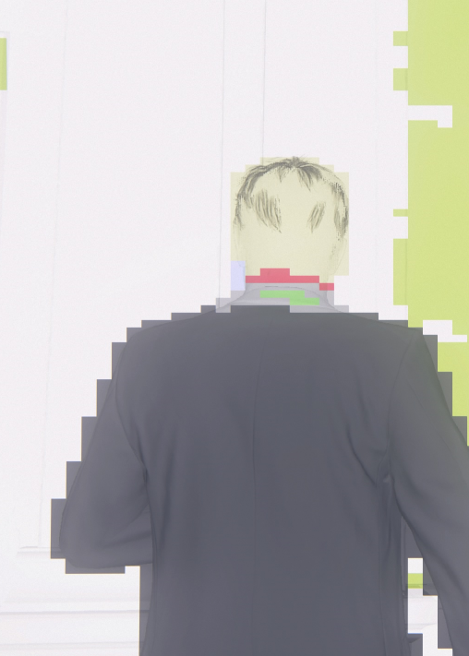
Classification
Already a huge improvement.
Similar techniques have been used before [1].

Slide 24
Optimization
Take a fabric shader for example.
For tiles where all pixels are fabric (i.e. have the fabric material mask bit set to 1), all this branch does is add overhead.
We know that it should always evaluate to true.
if (setup.materialMask.hasFabric)
{
...
}

Slide 25
Optimization
Create another precomputed table that is used when all pixels in the tile have the same material mask: the “branchless” permutation table.
Check for that condition during classification and use the appropriate table.
Not only removes the branch, but opens up opportunities for global compiler optimizations.
Before:
short shaderIndex = shaderTable[orReducedMaskBits];
After:
bool constantTileValue = IsTileConstantValue( … );
short shaderIndex = constantTileValue?
branchlessShaderTable[orReducedMaskBits] :
shaderTable[orReducedMaskBits];

Slide 26
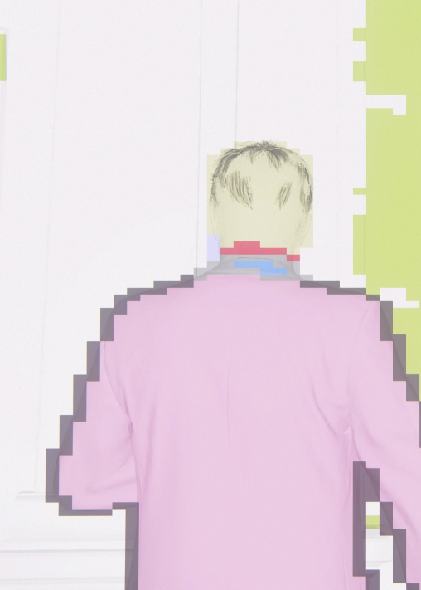
Optimization

Slide 27
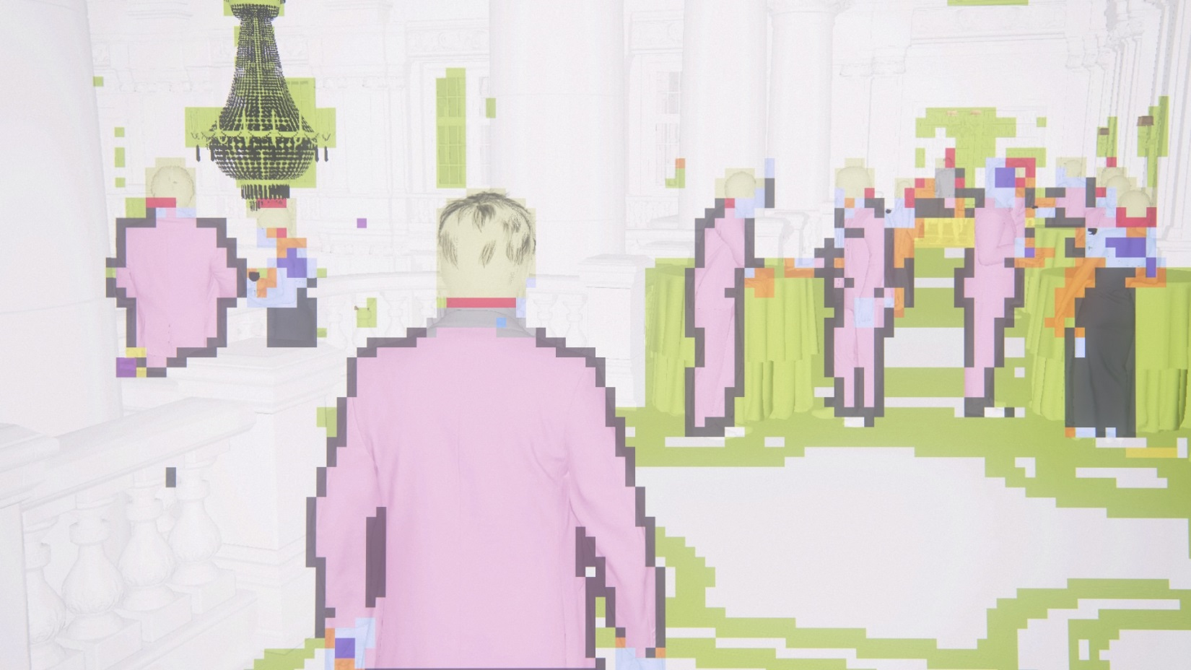

Slide 28
Results
Performance improvement in worst-case expensive cutscene:
4.0ms without any optimizations (“uber shader”)
3.4ms (-15%) by picking the best shader
2.7ms (-20%, -30% overall) by using branchless shaders
On average, branchless shaders give an additional 10-20% improvement, for very little cost. While picking the best shader gives, on average, 20-30% improvement.

Slide 29
Results
Allows us to have material complexity and variation without affecting base performance.
Adding complexity to one shader (e.g. silk shader), doesn’t affect the rest of the game.
Interface implemented cleanly and transparently.
After a couple of iterations ☺
Bonus: Classification compute shader runs on async compute – barely affects runtime.

Slide 30
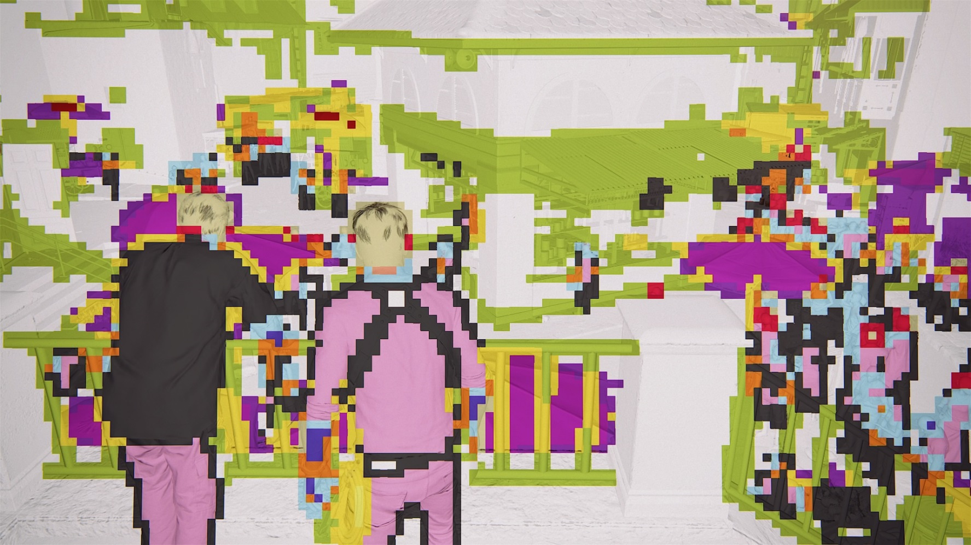

Slide 31
Discussion
Can take the system even further.
Dispatch different compute shaders based on light-type as well. Minority of light types add the majority of the complexity and cost.
Iteration is hard.
Really learn the value of one bit ☺.
Eventually reached a good system.
Simpler is always better. Could have sacrificed certain features for slight performance gain.

Slide 32
Specular occlusion

Slide 33
Specular Occlusion

Slide 34
Specular Occlusion
Cubemaps don’t take into account local occlusion.
The solution is to sometimes add more cubemaps in/around occluders
Not always possible due to how the geometry is arranged.
Not to mention performance/memory costs
Could use only an AO value at the sample position. E.g. Frostbite’s specular occlusion[2].
Works well, but what about directionality?

Slide 35
Specular Occlusion (Top View)

Slide 36
Formulation
In order to get more accurate occlusion, we will somehow occlude the specular lobe with something that encodes how and in what direction a sample point is occluded.

Slide 37
Formulation
Reflection Cone
Cone of least occlusion. “Bent Cone”

Slide 38
Bent Cone
During offline processing, we generate the bent cones using the method outlined in [5]
The direction of least occlusion is defined as: $N_{ss}\left(i\right)≔{\sum_{j∈P_{i}}{d\left(∆_{ij}\right)}}^{−1}\sum_{j∈P_{i}}{\frac{∆_{ij}}{\left|∆_{ij}\right|}d\left(∆_{ij}\right)}$ Where $d\left(\vec{v}\right)$ is 1 if the ray’s length is less than a certain distance
And the angle: $C\left(i\right)≔(1 −\max\left(0, 2\left|N_{ss}\left(i\right)\right|−1\right))\frac{π}{2}$

Slide 39
Reflection Cone
Use an idea similar to Drobot’s fit for Phong/GGX lobe [3]. Find the cone angle that fits 90% of the lobe energy.
We found a simple fit for GGX:

Slide 40
Intersection
Intersect both cones.
Well, get the solid angle of the intersection.

Slide 41
Intersection
We can calculate the solid angle of two intersecting cones using the following formula [4].
Given the two cone angles, $θ_{1}$and $θ_{2}$, and the angle between them, $α$, the solid angle of the intersection is on the right.
Notes:
Reference the original paper for more detailed notes, and numerical precision issues, etc..

Slide 42
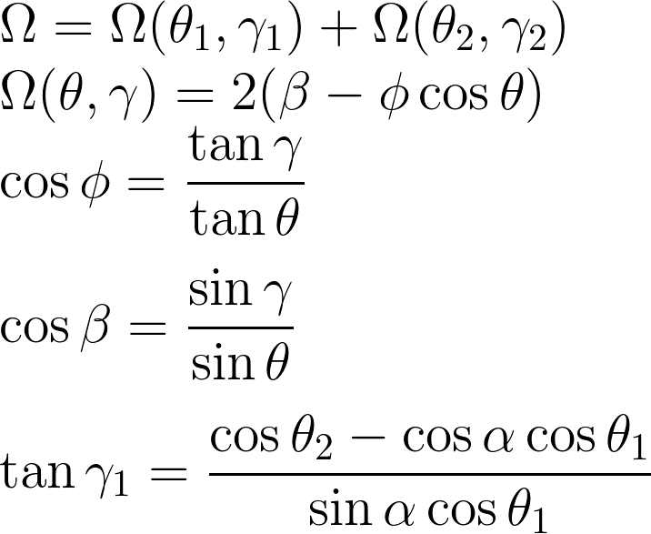
Implementation
Do a slight change of variables to take in cos/sin theta as inputs to a lookup texture.
Divide the solid angle of the intersection by the solid angle of the BRDF cone, ($\frac{1 −\cos{θ_{1}}}{2π}$), in order to get the percentage occluded.
float IntersectionSolidAngle(float cosTheta1, float cosTheta2, float cosAlpha)
{
float sinAlpha = sqrt(clamp(1.f - cosAlpha*cosAlpha, 0.0001f, 1.f));
float tanGamma1 = (cosTheta2 - cosAlpha*cosTheta1) / (sinAlpha*cosTheta1);
float tanGamma2 = (cosTheta1 - cosAlpha*cosTheta2) / (sinAlpha*cosTheta2);
float sinGamma1 = tanGamma1 / sqrt(1 + tanGamma1*tanGamma1);
float sinGamma2 = tanGamma2 / sqrt(1 + tanGamma2*tanGamma2);
// Now we compute the solid angle of the first cone
// (This is divided by 2*kPi. That factor is taken into account in the texture)
float solidAngle1 = 1 - cosTheta1;
return (SegmentSolidAngleLookup(cosTheta1, sinGamma1) +
SegmentSolidAngleLookup(cosTheta2, sinGamma2)) / solidAngle1;
}

Slide 43
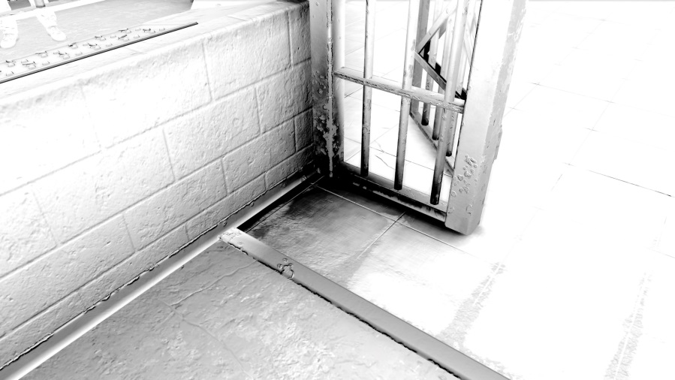
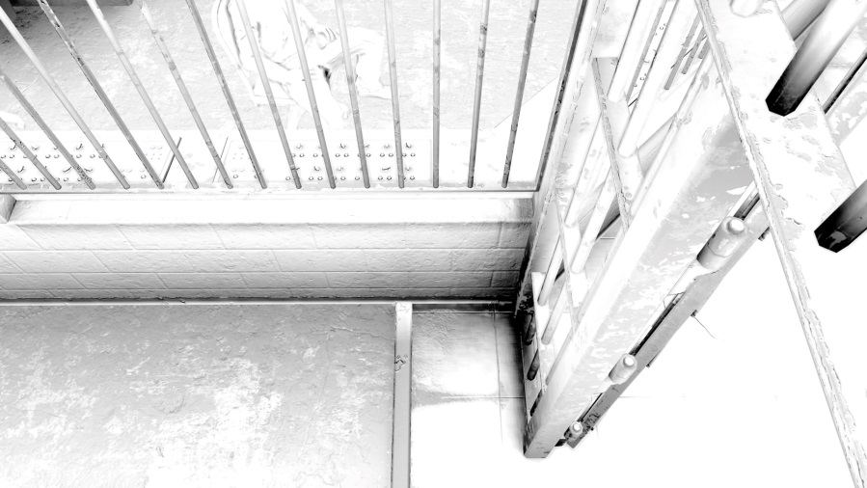
Results

Slide 44
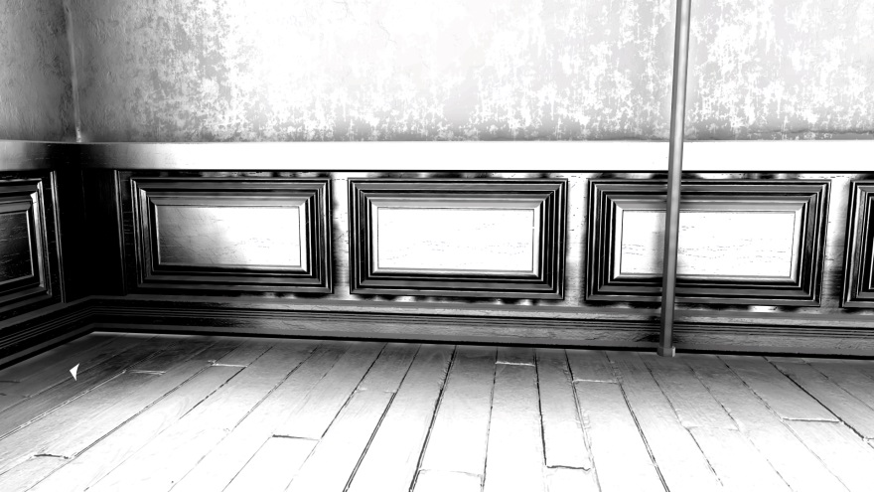
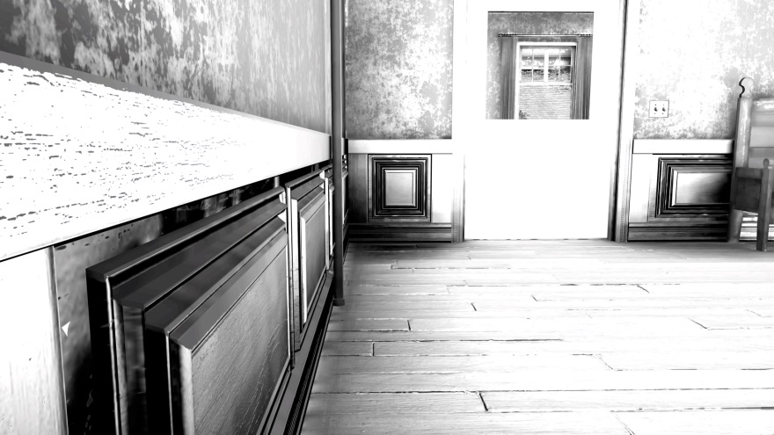
Results

Slide 45
Discussion
Fallback to directional lightmap spec when sample is very occluded
Preserves energy, but reflection detail is lost.
Looks good most of the time!

Slide 46
Discussion
The method is relatively expensive.
Function gets simplified if one parameter is fixed. Could perhaps fix the roughness parameter, then adjust the final result based on roughness.
It got disabled on some levels for performance reasons.
Does not work on dynamic objects (e.g. characters). In that case, it falls back to the simpler occlusion method mentioned earlier.
Not physically based.

Slide 47
Discussion
But, solves a lot of occlusion problems.
Can be taken forward
More accurate occlusion using some other representation
Go in a completely different direction

Slide 48
Special Thanks
Carlos Gonzalez-Ochoa
Ke Xu
Marshall Robin
Vincent Marxen
Wang Fengquan
Waylon Brinck

Slide 49
We’re Hiring!
http://www.naughtydog.com/work

Slide 50
Questions?

Slide 51
References
[1] SPU-Based Deferred Shading in Battlefield 3 http://www.dice.se/news/spu-based-deferred-shading-battlefield-3-playstation-3/
[2] Moving Frostbite to PBR http://www.frostbite.com/2014/11/moving-frostbite-to-pbr/
[3] GPU Pro 5: Physically Based Area Lights, Michal Drobot
[4] Solid Angle of Conical Surfaces, Polyhedral Cones, and Intersecting Spherical Caps http://arxiv.org/ftp/arxiv/papers/1205/1205.1396.pdf
[5] Bent Normals and Cones in Screen-Space https://people.mpi-inf.mpg.de/~oklehm/publications/2011/vmv/SS_Bent_Cones_Klehm11.pdf

