Slide 2
Accelerating Rendering Pipelines Using Bidirectional Iterative Reprojection
Lei Yang Bosch Research (Palo Alto, CA,USA)
Huw Bowles Gobo Games (Brighton, UK)
Additional contributors:
Kenny Mitchell Pedro Sander Disney Research Hong Kong UST
Notes:
Hello, I’m Lei Yang from Bosch Research in Palo Alto, And I’m with Huw Bowles who is from Gobo Games in Brighton UK.
In this talk we will present some general tools that accelerate real-time rendering pipelines by reusing rendered results across frames.
The key idea behind these tools is a technique called image-based iterative reprojection.

Slide 3
Overview
Introduction
Iterative reprojection
Bidirectional reprojection
Conclusion
Notes:
So we will first introduce the background, and then discuss how to transfer rendering results from one frame to another using iterative reprojection.
And then based on this technique, we introduce a frame interpolation method called bidirectional reprojection. In the end we conclude with some results and discussions.

Slide 4
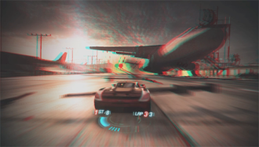
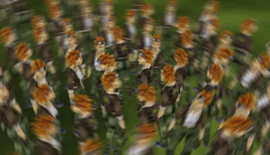
The papers
Two papers (concurrent work) on iterative reprojection:
Iterative Image Warping H. Bowles, K. Mitchell, B. Sumner, J. Moore, M. Gross Computer Graphics Forum 31(2) (Proc. Eurographics 2012)
Image-space bidirectional scene reprojection L. Yang, Y.-C. Tse, P. Sander, J. Lawrence, D. Nehab, H. Hoppe, C. Wilkins. ACM Transactions on Graphics, 30(6) (Proc. SIGGRAPH Asia 2011)
Notes:
This talk is based on two recent concurrent works. They both propose the idea of iterative reprojection, but focusing on different aspects.
The work by Huw and colleagues titled “Iterative Image Warping” focuses more on a theoretical analysis and a generalized robust image warping algorithm.
The one from me and colleagues titled “Image-space bidirectional Scene Reprojection” mainly discusses this reprojection algorithm in the context of frame interpolation.
In this talk we will cover the gist of both papers. Next Huw will give an introduction to the problem and discuss the main reprojection algorithm.

Slide 5
Split/Second
Notes:
Hi everyone. So real-time rendering is incredibly resource intensive, in both memory and computation. This image is from Split/Second, a racing game released by Black Rock Studio. The Xbox and PS3 versions of this game ran at 30fps, which is much lower than we would have liked. We get strong strobing artifacts that must be addressed with motion blur, and its difficult for the player to read the motion of the game and to track objects. Unfortunately, we couldnt have achieved the same graphical quality at a higher framerate such as 60fps, within the project’s time and budget.

Slide 6
Traditional pipelines
Current graphics architectures require brute force rendering of every frame, so they don’t scale well to high frame rates
However, nearby frames are usually very similar thanks to temporal coherence
We can synthesize a plausible frame without performing the rasterization and shading, by reusing rendering results from neighbouring frame(s)
Notes:
Why is that? Well, current graphics pipelines do not scale well in the number of frames. All projection, rasterization and lighting simulation is repeated more or less from scratch for every frame, with little reuse of rendering results across frames. On the other hand, nearby frames of an animation are highly similar. So a lot of computation is repeated even if the differences between frames are negligible. We propose a solution that can use rendering results from one or more frames to synthesize new frames, and that maps efficiently to current rendering architectures.

Slide 7
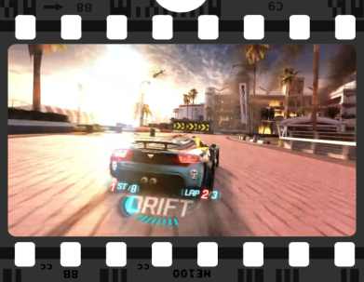
Frame interpolation
Rendered
Frames
Interpolated
Frame(s)
Notes:
So broadly speaking, we propose to take the rendered 30Hz frame on the top row, and insert interpolated or extrapolated inbetween frames.
These new frames are synthesized by transferring shading from rendered frames.

Slide 8
Real-time reprojection strategies
Rasterize scene from target viewpoint and sample shading from the source viewpoints (Nehab2007)
Warp the existing frames using per-pixel primitives into the target viewpoint (Mark1997)
Use some kind of approximation (Andreev2010, Didyk2010)
Warp frames using an iterative search (Yang2011, Bowles2012)
See papers for detailed comparison
Notes:
This has been studied in the past, and I’ll give a really quick overview here, please see the papers for a detailed comparison.
Requires scene geometry to be processed
Uses per-pixel triangulation or splats. Faster but still heavy workload
Theres a couple of recent approaches that approximate the reprojection in space or time. I’m referring to these as approximations because they don’t attempt to perform an accurate reprojection. We provide more comparison in our paper.
Ours [also an approximation, but closer]

Slide 9
Overview
Introduction
Iterative reprojection
Algorithm
Iteration initialisation
Disocclusion handling
Bidirectional reprojection
Conclusion
Notes:
I’ll now introduce iterative reprojection, the algorithm we use to efficiently transfer shading results across frames.

Slide 10
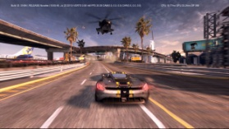
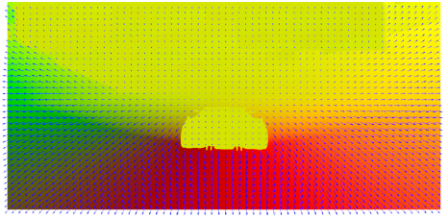
Iterative reprojection
Rendered
Frame
[t]
Motion
Vectors
$p_{src}$
$$V_{}$$
Target
Frame
[t+$α$]
?
$p_{tgt}$
$$p_{tgt}=p_{src}+V(p_{src})$$
Notes:
* So, lets say we have a rendered frame generated using some renderer. How to synthesize a new frame given a rendered frame?
* MVs, a common byproduct of rendering pipelines, provide a mapping from source to target frame.
* Use following terminology.

Slide 11
Image-based iterative reprojection
Know mapping of each pixel via equation:
Run a GPU shader over the target frame: $p_{tgt}$ known
Problem: How to solve for $p_{src}$?
$$p_{tgt}=p_{src}+V(p_{src})$$
Notes:
Explain that Ptgt is destination coordinate in the reprojected frame of the pixel at Psrc in the source frame(s)
Cant simply invert to get Xsource as we dont in general have a closed form expression for V().

Slide 12
Iterative solution
Know mapping of each pixel via equation:
Idea - Solve iteratively:
Fixed Point Iteration
$$p_{tgt}=p_{src}+V(p_{src})$$
$${p_{src}}_{}^{i+1}=p_{tgt}−V({p_{src}}_{}^{i})$$
Notes:
Idea – write this as a recurrence relation and solve iteratively. We start with an initial psrc, and then we compute successively better approximations by applying the formula.

Slide 13
Iterative solution
Algorithm
Pick a start point: ${p_{src}}_{}^{0}$ (e.g. $p_{tgt}$)
Apply recurrence relation until convergence: ${p_{src}}_{}^{i+1}=p_{tgt}−V({p_{src}}_{}^{i})$
Motion flow
Iterative reprojection
$$V({p_{src}^{}}^{0})$$
$$V({p_{src}^{}}^{1})$$
$${p_{src}^{}}^{0}$$
$$V({p_{src}^{}}^{2})$$
$$p_{tgt}$$
$${p_{src}^{}}^{1}$$
$${p_{src}^{}}^{2}$$
$${p_{src}^{}}^{3}$$
$$p_{src}$$
Notes:
Describe target pixel, source pixel.

Slide 14
Single frame reprojection – Split/Second scene (6x slow motion)
Video
Hz (With reproj. frames) Hz (Original)
Notes:
Show S/S temporal reprojection video.
[Lei: explain every other frame Is generated purely by reprojection]

Slide 15
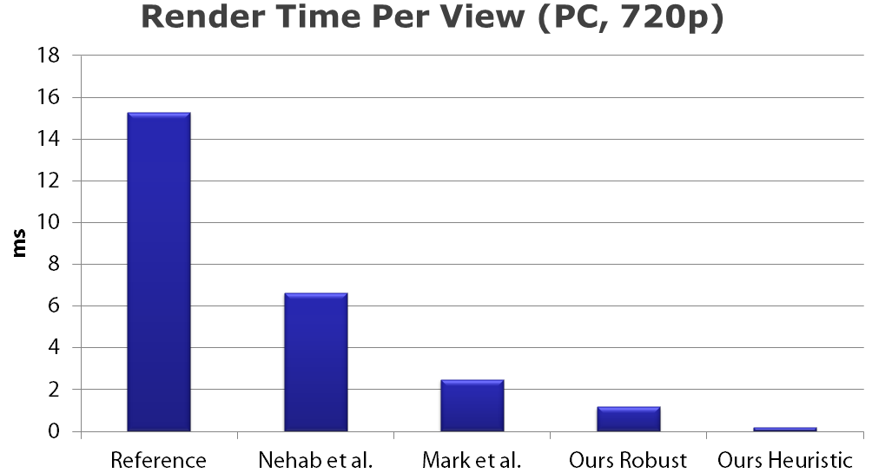
Performance
Notes:
The main advantage of iterative reprojection is a significant speedup over existing approaches. See the papers for performance comparisons.

Slide 16
Considerations
Iteration initialisation
Disocclusions

Slide 17
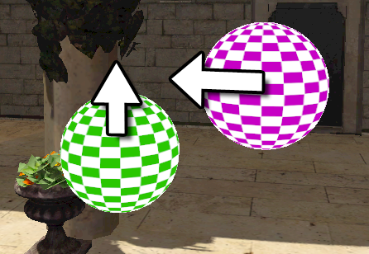
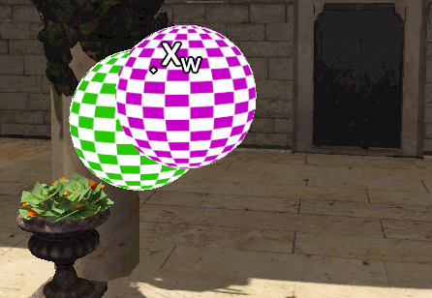
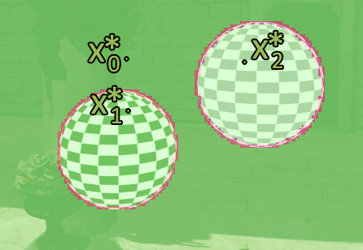
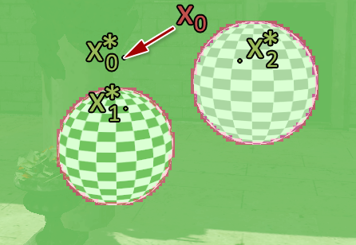
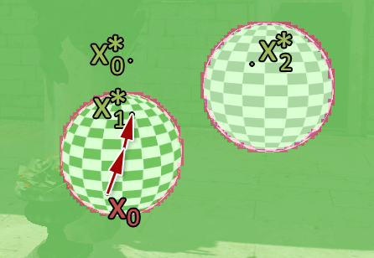
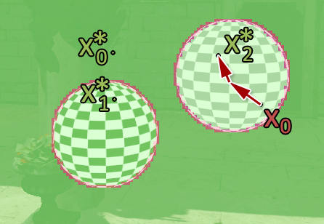
Iteration initialisation
Source
Target
Source Analysis
Background
Green Sphere
Purple Sphere
Notes:
Roughly speaking, FPI converges greedily to the nearest solution. Example with two spheres that are moving as shown in the source image.
And end up in overlapping configuration in target image as shown
Three solutions – three surface points in source image become colocated in target image. Motion boundaries create discontinuities in the MVs, shown in red
Start iterating in each region returns closest solution
Want to start iterating here
See Bowles2012 for details.

Slide 18
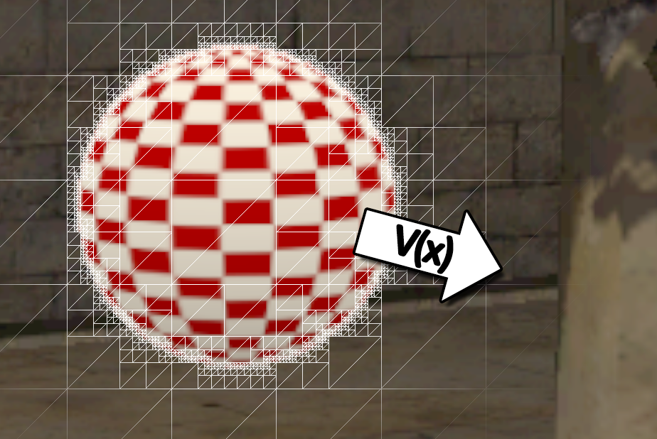
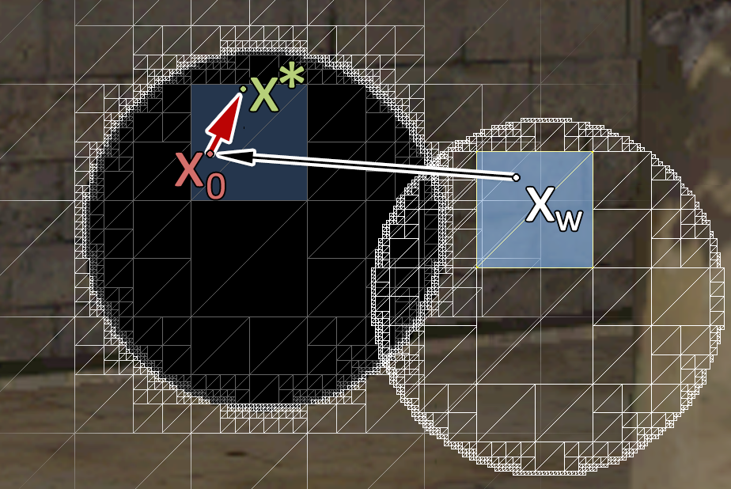
Iteration initialisation
Subdivide into quads and rasterize at warped positions (Bowles2012)
Notes:
We also proposed a robust variant that rasterizes adaptive proxy geometry and ensures all solutions are considered, but we won’t go into detail about that now. Instead we can use heuristics that work in most situations, which Lei will talk more about later.

Slide 19
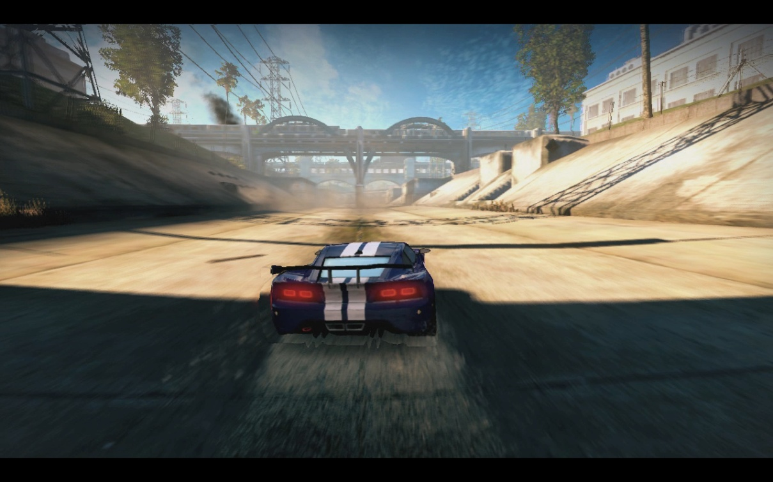
Disocclusions
Notes:
This is a pathological case where there is a large motion discontinuity between the stationary car pixels and the fast moving road pixels, which results in a region behind the car which is disoccluded in the source view.

Slide 20
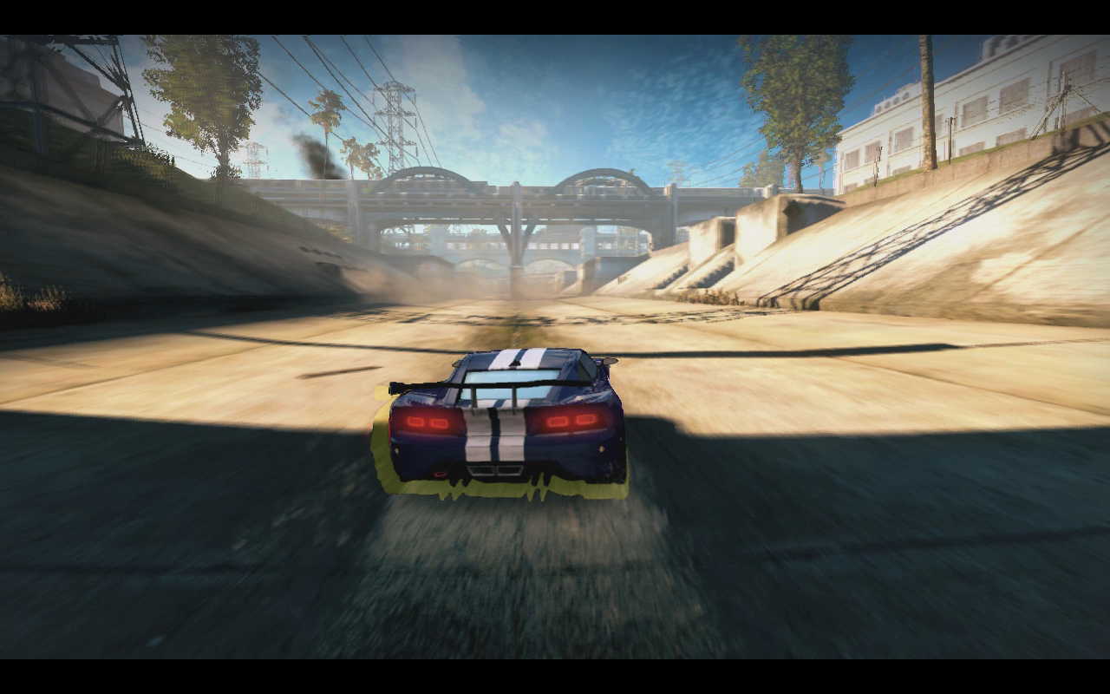
Disocclusions
Notes:
There is a disocclusion behind this car.

Slide 21
Disocclusions
Reshading (Nehab2007)
Requires traversing the scene again
Inpainting (Andreev2010, Bowles2012)
Image-based
Depends on the hole size and visual saliency of the region
Bidirectional reprojection (Yang2011)
Notes:
Perform another render pass to fill in the gaps
It may be possible to use purely image-based inpainting, although these don’t guarantee to produce plausible results.
We can use two source frames provide more coverage, which Lei will talk about now.

Slide 22
Overview
Introduction
Iterative reprojection
Bidirectional reprojection
Algorithm
Practical details
Results
Conclusion
Notes:
Next I’ll introduce bidirectional reprojection which will greatly reduce the chance of disocclusion.
I’ll introduce the whole algorithm pipeline, describe some practical details and then show some results.

Slide 23
Reducing disocclusion
Corresponding surface point in I-frames:
Our solution: reproject from two sources
Visible
Occluded
…
…
Frame t
Frame t +α
Frame t +1
Notes:
Our solution is to reproject from both the previous and the next rendered frames. Let’s look at this simple example.
(HIT) there are two triangles that are translating and rotating separately. After reprojecting to a new frame t+alpha from the previous frame t (HIT), we can see that the green regions are successfully reprojected, and the red regions are missing in the source frame.
(HIT)Similarly we can reproject from frame t+1, in the backward direction, and the visible regions are different.
Not surprisingly, when we combine these two results, (HIT) they complement each other. So the red region is now negligible. This is the major benefit.
((Another benefit is that for regions that are visible in both frame t and t+1, we can interpolate shading between these two and provide a smoother visual appearance for dynamic shading effects.))

Slide 24
Bidirectional reprojection
Scenario: frame interpolation: Render I-frames (Intra-frames, or key-frames), Insert interpolated B-frames (Bidirectionally interpolated-frames)
“Bidirectional Reprojection” (Bireproj)
I-frame t
B-frame t +¼
B-frame t +½
B-frame t +¾
I-frame t +1
Notes:
So when we take both time directions into account, we are effectively performing frame interpolation.
In our work, we follow the terminology in the video compression field. The rendered frames are called intra frames, or I-frames, and the interpolated frames are called B-frames.
In runtime, when both the two source I-frames t and t+1 are rendered, we are ready to generate the interpolated B-frames.
(HIT) And all the B-frame generation is performed on the fly. We call this scheme Bidirectional Reprojection, or Bireproj.

Slide 25
Bidirectional reprojection
Generate motion flow fields for each pair of I-frames
For each pixel in B-frame t +α
Search in forward flow field $V_{t}^{f}$ to reproject to I-frame t
Search in backward flow field $V_{t+1}^{b}$ to reproject to I-frame t +1
Load and blend colors from frame t and t +1
…
…
I-frame t
B-frame t +α
I-frame t +1
(forward flow $V_{t}^{f}$)
(backward flow $V_{t+1}^{b}$)
Notes:
Let’s now look at the key part, which is the B-frame generation algorithm.
For each pair of I-frames, (HIT)we first generate a forward motion flow field VTF and and a backward motion field VT+1B for storing (HIT) the reciprocal correspondence between the two I-frames. Here f and b stand for forward and backward.
Then for each pixel in a target B-frame, (HIT)we search in the forward flow field to reproject to I-frame t, and(HIT) in the backward flow field to reproject to I-frame t+1. (HIT)After that we can load and blend the visible results based on alpha.
You might notice that this is a little bit different from what Huw described just now. In the past we had a motion vector field that links between the source and the target frame.
Here we have two source I-frames, and possibly multiple target B-frames with different alphas. And surely we don’t want to generate a vector field for each combination.
So we instead have only two flow fields mapping between the two I-frames t and t+1.

Slide 26
Iterative reprojection
Motion flow fields map pixels between I-frames t and t +1
Independent of $α$
Assume the motion between t and t +1 is linear: scale the vectors by $α$(or $1−α$)
Use iterative reprojection to solve $p_{t+α}$
Motion flow field
$p_{t}$₊₁
$$p_{t+α}$$
α : 1-α
$$V_{t}^{f}[p_{t}]$$
$$p_{t}$$
Notes:
This makes the vectors independent of alpha. To make use of this, we need to assume linear pixel motion between frame t and t +1.
And under this assumption (HIT) we can scale the motion vectors by alpha in the forward flow field, or by 1-alpha in the backward flow field.
For any target pixel p_{t+alpha} we then simply apply iterative reprojection on this scaled vector field, and will have the correct results.
((Note that under this linear motion assumption, the reprojection will still be precise, but the motion trajectory of any pixel will be linearized. In the case of highly nonlinear motion, like a fast spinning wheel, this assumption will be violated, but it is rare, and it won’t be worse than simply holding and switching the original I-frames.))

Slide 27
Motion vector field generation
Additional position transform in the VS
$V_{}^{b}$ commonly found in the G-buffer (for motion blur)
Missing forward motion field $V_{t}^{f}$?
Negate the field $V_{t}^{b}$
Use iterative reprojection to improve the precision (based on a precise $V_{t+1}^{b}$)
Notes:
The backward motion field is commonly found the in the G-buffer for generating motion blur effects. It is computed with an additional position transform in the vertex shader.
We can do the same thing to generate the forward motion field. But if we cannot afford to do so, we can simply negate the previous backward field V_t^b, and use iterative reprojection to improve the precision of the forward vectors.

Slide 28
Choosing the right pixel
The results from frame t and t +1 may disagree
Reasons:
Occlusion: one source is occluded by the other in t +α
choose the visible one based on the interpolated depth
…
…
I-frame t
B-frame t +α
I-frame t +1
Notes:
After we obtain the results from both frame t and t+1, we need to properly combine these two results, because in many cases they may disagree.
The most common reason for this is occlusion changes. Basically two different objects can move to the same point at time t+alpha, (HIT)and each one is found in one of the I-frames.
In that case we need to compare the reprojected depth of the two candidates, and do manual depth culling.

Slide 29
Choosing the right pixel
The results from frame t and t +1 may disagree
Reasons:
Incorrect reprojection: iterative reprojection failed
Sign: reprojection error -- residual between $pt+v$ and $p_{t+α}$
mutual correction between $pt {\& p}_{t+1}$with correspondence
$$p_{t+α}$$
Reprojection error
$$v$$
X
p_{t}
t
t +α
t +1
Notes:
The second possible reason is incorrect reprojection. The sign to look for this type of error is the residual during iterative reprojection.
(HIT) This residual measures the target reprojection error. We always check if the error is within a certain tolerance. And if not, we can correct it using the result from the more precise side.
(HIT) For example if reprojection to frame t+1 is more precise, we can use the correspondence between frame t an t+1 to improve the result in frame t.

Slide 30
Choosing the right pixel
The results from frame t and t +1 may disagree
Reasons:
Shading changed: lighting, shadows, dynamic texture…
interpolate the results based on α
…
…
I-frame t
B-frame t +α
I-frame t +1
Notes:
The third possible reason is shading change. This could happen with dynamic lighting, shadows and textures.
We always interpolate the result based on alpha. This is not always correct, but it is always less objectionable than simply showing the original frames.

Slide 31
Additional search initialization
Problems when using the target pixel as iteration starting point
Imprecise initial vector across object boundaries
Search steps can fall off the object
For a) :
Additional 4 candidates within a small neighborhood
Initialize using the result from a closer B-frame
fast
●● ●●
slow
I-frame t
B-frame t +α
I-frame t +1
Notes:
In our current implementation of Bireproj, we pick the motion flow vector at the target pixel as the iteration starting point.
So there are two problems related to this simple heuristic.
First, (HIT) the initial vector V can be totally wrong across object boundaries, and Second, (HIT) the search steps can fall off the object and fail to converge.
So we perform additional search initialization to overcome these problems.
For the first one, (HIT)we try 4 more candidates around the current pixel position, and (HIT) we also attempt to initialize using the result from a closer B-frame generated earlier.

Slide 32
Additional search initialization
The motion field is often only piecewise smooth
Imprecise initial vector across object boundaries
Search steps can fall off the object
For b):
Initialize using the vector from the opposite I-frame
fast
slow
I-frame t
B-frame t +α
I-frame t +1
Notes:
For the second problem, (HIT) we attempt to initialize using the vector from the opposite I-frame, to avoid overly large steps.

Slide 33
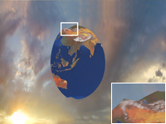
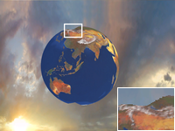
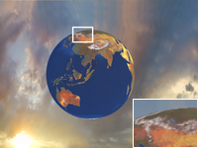
Additional search initialization
I-frame t
B-frame t +½
I-frame t +1
…
…
Image-based (No additional init.)
Image-based (with “b”)
Image-based (with “a+b”)
Notes:
And here are the results comparing these initialization approaches.
(HIT)With no additional initialization, only SOME regions are properly initialized.
(HIT) With initialization from the opposite I-frame, we see a more complete globe;
And, (HIT) by adding proper initialization across object boundaries, all the regions are correctly reprojected.

Slide 34
Partitioned rendering
I-frame shading parallel to B-frame generation
Partition the I-frame rendering tasks evenly
Straightforward for games that has hundreds or more draw calls per frame
Runtime: interleave B-frame generation (green) with I-frame rendering (red)
Possible: no need to partition with (future) GPU multitasking
Animation input for I_{t}
display
I_{t} computation & display
use
B computation & display
t-2
t-1
t
Notes:
With frame interpolation, the refresh cycle is shortened, an I-frame shading pass may span a few cycles. And we need to do this in parallel with B-frame generation and display.
So we partition the rendering tasks evenly and fit them into each individual B-frame time slot (HIT), as shown in the red boxes in this timeline graph.
Most modern games issue a large number of draw calls per frame, so an even partition is often possible.
At run time, the B-frame generation shown as the green boxes are interleaved with the red boxes.
Notice that this partitioning will not be needed if GPU multitasking is an option in the future.

Slide 35
Lag
I-frame “t ” must start rendering at $t−1−\frac{n−1}{n}$ (n=4 here)
Introduces a potential lag to the pipeline – I-frame delayed by $\frac{n−1}{n}$
However: the motion of frame t is already seen at B-frame $t−\frac{n−1}{n}$
Response delay
motion delay
Animation input for I_{t}
display
I_{t} computation & display
use
B computation & display
t-2
t-1
t
Notes:
Let’s look at a simple timing analysis here.
Note that the content of I-frame at time t (HIT) is needed at the first solid green box. So it should start rendering nearly two timesteps before it’s displayed. (HIT) This introduces an additional lag to the rendering pipeline.
According to this graph, the display of the I-frame is delayed by (n-1)/n, where n is the number of frames per each I-frame cycle.
But if we look at this closely, the motion of I-frame t is already reflected in the first B-frame of that cycle(HIT). So although the motion is delayed, the response time is not.

Slide 36
Lag
Lag with standard double buffering:
Original: 1 time step (ts)
Bireproj: position:$1+\frac{n−1}{n}$ ts, response:$1$ ts
Lag with 1-frame render ahead queue:
Original: 2 ts
Bireproj: 2 ts (position)
Theoretical / empirical analysis (Yang2011)
Notes:
So here we put down the analysis results under two common scenarios.
The graph we shown just now is standard double buffering. Assume the lag of standard rendering is one time step.
With Bireproj, although the position update takes a little bit less than 2 time steps to complete, the response is already shown in the first B-frame, which takes exactly 1 timestep to show. So there’s no response lag in that sense.
If we use a one frame render ahead queue, which is commonly implemented in game engines and drivers, both the original and Bireproj rendering take 2 time steps to see an input. Please see our paper for the detailed derivation and analysis.

Slide 37
Bireproj results
Example: three B-frames per I-frame time step
2-3ms for a B-frame (1280x720)
Suitable scenarios:
Vertex-bound scenes
Fill-bound scenes
Multi-pass / deferred rendering
Notes:
Here I show some results generated using our method.
For all the results we generate three intermediate frames per I-frame time step.
Each B-frame requires around 3 milliseconds to generate for 720p resolution on a NVIDIA 8800 board, which is several generations behind.
I will first show some laboratory scenarios demonstrating different types of scenes.

Slide 38
Bireproj results – the walking scene
Fill-bound scene with an expensive pixel shader (2.6x speed-up)
Notes:
Here’s a fill bound scene with an expensive pixel shader applied on a crowd of walking characters.
(HIT)I am now showing the original scene running at a low framerate, and with our bireproj you can see the result closely matches the ground-truth reference. The seam in the middle is not noticeable.

Slide 39
Bireproj results – the terrain scene
Geometry bound scene (1M triangles) (2.8x speed-up)
Notes:
Here’s a vertex-bound terrain scene with 1 million triangles. With Bireproj, the framerate is boosted by nearly 3 times.

Slide 40
Bireproj results – the head scene
Multi-pass skin rendering ^{[d’Eon and Luebke 2007]} (2.6x speed-up)
Notes:
Here’s an example of multi-pass rendering effects, kind of in a deferred shading style. Again the speed-up factor is close to 3X.

Slide 41
Bireproj results – shading interpolation
Reduce popping artifacts with dynamic lighting and shadows
Notes:
let’s take look at how bireproj improves the smoothness of dynamic lighting and shadows.
We compare single-directional reprojection on the left with bireproj on the right.
(HIT)The popping artifacts of the moving shadow and specular highlights is significantly reduced using bireproj.
We then compare bireproj with groundtruth. You can see they are quite similar.

Slide 42
Bireproj results – Split/Second
Results from Split/Second by Black Rock Studio
Input: an image set with corresponding depth and backward motion vector fields
Some of the edge artifacts are caused by imprecise depth
A stress test for Bireproj
Notes:
Next I’ll show Bireproj applied to the split/second game.
Due to some constraints, we are only able to work on an image set captured from the game, together with depth buffers and backward motion vector fields. The forward motion fields were generated using iterative reprojection, btw.
And due to data precision issue we couldn’t eliminate some of the artifacts.
So it’s kind of a stress test for Bireproj. It’s definitely not our best results, but it’s good to see both the benefits and the limitations in a game.

Slide 43
Bireproj results – Split/Second
Notes:
The frames are upsampled from 30 herz to 120 herz, and I’m playing it in 4 times slow motion.
The first artifact to notice is the flickering shadow under the car. This particular region cannot be interpolated because it is occluded by the car in the previous I-frame. So that region only gets the result from the next I-frame.
The best strategy is to separate this image-space shadow component layer and add it after frame interpolation, but we didn’t have access to this layer.
And there are some visibility error around thin object boundaries. Some of them were caused by the fact that we had an imprecise depth buffer, so depth comparison was not always reliable.

Slide 44
Notes:
Here we are showing one of the clear advantages. The pattern on the ground suffers from temporal aliasing in the original one, and it’s removed in our result.
If this is updated at 120Hz or even higher, the eye could better track these patterns and it will look more realistic.

Slide 45
Limitations
Dynamic shading interpolation
Does not work when visible in only one source
Separate and render the problematic components per B-frame
Fast moving thin object visibility
Reprojection may be improperly initialized
Use robust initialization (with DX 10+ level hardware)
Bireproj introduces a small lag
Less than one (I-frame) timestep of positional delay
Response delay is minimum (≈0)
Notes:
After looking at it in the game, let me summarize the limitations of our approach.
The first one is that dynamic shading interpolation does not work when the pixel is visible in only one of the I-frames. As I sad, the solution is to separate the layer and render it after frame interpolation.
Another one is that fast moving thin geometry may miss proper initialization. The good thing is that we can apply the robust initialization technique described in Huw’s paper so that every pixel is guaranteed to be properly initialized.
Finally, Bireproj introduce a positional lag for less than 1 timestep. This might be critical to some games, but the good thing is that the response delay is almost zero, which means any motion input will be seen in the intermediated frames almost without additional lag.

Slide 46
Summary
Reuse shading results to reduce redundant computation
Image-based iterative reprojection
Purely image-based (no need to traverse the scene)
Fast – 0.85 ms on PS3 (1280x720)
Very accurate reprojection when given proper initialization
Bidirectional reprojection
Almost eliminates disocclusion artifacts
Boosts framerate by almost n (# of interpolated frames) times
Interpolates dynamic shading changes
Notes:
To summarize the talk, we have introduced some tools to improve the performance of rendering pipelines using pixel reprojection.
The iterative reprojection technique is purely image-based and the performance independent of scene complexity. The basic algorithm reprojects a whole 720p screen in less than 1 millisecond on PS3. And the result is precise when proper initialization is given.
Then with the help of bidirectional reprojection, disocclusion can be eliminated in most cases, and we can generate multiple intermediate frames almost for free.
In the intermediate frames, dynamic shading are also interpolated to provide a smooth visual appearance.

Slide 47
Further details
Refer to [Bowles et al 2012] for:
Application to general image warps, inc. spatial rerpojections and non-linear temporal reprojection
Analysis of convergence properties of FPI
Robust initialization algorithm
Refer to [Yang et al 2011] for:
Bireproj using traditional reverse reprojection
Hybrid geometry/image-based reprojection
Theoretical & empirical lag analysis
Notes:
There are a lot of details that we omitted in this talk due to time constraints.
The EG 2012 paper contains details such as …
the SIGGRPAPH Asia 2011 paper contains some details about Bireproj, such as a variant using traditional geometry-based reprojection, the interoperability between the two approaches, and a thorough lag analysis.

Slide 48
Thank you!
Acknowledgements
Paper authors group 1 (IIW): K. Mitchell, B. Sumner, J. Moore, M. Gross
Paper authors group 2 (Bireproj):Y.-C. Tse, P. Sander, J. Lawrence, D. Nehab, H. Hoppe, C. Wilkins.
Disney Interactive Studios (for the Split/Second assets)
NVIDIA and XYZRGB (for the human head assets)
Notes:
That’s the end of our talk, and we are happy to take any questions.

Slide 49
References
Mark W. R., McMillan L., Bishop G. “Post-rendering 3D Warping”, I3D 1997
Nehab D., Sander P., Lawrence J., Tatarchuk N., Isidoro J. “Accelerating real-time shading with reverse reprojection caching”, Graphics Hardware 2007
Andreev D., “Real-time frame rate up-conversion for video games”, SIGGRAPH Talk 2010
Bowles H., Mitchell K., Sumner R. W., Moore J., Gross M., “Iterative Image Warping”, Eurographics 2012
Yang L., Tse Y.-C., Sander P. V., Lawrence J., Nehab D., Hoppe H., Wilkins C. L. “Image-based bidirectional scene reprojection”, SIGGRAPH Asia 2011
Didyk P., Eisemann E., Ritschel T., Myszkowski K., Seidel H.-P., “Perceptually-motivated Real-time Temporal Upsampling of 3D Content for High-refresh-rate Displays”, Eurographics 2011

